Slide 1
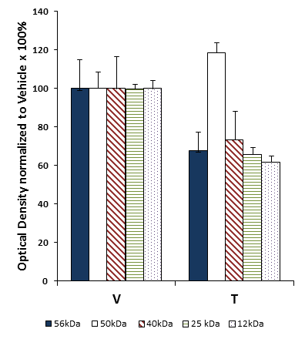
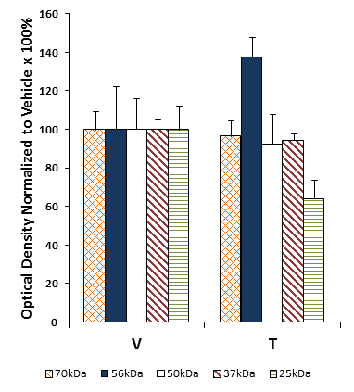
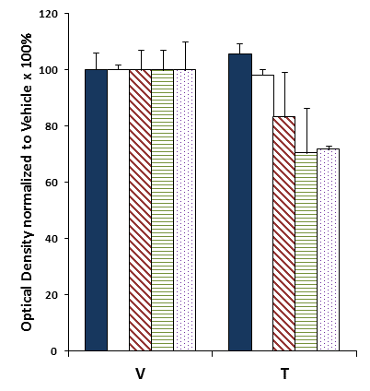
A
B
Aβ₁₋₄₂ Oligomers
MW
75-
50-
dodecamer
*
37-
nonamer
25-
hexamer
20-
Vehicle
NNC 26-9100
15-
trimer
C
Extracellular
D
Membrane
E
Intracellular
*
*
¥
***
**
***
*
Vehicle
NNC 26-9100
Vehicle
NNC 26-9100
Vehicle
NNC 26-9100
Figure. (A) Acquisition learning of APPswe Tg2576 mice was evaluated using the T-maze task following i.c.v. injection of 0.2 µg NNC 26-9100 (T) or vehicle (V) (n = 3-4/group). (B) Representative Western blot of soluble oligomeric Aβ₄₂ forms extracted from extracellular (Extra), membrane (Mem), and intracellular (Intra) fractions (cortical tissue). Bar graphs of Aβ₄₂ forms identified within (C) extracellular, (D) membrane, and (E) intracellular fractions. Optical densities normalized to respective vehicles. *p < 0.05; ** p < 0.01; *** p < 0.001 (Student’s T-test), values are mean ± S.E.M. ¥ indicates delineated split of the 25 kDa band with NNC 26-9100 treatment. (Millipore antibody: AB5078P). (Sandoval et al., 2013)

