Slide 1
5 Strategies for Moving a Course Online
Jennifer Albat – Instructional Designer
Notes:
Type in chat that everyone is automatically muted upon entry.
Welcome everyone, thank you for joining us. I’m Jennifer Albat with the ITS Instructional Design & Learning Technologies group. Today we’ll be presenting 5 strategies for moving a course online.

Slide 2
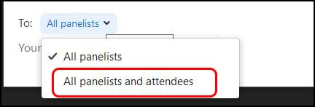
Webinar Features
Notes:
To get started, let’s go over the features of the webinar. First, there’s the chat. When using the chat, be sure your messages are going to the intended recipients. The default is to all panelists. Change the drop-down so that it goes to all panelists and attendees if you want everyone to see it. Let’s practice that now. Say hello to everyone. Remember to say it to all panelists and attendees.
Pause Okay, thanks for practicing that. Jonathan will be helping us out today and monitoring the chat.
The next feature is the Q&A. Please use this feature to ask questions. This can be answered more formally anytime throughout the presentation as questions can really get lost in the chat. We have Matt helping out with the Q&A today. We’ll also be using this feature at a couple stops in the presentation to see if there’s anything that can be answered live.
The final feature is the raise hand feature. At couple of stops in the webinar, I’ll take questions from the audience. Use the raise hand feature so we can turn on your audio to ask the question live.
Okay let’s get started.

Slide 3

Notes:
With a disclaimer. I have to say it, but unfortunately if you came to learn everything there is to know about teaching online, we just can’t fit that into an hour. Each one of these topics could be its own hour or longer workshop.
Just like teaching in the classroom, you all have different styles and management techniques. So trying to tell you exactly how to design your online course just doesn’t work. There are of course some guidelines and quality standards that we can recommend for all to use.
You may actually leave here with more questions than answers. And luckily, there’s a solution for that.
Image: http://snowreport.co.za/disclaimer/

Slide 4
Use Your Resources
Notes:
Resources. The first strategy for moving online is to use your resources. We have some excellent ones to assist you with building online courses.

Slide 5
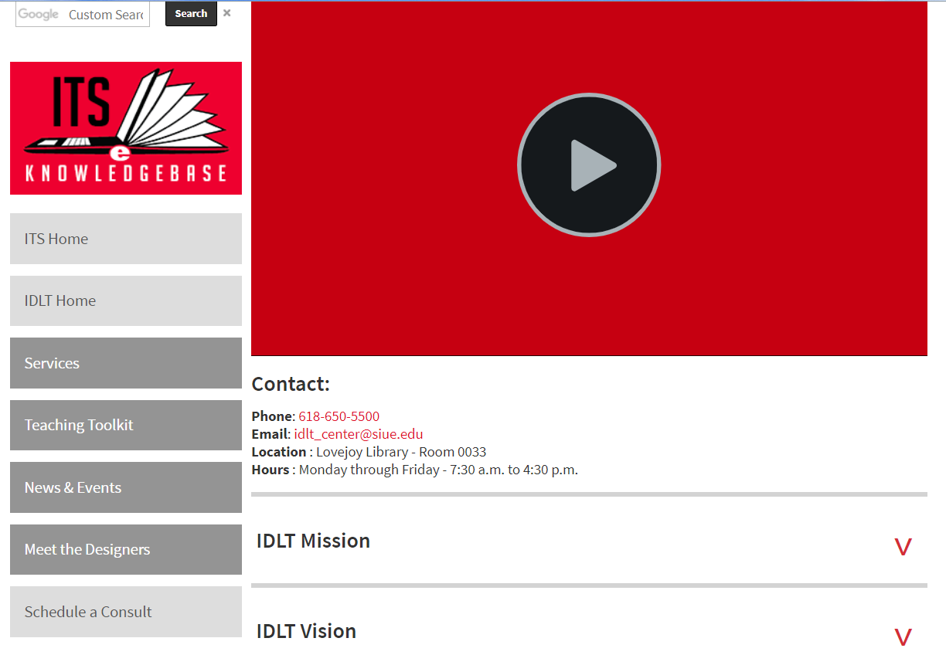
Insructional Design & Learning Technologies
http://www.siue.edu/its/idlt/
Consultation
Request
Notes:
First, is our Instructional Design and Learning Technologies team. We can help you plan and build your courses, design activities, or implement a new technology. To get in contact with us, you can go to our page here, or search the SIUE site for IDLT and our consultation request form is in the lower left-hand corner.

Slide 6
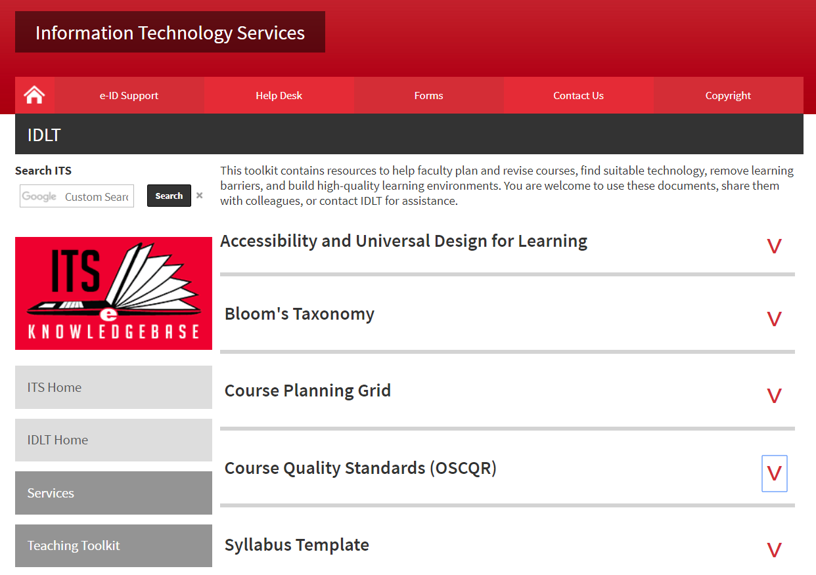
IDLT – Teaching Toolkit
http://www.siue.edu/its/idlt/toolkit.shtml
Notes:
Also on the IDLT site is the teaching toolkit. There are many resources here for planning and implementing your course. We are adding to this all the time, so please check back often.

Slide 7
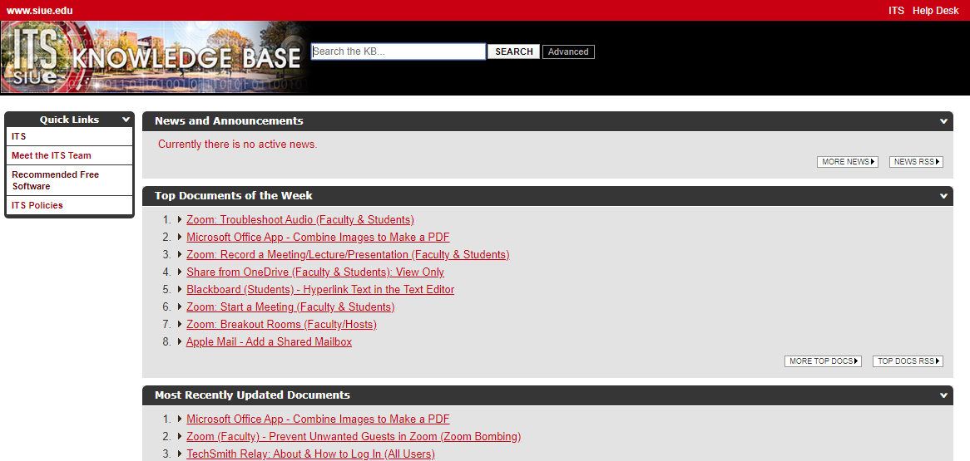
Its Knowledge Base
https://kb.siue.edu/
Type Keyword Here
Notes:
Also, if you’re a do-it-yourselfer, the ITS Knowledge Base is an excellent resource for all things technology at SIUE. Blackboard, TechSmith Relay, Zoom, even Office 365 how-tos can be found here.

Slide 8
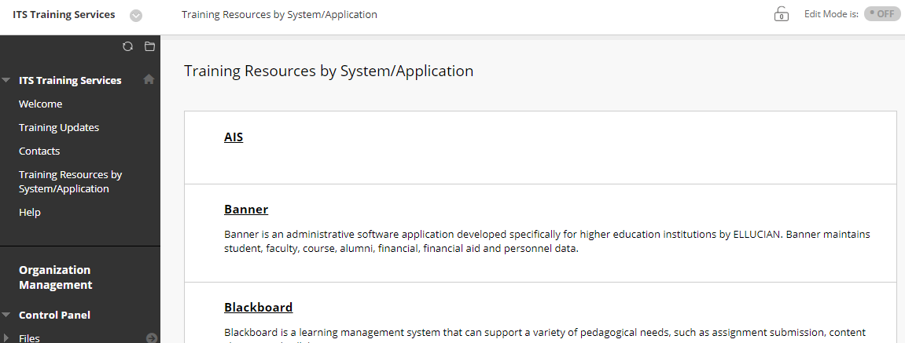
Virtual Training
https://bb.siue.edu/
Organizations>ITS Training Services
Notes:
Another great resource is our virtual training available through Blackboard. Look under Organizations and then ITS Training Services.
Remember, if you’re teaching online and lack the technology skills, your students will know. And I have to say it, but if you’re in a pinch and don’t know something, please refrain from blaming the products we use. When you throw Blackboard or ITS under the bus to make yourself look better, nobody wins. We’ve seen it happen too many times, unfortunately.
Okay, so those are some great resources to start with. Let’s move on to the next strategy for teaching online.

Slide 9
Make a Plan
Notes:
Make a plan. Okay, let’s take a quick poll in the chat. When you start developing a new course, where do you generally start? Textbook? Syllabus? Type in the chat. Be sure it’s to all panelists and attendees.
As you said in the chat, most of you start with the [syllabus] when you begin developing a course. There are actually some other considerations well before starting with the syllabus.

Slide 10
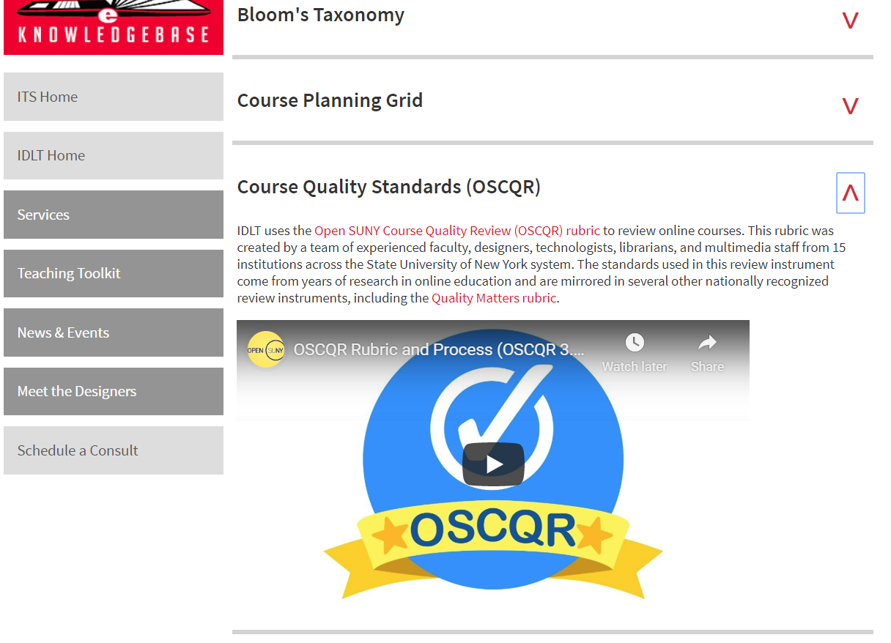
IDLT – Teaching Toolkit > OSCQR
http://www.siue.edu/its/idlt/toolkit.shtml
Notes:
The first thing you should think about when moving online are some standards or guidelines. What makes a quality online course? There’s a rubric for that! It’s called the Open SUNY Course Quality Review or better known as OSCQR.

Slide 11
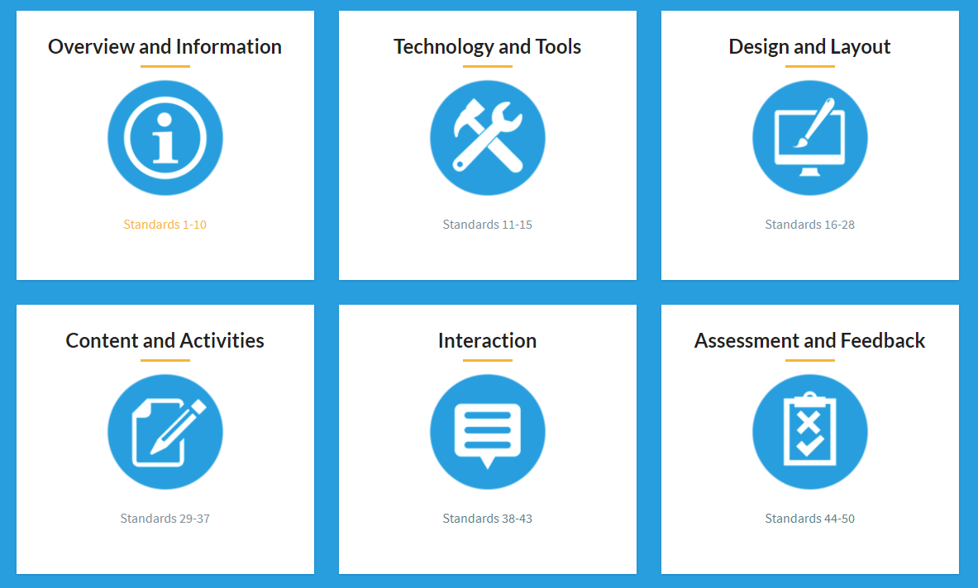
Notes:
The OSCQR rubric breaks up the 50 standards for a quality course into 6 categories. If you visit the website, you can click a category and view a detailed explanation of each standard.

Slide 12
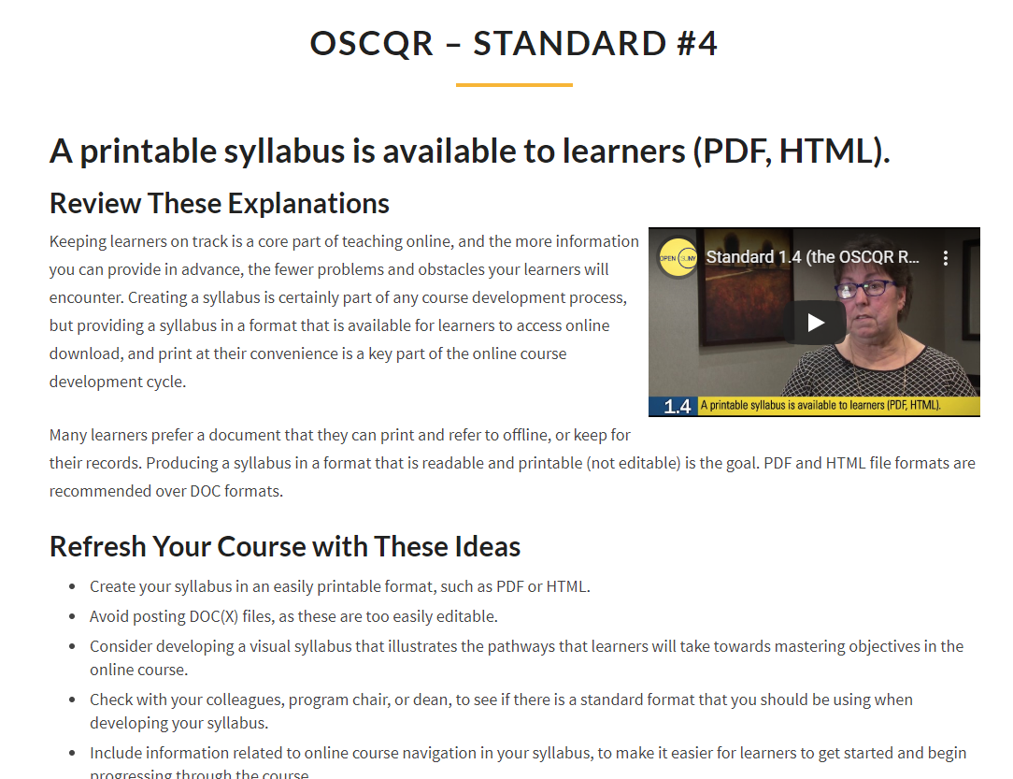
Notes:
There’s even a nice video that goes with each one. Toward the bottom of the page is the research behind why that standard is included in the rubric. It’s a great resource.

Slide 13
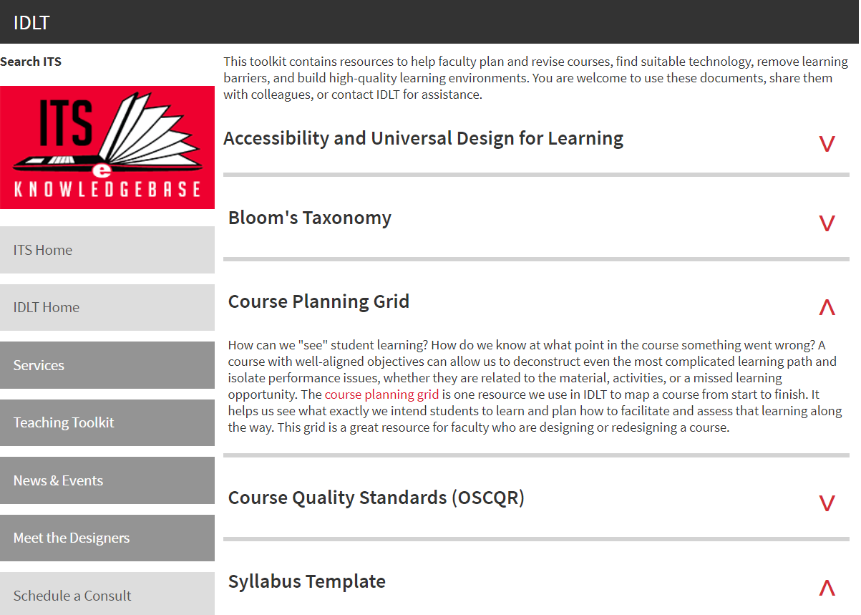
IDLT – Teaching Toolkit > Course Planning Grid
http://www.siue.edu/its/idlt/toolkit.shtml
Notes:
So now that you know what the standards are, you can start planning the activities and assessments and how they align to the course objectives. We have a document called a Course Planning Grid which is available for download on our teaching toolkit page. This will help you bring to light what you intend for students to learn and how you intend for them to learn it.

Slide 14
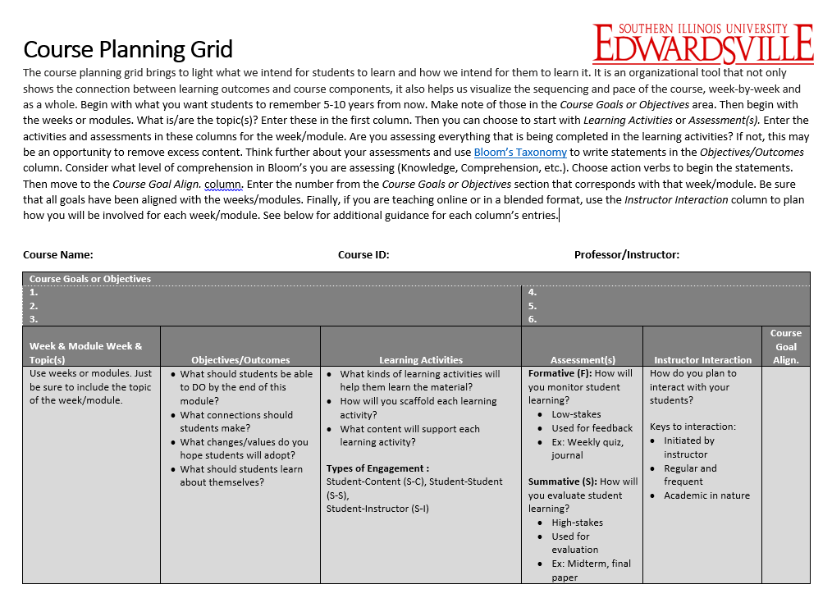
Notes:
The document can look overwhelming at first, but if you read the directions at the top, there is no right or wrong way to complete this document. Asking an instructional designer for help is also a really great idea. Writing those weekly objectives can be tricky if you’re not used to working with Bloom’s Taxonomy. Which is another resource in the toolkit that can be used in conjunction with the course planning grid.
The planning grid is an organizational tool that not only shows the connection between learning outcomes and course components, it also helps us visualize the sequencing and pace of the course, week-by-week and as a whole.
It may seem like a waste of time to some, but all of these components wind up in the course or on the syllabus, so it’s best to put the plan to paper.

Slide 15
Other Recommendations for Planning
Think about your students
  Grad/undergrad; degree completion
  Ask them
    Discussion board
    Survey or poll
    Video bio
Assess differently
  Authentic assessment
  Personal, Meaningful, Relevant
  Formative vs. Summative
Notes:
There are some additional considerations we’d like you to think about when in the planning phase. (Click) The first is to think about your students. Are you designing the course for graduates or undergraduates? (Click) If this is for online degree completion, these are students that will be juggling a lot besides your course. Also, when you begin the course, find out more about your students. (Click) Discussion boards are commonly used for “Getting to Know You” ice breakers, create a survey or poll, or have the students create short video bios. These can then be used to tailor your course to make it more student-centered.
The other consideration is thinking about assessments differently. (Click) First, they should be authentic which means students should demonstrate their learning other than through multiple choice tests. (Click) These can be reflections of how this applies to a current or future, job, or even to everyday life. Activities and assessments should be Personal, Meaningful, and Relevant to keep students interested and engaged with the content. (Click) For example, in a history class, have the students look up key dates in their lives, starting with their birthday and see what the headlines of that day were. In an Econ class, give the students a “salary” and have them budget for expenses based on their lifestyle. In a Nursing class, have students analyze a case study based on real patients cases. Also, remember to use formative assessment instead of summative. (Click) If you have a cumulative project, have pieces due throughout the semester so that feedback can be given at each phase.

Slide 16
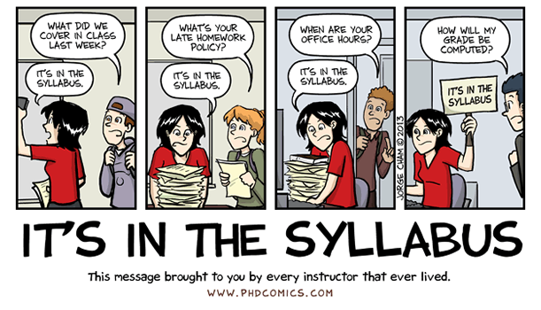
the Syllabus
Notes:
Once you have the course planning grid completed, you can begin work on the syllabus. I’ll pause a minute to let you read this. Pause to let them read comic. I’m sure we’ve all heard something like that a time or two. The syllabus becomes even more critical in an online course because sometimes that is the only line of communication from us that the student may refer to. Probably because they’ve heard “it’s in the syllabus” too many times. How do you think the syllabus changes from a face-to-face course? (Next slide quick)

Slide 17
How does the syllabus change for online courses?
Type in chat.
Notes:
What do you think additionally needs to go in an online syllabus vs. a face-to-face course? Type in the chat what you think. Remember to use chat at not the Q&A and send to all panelists and attendees so everyone can see your responses. Read some of the responses.
Expected responses:
attendance policy
technical support
log in information
assignments – more details
communication methods
skills needed to take course
Okay, thank you for your responses.

Slide 18
Additions/Changes
Welcome message
Assignments
Detailed calendar
Communication methods
Class norms
Technical requirements
Skills needed to take the course
Technical support
https://www.facultyfocus.com/articles/online-education/practical-advice-for-going-from-face-to-face-to-online-teaching/
Notes:
A lot of what you said is correct, here are a few more of the things we need to think about when developing an online course syllabus. I enlisted some help from a faculty focus article when compiling this list.
A welcome message. (Click) You won’t be in front of the students to introduce yourself and the layout of the course, unless you do an introductory video. Even if you decide against the video, be sure to duplicate the welcome message from the syllabus inside the online course also.
Assignments. (Click) Some students actually like to print the syllabus and follow it throughout the course. Crazy. I know. Picture yourself in the middle of nowhere with a slow internet connection. You need to know the next assignment but the description is only online. It’s good to have in the syllabus too.
Likewise, the detailed calendar of assignments and things to do should be on the syllabus. (Click) If you’re a checklist person like me and you get incredible satisfaction of crossing something off, students have that quality sometimes too. And then it’s also nice if the corresponding folders containing each week’s information matches with the layout on the syllabus. And please, make sure you name items the same online as you do on the syllabus. Don’t call it Assignment 1 on the syllabus and discussion 1 online. Consistency with assignment names is important online. That will only lead to several emails questioning what to do.
Which leads to the communication method. (Click) How do you want questions? Email? Phone call? When can students expect to hear back from you via email? 24 hours, maybe 48 if it’s a weekend? Also set up an open forum on the discussion board for questions. Students can sometimes help you out and answer those questions. This is also great because you can reach multiple students with the same question.
Okay, and then here’s some other things that should be considered on the syllabus. (Click) Remember that the syllabus is everyone’s roadmap to the course – even yours. If you have trouble building courses in Blackboard, you should attempt to finalize the syllabus and then everything else will fall into place.
Also, if you’re worried about having to write this extra language, we have a template.

Slide 19
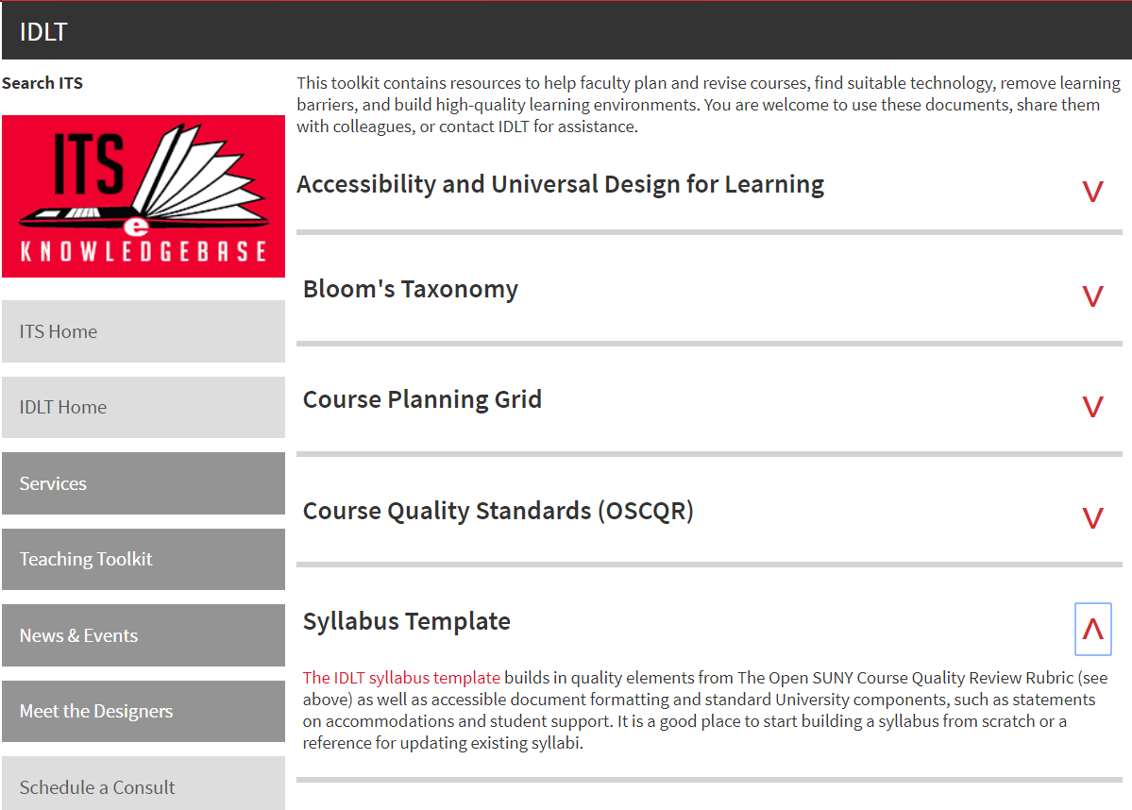
IDLT – Teaching Toolkit > Syllabus Template
http://www.siue.edu/its/idlt/toolkit.shtml
Notes:
It is once again in our Teaching Toolkit. It has all of the necessary sections for online courses, and it has already been formatted in an accessible format. We’ll get to accessibility here in a bit.

Slide 20
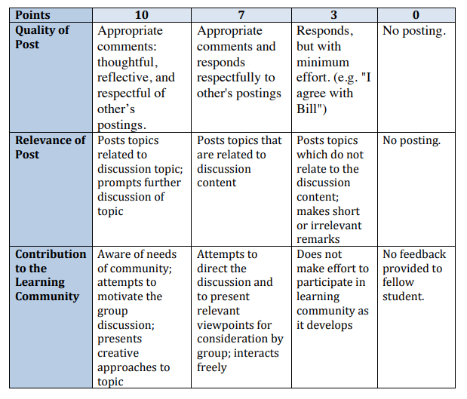
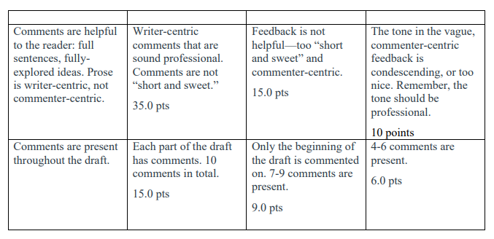
Rubrics
Discussion Board
Peer Review
Notes:
One last item to think about when planning are rubrics. Students should have very clear written expectations on all assignments. This will help avoid a multitude of questions on how to complete it. Anything from discussion boards, written assignments, and especially peer reviews should have a rubric provided. There are tons of examples online. A good old Google search is a good way to find the ones that are right for your course.

Slide 21
Q & A
Resources & Planning
Notes:
Okay, so let’s pause a moment and see if we have any questions on resources and planning that need to be answered live. If you would like to come on live and ask a question, please use the raise hand button. Remember we have more to come, so please keep the questions focused on resources and planning.
Okay the next strategy for moving online is organizing your course.

Slide 22
Organize Your Course
Notes:
Having a course that is easy to navigate is one of the most important things for an online student.

Slide 23
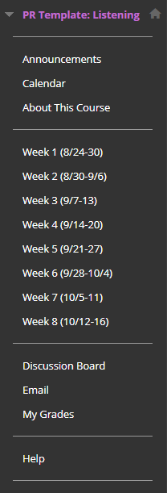
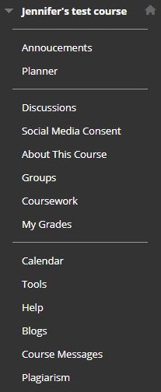
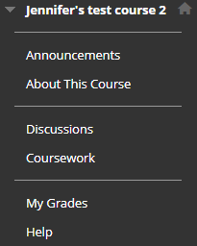
Course Menu
Notes:
Here is an example of 2 left side navigations. (Click) Just looking at the menu on the left makes my heart beat faster. Overwhelming right? Get rid of unnecessary tools and don't make the students search for the content. They should know exactly how to navigate the course. The biggest one is the Tools link. (Click) This links to every tool possible inside of Blackboard. It is very confusing to students if you're not using any of them. If you're using tools such as blogs, wikis, or journals, link to them within the weekly folders. The Email tool is always a good one to add to the left navigation for easy access.
Here’s another example of a menu I recently did for a course. (Click) If the course is 3, 5, 8, or 10 weeks, just take the coursework link out and move the weeks or modules to the left side. This will reduce the number of clicks for students. The rule of thumb is you never want more than 3 clicks in to get to something.

Slide 24
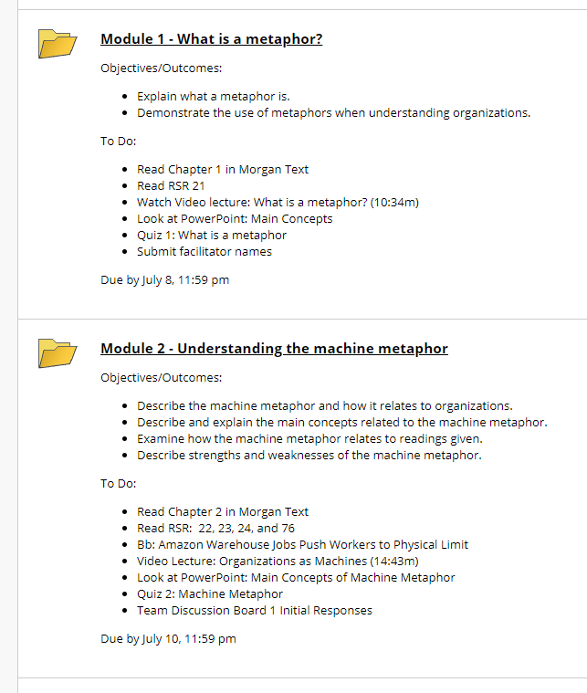
Weekly/Module Folders
Notes:
So how should those weekly or module folders look? Clean, organized, and consistent. The folder level should let the students know what the topic is for that week or module, the objectives or outcomes, and then what to do. Notice the times of the videos. This is so helpful to students. They can tell in one look at this folder what the expectations are for the week and what kind of time commitment it will be.
Also, I always tell faculty – to make life easier on yourself, only type dates on the syllabus and the folders in Blackboard. This will make using your course shell from term to term so much easier. For the actual dates on the items, you can always use the Date Management tool for that.

Slide 25
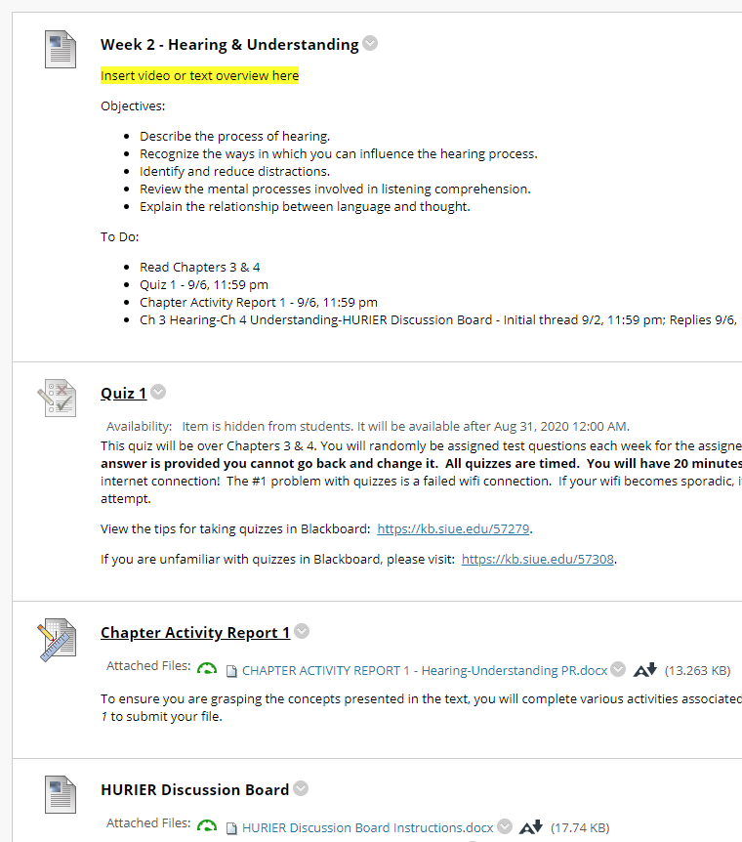
Weekly/Module Folders
Notes:
If you’re using the format with the weeks or modules in the left navigation, place an item at the top with these same items. Another thing to remember is to be explicit on each item about what students are to do with it and what they should get out of it. For example, here, there are directions on the quiz and why they are taking it, as well as the chapter activity report.

Slide 26
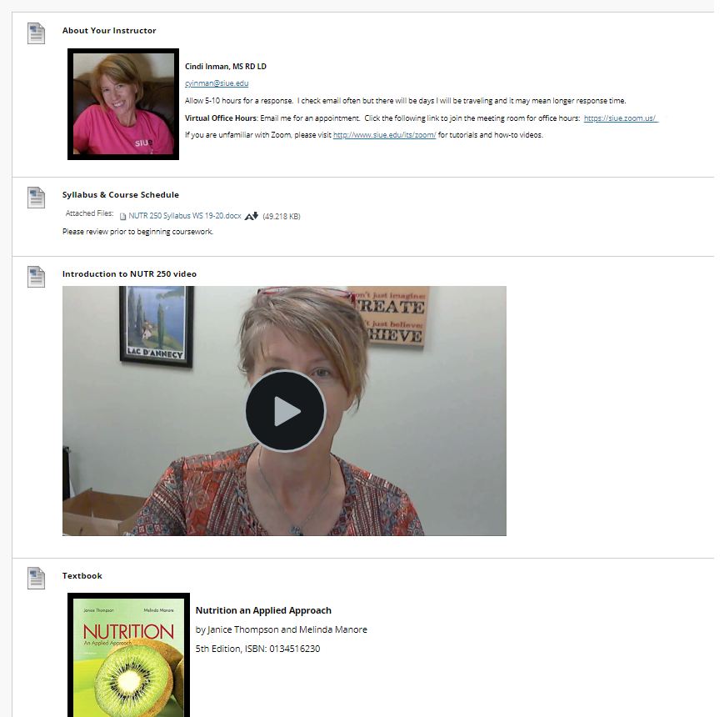
About This Course
Notes:
In the standard Blackboard template, there’s an About This Course link. So what should you put there? It’s always a good idea to repeat the “About Your Instructor” section from the syllabus. This includes contact information with a preferred method of contact, office hours, etc. You can put the syllabus here, introduction video, and textbook information. When I design a course, I will usually put course links back to the syllabus and welcome videos in the week 1 folder just in case the students did not find them here.

Slide 27
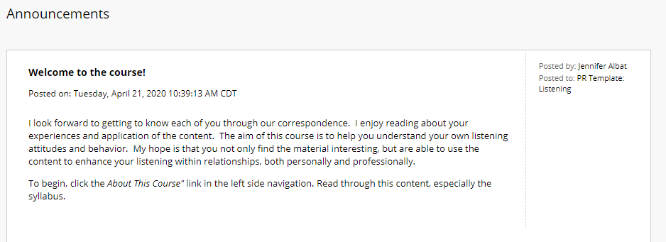
Where to Get Started
Notes:
One final thing about course organization and building is that you MUST tell students where to get started in the course. This can easily be done in a welcome announcement. There should be a welcome in your syllabus. Copy this message about what students can expect from the course and what you hope they learn and then tack on a message about what link to explore first, what to watch and what to read.

Slide 28
Build An Online Community
Notes:
The fourth strategy for moving online is to build an online community. Building a community in your course is crucial for so many reasons. It helps students feel welcome, like they’re part of something. It also helps with retention and keeping students engaged.

Slide 29
Welcome video/Course Tour
Notes:
We just took a look at the About This Course section of the course. In that introduction video or welcome video, be sure to include some personal information, such as hobbies, pets, or other things you’re comfortable sharing. This can really help the students see you as a person and not just a robot behind the screen. Also, feel free to also make the video the tour of the course. Let students know how to navigate for each week, how to find readings and assignments. This can also be a really great platform for letting students know the course expectations and what you hope they take away from the course.

Slide 30
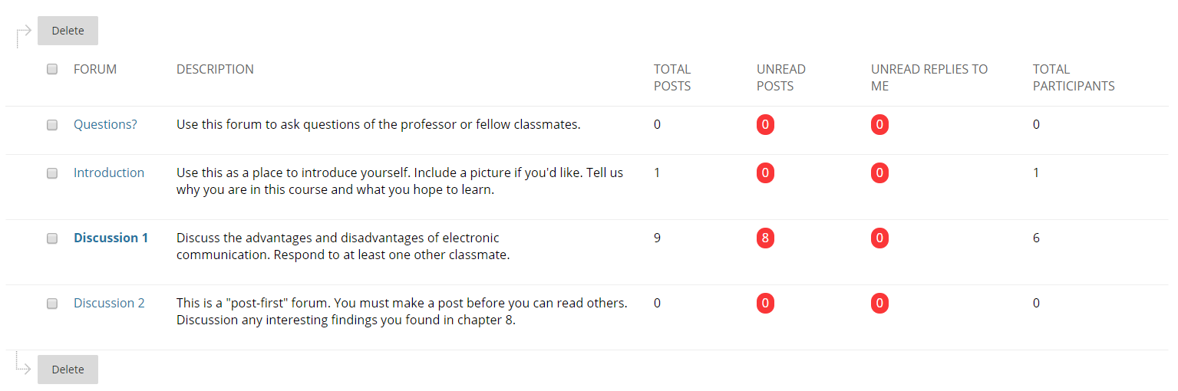
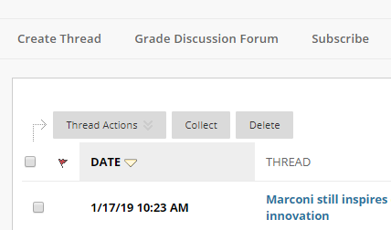
Discussion Board
Notes:
Another best practice to employ in your course to build community is to have an open questions forum on the discussion board. This allows students to answer each other's questions about course materials. A quick tip for this is to go into that forum and click the subscribe button. (Click) This will alert you via email when a question is posted here. Make sure to specify in the directions not to post grade questions to this forum and to email those to you separately.
In the first week, have the students introduce themselves. Allow them to choose the medium in which they complete the post. It can be text, audio, video, or a PowerPoint. If you are having them make videos as part of the class, or using another technology, this is a great time to get them introduced to that technology. Ask them to include interests and career goals. Take notes from these introductions as they can be things to bring back in when giving personalized feedback.
Another good way to build community is to design discussion board questions that are debatable. Write questions so students are forced to not just say "I agree". Make it something they can relate to their own life or something where they would have an opinion.

Slide 31
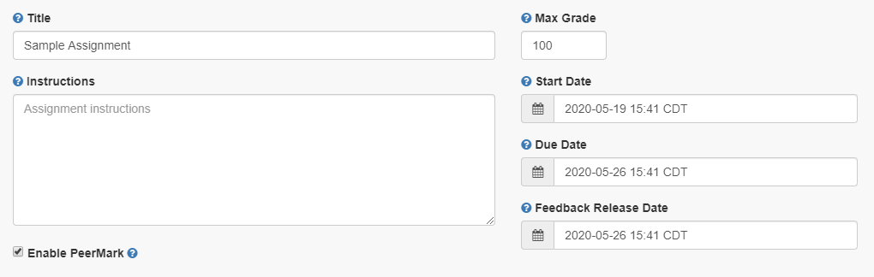
Peer Reviews
Notes:
Another strategy to help students not feel isolated is peer reviews. This gives students the opportunity to hear other opinions, but this can also be a lifesaver for your workload. You can do this via Blackboard Groups, or Turnitin even has this feature built into it. Remember that the grading will need to be very structured, and providing a rubric will be critical.

Slide 32
Tutoring and Learning Support
Speech Center
ACCESS
Practice Assignments
& Quizzes
ITS
Writing Center
ITS Knowledge Base
Notes:
Another thing you can do for the online community is simply remind students of the other resources that are available to them. (Click) Add things like the speech center, writing center, ACCESS, and ITS to your syllabus, but then duplicate those resources where appropriate in your course. For example, if students have a big writing assignment coming up in a few weeks, add the writing center link as an announcement, or right next to the assignment instructions.
Another thing you can do to add learning support is to provide scaffolding for technical support. (Click) Allow students to submit practice assignments and quizzes. This will ease the tension in using technology. Also add links to the ITS knowledge base where appropriate. The knowledge base has articles on how to specifically do things in Blackboard. For example, if you have a quiz, link to the tips for taking an online test. Or if you're having them turn in a Blackboard assignment, link to the how-to article in the instructions. Building in supports like these can help the students feel confident and not isolated.

Slide 33
Your Presence in the Course
Announcements
Office Hours
Discussions
Feedback
  Ask your students for feedback
Reaching Out
Lectures
Notes:
Another thing to think about in online courses is your presence in the course. Some people believe that they develop an online class at let it run itself. No! This is not how online courses should work. Yes, when set up properly the students should be able to get in and navigate the materials, but you still need to facilitate the course and give the feedback necessary for learning. So here are some examples of how you can be present in your course.
Weekly announcements (Click) – a great way to use announcements is to summarize the previous week and let the students know what’s coming up for this week. Maybe share something personal, or make a connection between the course material or assignment and real life. I had a faculty member in my grad program that posted every Monday morning at 8 am. It was a wrap up of the following week, maybe some assignment feedback and then what we could expect for the coming week. It was so reassuring to get that at the same time each week. And remember, with Blackboard you can set those up to go out ahead of time.
Office Hours (Click) – be sure to give your students an option to meet with your privately. Set specific times and hang out in your Zoom room, or let students know they need to make an appointment.
Be a part of the discussion (Click) – facilitate the conversation by asking clarifying and probing questions, recap on points of agreement/disagreement, or redirect off-topic contributions. Also encourage student-to-student interaction, for example, if they neglect to answer each other, or even consider a student-led discussion activity.
Offer specific feedback (Click) – I cannot say enough about feedback. It is so important to an online course. Try to say more than “great job”, or “good work” though. Would that motivate you if you heard that every assignment? Focus on what they can do to improve, what they did well. Yes, feedback can take a lot of time, but rubrics can help speed up grading, but again, be sure to personalize what is being said. Another time saving tip is giving feedback on some assignments as a whole. Put out an announcement highlighting an example of the best work. Tell everyone where there’s room for improvement. This has been proven to be just as effective as individual feedback. Also, create opportunities for non-graded work or peer feedback. Get to know your tools. There are even options in Blackboard for voice feedback. Again, IDLT is here to help!
Also, don’t be afraid to ask your students for feedback. (Click) Do a survey about 2-3 weeks into the course and just ask how things are going. Are your expectations clear? Is the content useful? If you decide to make changes, be sure to explain why and that it was a result of their feedback.
Reach out to struggling students (Click) – a lot of times you’ll know who’s struggling in the class, but if you don’t - there’s a tool for that. Blackboard has a retention center that can help you identify if students are struggling.
And finally, lectures. Lectures are a way for you to be present in your course. (Click) But some faculty just can’t fathom how their face-to-face lecture is going to transfer to an online situation. First, I ask them what they do in their face-to-face class. Do you write on the board, use a PowerPoint, just talk? There’s no reason these situations can’t be transferred to online. There’s just one big thing that has to be done differently…timing.
How long are your typical face-to-face lectures? Type in chat. (Quick Slide change)

Slide 34
How long are your typical face-to-face lectures?
Type in chat.
Notes:
Read some of the responses.
Okay, thank you for responding. So simply recording a 50-minute lecture and putting it up online just doesn’t work. A 2016 study showed that we now have a shorter attention span than (quick slide change)

Slide 35

https://www.nytimes.com/2016/01/22/opinion/the-eight-second-attention-span.html
Notes:
a goldfish. So with that being said, how can we expect our learners to sit and watch a video on their computer or device for over 15 minutes? When’s the last time you watched an online video over 10 minutes?
Image: http://mentalfloss.com/article/90963/9-colorful-facts-about-goldfish

Slide 36
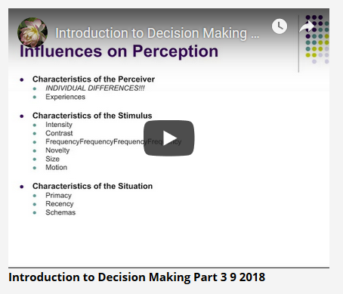
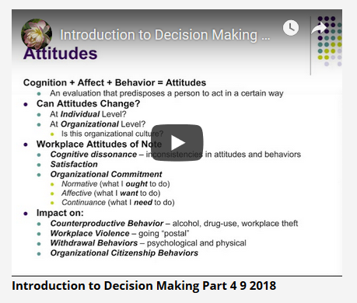
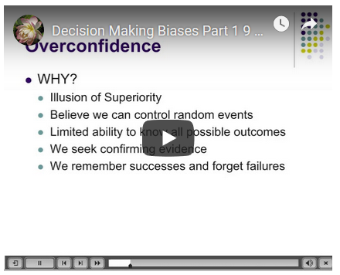
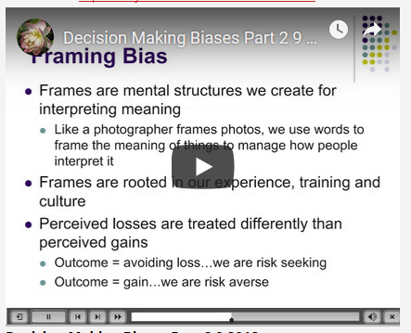
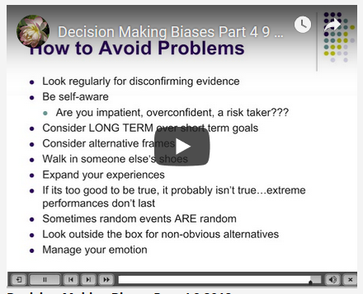
Notes:
I’m not saying you can’t have a 30-minute lecture, it just needs to be broken up into digestible segments. Like this one for example was on Decision making. We were able to break that topic down into small segments like attitudes, biases, etc.
The other big thing here is cognitive load.

Slide 37


Working
Memory
Long-Term
Memory
Notes:
You have to give students time to process what they just learned or it will be gone. What do you do in lecture? Hopefully you pause and let the students think about what you just said, or ask a thought provoking question that allows them to digest the concept you just presented. We have to do the same for our online learners. We have to allow them time to think and reflect on what was just presented. (Click) And that’s a huge part of moving the information from the working memory to long-term memory. (Click)
https://exploringyourmind.com/john-swellers-cognitive-load-theory/

Slide 38
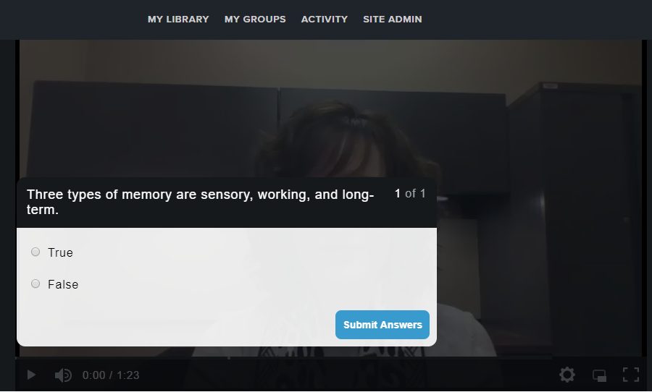
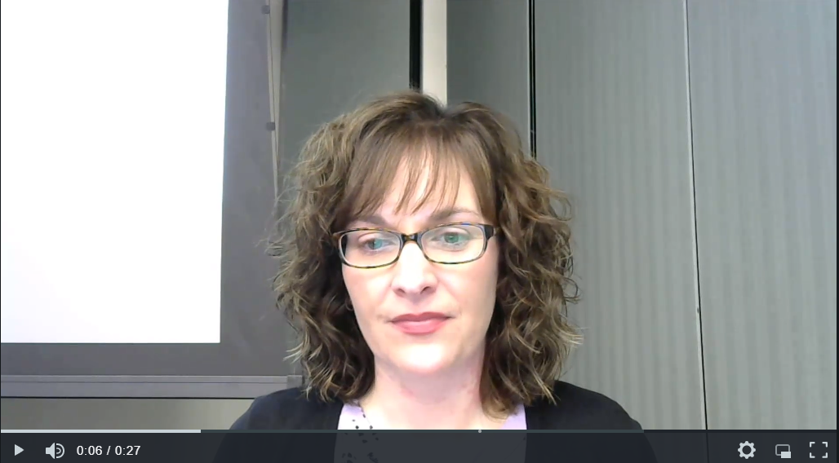
Notes:
There are a couple of strategies you can employ here to accomplish this. In the middle of the video, simply ask open ended questions and give the students a moment to think about the answer, or you can actually have them submit it as an assignment. Or, you can use a tool such as TechSmith Relay that has quizzing capabilities built right within the videos. (Click) While the true/false, multiple choice, and fill-in-the-blank questions are good, the free response is great for asking students to summarize concepts in their own words. This is even better for memory processing.

Slide 39
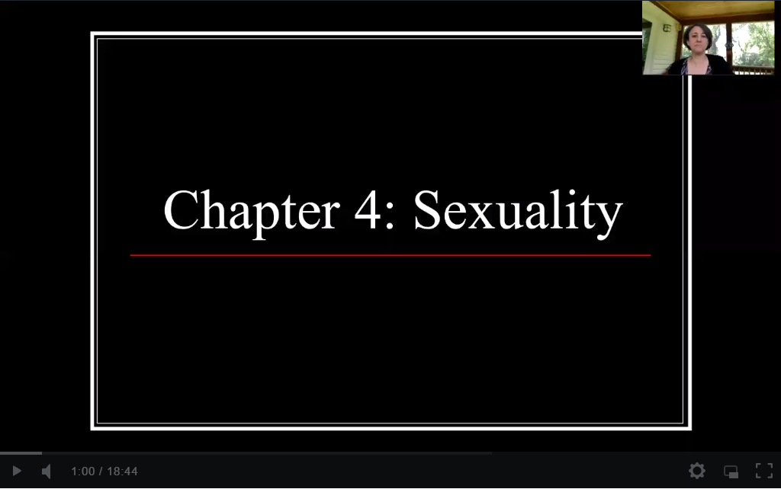
Notes:
And lectures don’t have to be super fancy. Many of us dread hearing our own voices or for sure being on camera. Kind of like I will when I process the recording of this webinar. Watch this snip of Dr. Linda Markowitz from our Sociology department.
As you can see, she’s on her porch, the birds are chirping. I find it quite tranquil actually. The video quality is great – I can see and hear her fine. She talks as though the students are right there, not like a robot. And even though there’s a slight delay in getting the slides up, it’s fine. It makes her human. Also, notice that she’s not just repeating what the students read in the text. She tells stories, this helps students make connections to the material.
I had a course where the instructor’s kids could occasionally be heard through the closed door, or her cat would crawl across her lap. We started to feel as a class like we knew Skittles the cat, and it even became a topic on the discussion board. We all wanted to know how Skittles was doing and started sharing stories of our own pets.
There’s so much more I could say about creating multimedia presentations and video lectures, but we are limited on time. Please visit our teaching toolkit for recordings from previous webinars on each. And if you’re wondering tools, Zoom and TechSmith Relay are our supported tools for video capture.

Slide 40
Q & A
Course Organization & Online Community
Notes:
Okay, so let’s pause a moment and see if we have any questions course organization and online community that need to be answered live. If you would like to come on live and ask a question, please use the raise hand button. We still have one more strategy to go and then we’ll take more questions at the end.

Slide 41
Accessibility Always
Notes:
Our final strategy for moving online is always keeping accessibility at the forefront of course design.

Slide 42
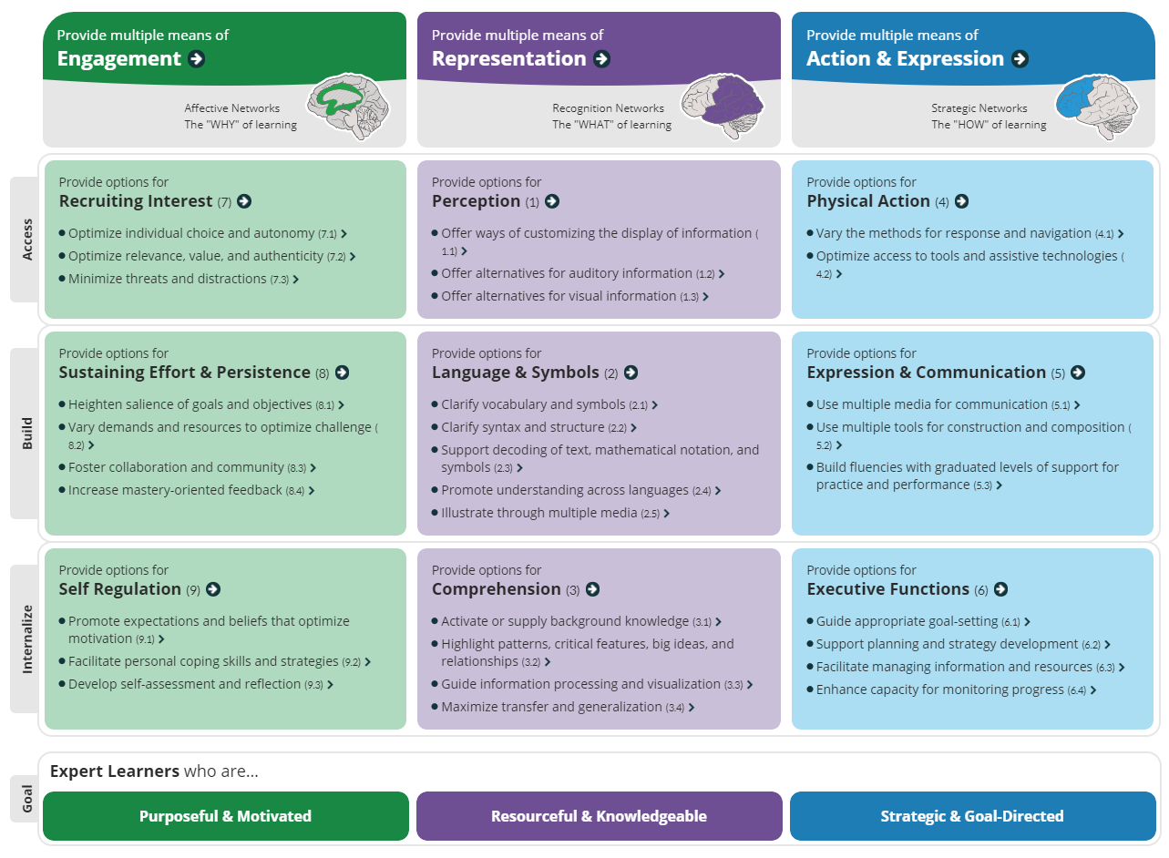
Universal Design for Learning (UDL)
http://udlguidelines.cast.org/
Notes:
These are the guidelines in Universal Design for Learning or UDL. I know they are hard to see, but I wanted to demonstrate how they are presented. UDL is a framework that was developed back in the 90s by a group of neuroscientists. They discovered that the way people learn is unique to each individual, and by designing a course through multiple means of engagement, representation, and action and expression, you can optimize learning for all. So it is definitely something you need to consider in your course design. Visit the website for further details on each guideline.

Slide 43
Universal Design for Learning (UDL) - Examples
Transcripts
PowerPoint files
Reflective assignments
Collaborative
Micro-assessments
Peer review
Assignment delivery
Connect to interests
Multiple file formats
Notes:
Here are just a few examples of how you can use UDL in your courses:
Providing transcripts with videos and PowerPoint presentations that are used in videos (Click)
Allow students to engage reflective practices (Click)
Make collaborative experiences when possible (Click)
Use lower stakes or micro-assessments instead of larger high-stakes ones (Click)
Use peer review (Click)
Allow students to choose their preferred method of completing assignments in either text based, audio, or multimedia formats (Click)
Create assessments that connect to students’ home culture, interests, and background knowledge. This assesses higher-order thinking skills while allowing you and your students to learn about each other. (Click)
Provide files in multiple formats such as HTML, audio, PDFs (Click)
You’re probably wondering how you can accomplish that last task without doing a ton of work. Fortunately, we have a tool for that.

Slide 44
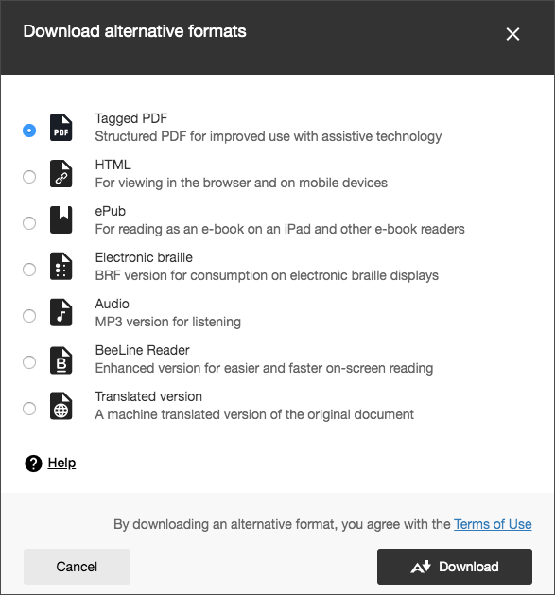
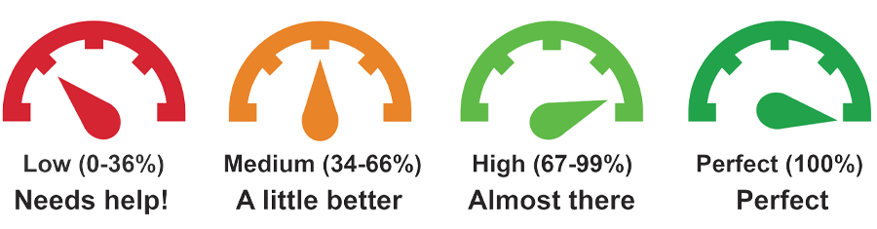

Blackboard Ally
Notes:
It’s called Blackboard Ally. You may have seen this icon in your course next to uploaded files. This allows you or the students to download files in a number of alternative formats such as these depending on the type of file.
But the thing is, those files have to be formatted correctly for these alternative formats to work. (Click)
You’ve probably also seen icons like these in your courses next to uploaded files. These are the scores for accessibility. If you click this icon, it will give you directions on how to fix the issues.
I know what you’re thinking. That’s a lot of work, and I don’t have a student with an accommodation? The truth is, we have to be proactive instead of reactive with accessibility. Access for all, remember? Think about the student that has to read a 10-page article and can now listen to the audio version on their commute. Or the person that doesn’t read very well and can get the HTML version on their iPad that is clearer and less distracting than what was put up in the course. Or the parent that is putting their kid to bed and can’t listen to your lecture but because it has closed captions, they now have an opportunity to learn.
So start slow. Make your syllabus accessible for next semester. Then once, a week, work on another file. You can also go under your Course Tools in your course to see an overall report for accessibility. This will give you easy fixes to start with first.
And the most important thing you can do is TELL your students this is available. This is really there for them, and most of the time they don’t even realize the feature is there.

Slide 45
Recap
Use Your Resources
            IDLT
            KB
            Virtual Training
            Make a Plan
            OSCQR
            Course Planning Grid
            Syllabus
            Rubrics
            Course Organization
            Folders
            About This Course
            Welcome Announcement
Build Online Community
Welcome video/course tour
Discussion board
Peer Reviews
Tutoring and Learning Support
Your Presence in the Course
Announcements
Office Hours
Discussion
Feedback
Retention
Lectures
Accessibility Always
UDL
Blackboard Ally
Notes:
So we’ve covered a lot of ground in a little time, but like I said in the beginning, each one of these topics could be its own hour-long workshop. Next we’re on to questions, so I thought this slide may spark something you saw earlier in the presentation.

Slide 46
Q & A
Notes:
So with that, we’ll take questions. Remember to use the raise hand feature if you’d like to come on and ask a question live. And if you’re leaving us, thank you so much for your attendance today. We appreciate your desire to build student-centered courses.

