Slide 1
Payroll Certification
Review
Notes:
This is the training for Payroll Certification Review. Payroll Certifications are available immediately after the payroll has processed. Only fiscal officers and or their delegates receive an email when certifications are ready for review

Slide 2
Getting Familiar
Getting Started
Select Payroll Certifications from the left-hand sidebar.
Notes:
Getting started. Select payroll certification from the left hand side bar. Please review the instructions and read the purpose of Payroll Certifications. Now select Payroll Certifications.

Slide 3
Getting Familiar
Main Screen
Three boxes (see next slide for screenshots):
Current Payroll Certifications Ready for Approval – outstanding certifications for review
Unresolved Disputed Payroll Certifications – review disputed certifications awaiting resolution from Payroll Department
Previously Processed Payroll Certifications – review certifications that have been approved or disputed
Each box also has column headers that can be used to sort and filter the contents
Notes:
On the main screen, you will see 3 boxes . The first box will be for the current Payroll Certifications Ready for Approval. certs in this box are the outstanding certifications for review
The 2nd box is for the Unresolved Disputed Payroll Certifications. If a cert has been disputed by the department it will be in this box for payroll to review, and is awaiting resolution from the Payroll Department. The 3rd box is for Previously Processed Payroll Certifications. certs in this box have been approved or disputed. Each box also has column headers that can be used to sort and filter the contents.

Slide 4
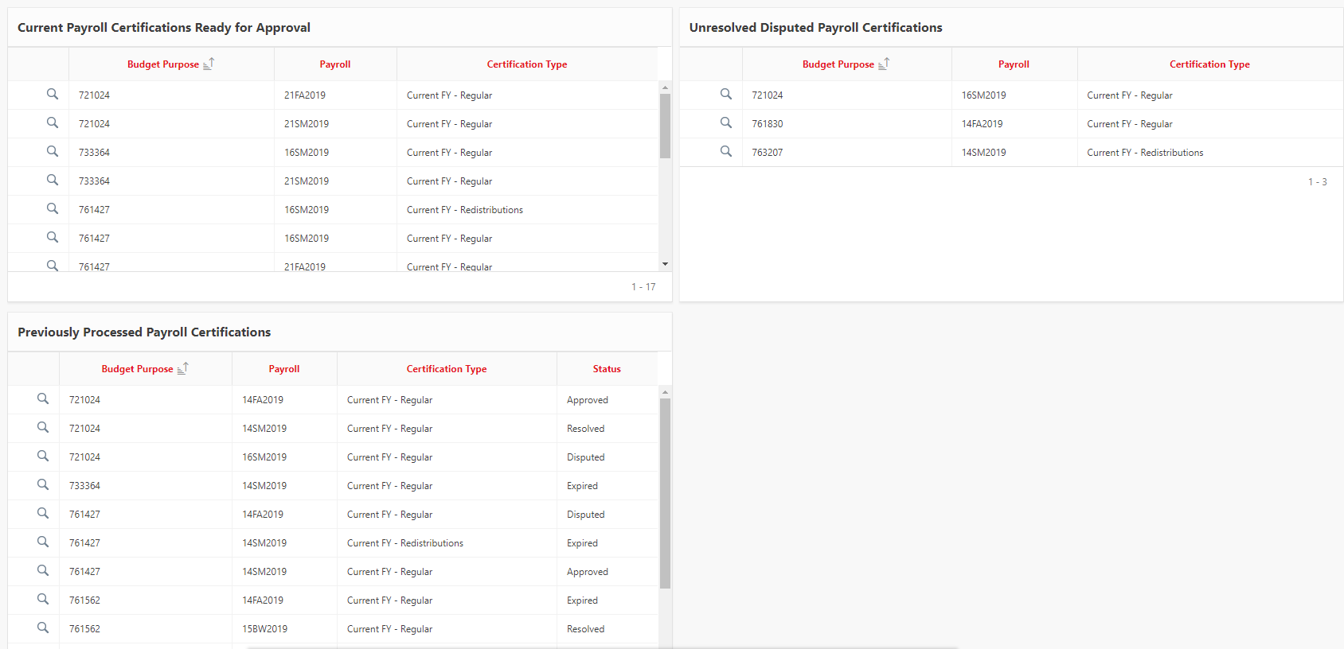
Getting Familiar
Main Screen
Three boxes:
Notes:
Here is an example of the three boxes on the main screen.

Slide 5
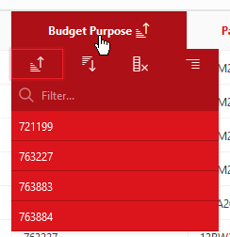
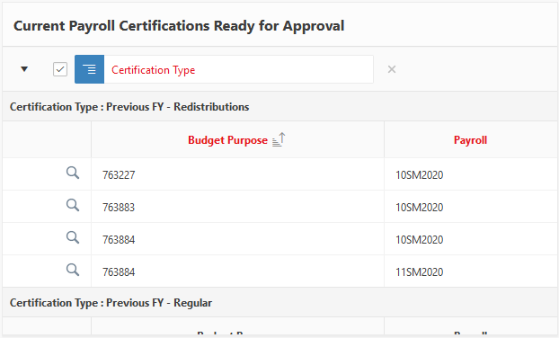
Getting Familiar
Main Screen
Sorting with column headers
Click the column header you want to sort by
Sorting options: Ascending (leftmost), Descending (second from left)
Can hide column with Hide Column
Can group by content with Control Break
Ex. Grouping by Certification Type
Notes:
Sorting the column headers. Click the column header you would like to sort by. You have the ability to sort the certifications to your preference by clicking the header you would like to sort. You have sorting options of ascending or descending. You can hide columns with the hide column tab. You can also group by content with control break.

Slide 6
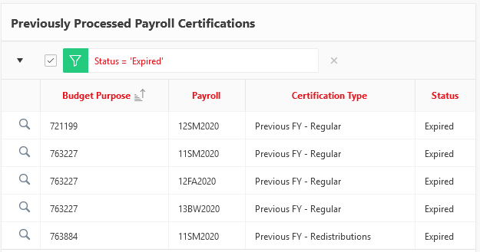
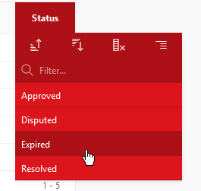
Getting Familiar
Main Screen
Filtering with column headers
Clicking on each header also provides a list to filter by
Filter by Budget Purpose, Payroll, Certification Type, and Status
Ex. filter only certifications that are expired
Notes:
Each box also has column headers that can be used to filter the contents. Clicking on each header also provides a list to filter by. You can filter by budget purpose, payroll certification type, and status.

Slide 7
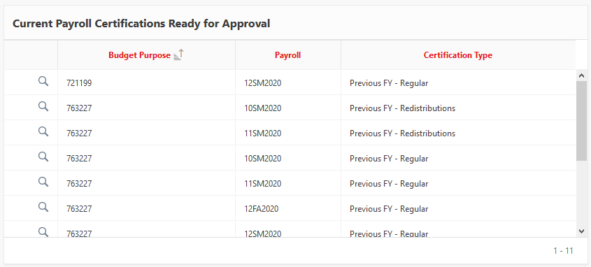
Getting Familiar
Main Screen
Current Payroll Certifications Ready for Approval
Notes:
This is an example of a current payroll certification that is ready for approval.

Slide 8
Getting Familiar
Main Screen
Unresolved Disputed Payroll Certifications
Payroll calendars with cutoff dates can be found at siue.edu/hr/payroll
Notes:
This is an example of an unresolved disputed payroll certification. Please note that if an employee is missing from the certification, please contact payroll before submitting a dispute. If the new employee paperwork has not been received by the payroll cutoff dates the employee will not appear until the following payroll. In this case, the certification does not need to be disputed. Payroll calendars with cutoff dates can be found on the payroll website. If disputed in error, reversal of a dispute can only be done with an email to payroll saying the dispute was in error. Also an email is required if an approval is done in error . Once the certification has been approved or disputed, it can not be changed. After the dispute has been resolved it will be removed from this box. Contact information for the appropriate payroll staff can be found on the Questions and Comments slide.

Slide 9
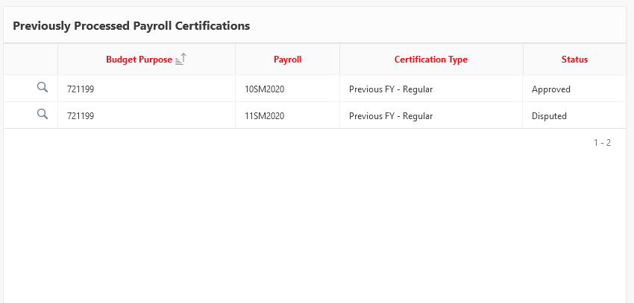
Getting Familiar
Main Screen
Previously Processed Payroll Certifications
Notes:
This is an example of a previously processed payroll certification. Certifications that have already been approved or disputed can be reviewed here.

Slide 10
Viewing and Reviewing
Reviewing Current Payroll Certifications
Click the magnifying glass
View account information and earning codes
Notes:
Now we will look at viewing and reviewing payroll certifications. To review current certifications ready for approval, click the magnifying glass. Listed is the payroll ID, payroll dates, and fiscal year. You will see the account information which includes the account number, name, fiscal officer, email of fiscal officer , and the campus box. Some of the most used earning codes are listed. A complete list can be found on the payroll website.

Slide 11
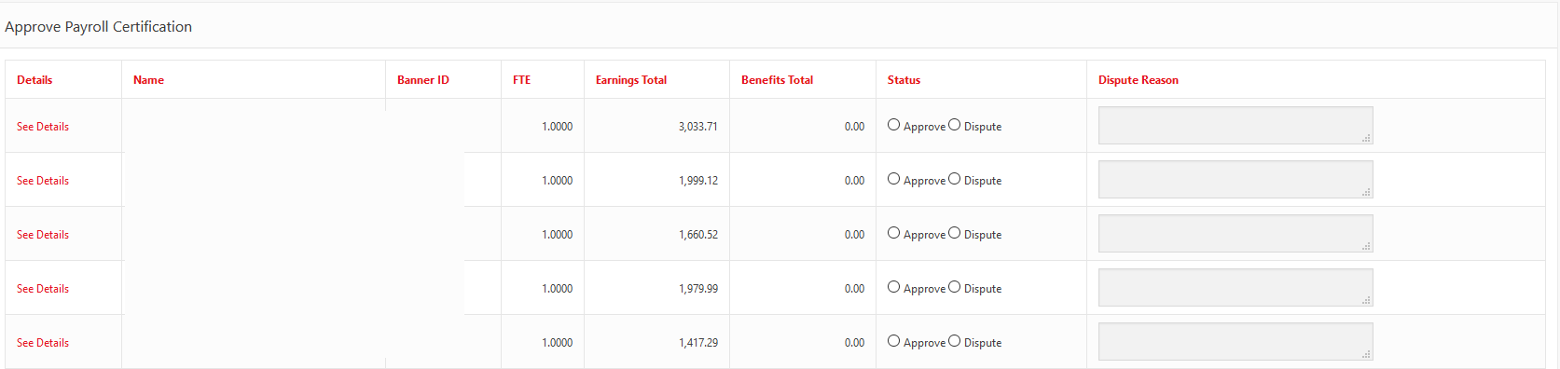
Viewing and Reviewing
Reviewing Current Payroll Certifications
View each employee and their FTE, total earnings, and total benefits (if grant account)
Notes:
Verify employee pay to confirm the pay is accurate and charged to the correct account. Please note, if an new employee is missing from the certification, please confirm with payroll if paperwork missed cutoff.

Slide 12
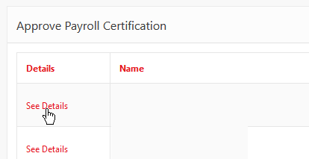
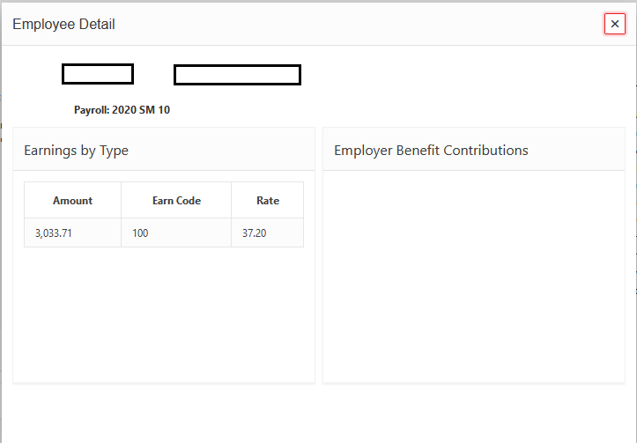
Viewing and Reviewing
Reviewing Current Payroll Certifications
To view details about an employee’s record, click See Details
Notes:
To view details of an employee’s record, click on see details. This will display the name, 800 ID number, earning code, pay amount, and rate. Check each for accuracy.

Slide 13
Pause for Deferred Pay
Salary Deferral
The certifications display paid salaries for employees who defer pay differently from employees who do not.
Example:
An employee makes $2,500 per payroll, for 9 months – 18 pay periods.
$$deferred=625.00/pay period$$
$$gross−deferred$$
$$=2,500.00−625.00 \\ =1875.00/pay period$$
To verify the salary is correct, add the amount paid out per pay period and the amount that is deferred per pay period.
If an employee is paid by multiple accounts, the certification amount for each account must be added to obtain the total gross pay for that employee.
Notes:
Salary deferral is for employees who work less than 12 months but elect to be paid over a 12 month period. Employees may not opt out of salary deferral during the year and may not opt in after the year has started. The deferred amount and the amount being paid out should equal to the employees total salary. If the employee is paid from different accounts, the fiscal officer or delegate will only be able to view their accounts. This is an example of an employee who has deferred pay and how it is calculated. To verify the salary is correct, add the amount paid out per period and the amount that is deferred per pay period. If an employee is paid by multiple accounts, the certification amount for each account must be added to obtain the total gross pay for that employee.

Slide 14
Pause for Deferred Pay
A Note About Deferred Pay
When an employee has opted for deferred pay, you will only see defer pay in (code 130).
When the employee is paid out, you will not see the defer pay out (code 131) on the appropriate payroll.
If you believe there is an issue with an employee’s deferred pay, please dispute that employee’s record and contact PayrollHR@SIUE.edu.
Notes:
A note about deferred pay. When an employee as opted for deferred pay, you will only see defer pay in, which is earning code 130. When the employee is paid out, you will not see the defer pay out code, which is 131, on the appropriate payroll. If you believe there is an issue with an employee’s deferred pay, please dispute that employee’s record and contact PayrollHR@s i u e dot e d u

Slide 15
Viewing and Reviewing
Reviewing Current Payroll Certifications
To approve a record, click Approve
To dispute a record, click Dispute, and provide a reason
Notes:
To review a current payroll certification, click approve or dispute. Please enter a complete reason for disputing a certification in the dispute reason box. Take as much space as needed

Slide 16
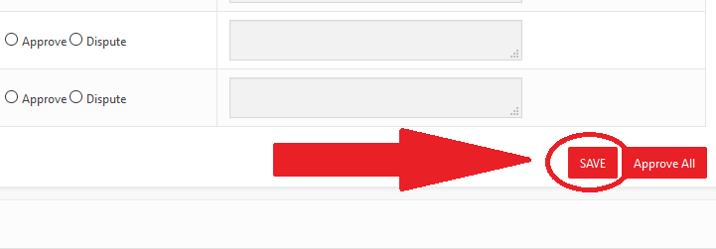
Viewing and Reviewing
Reviewing Current Payroll Certifications
After reviewing each record, check for disputes
If you have disputes, click SAVE
Be sure to check all records’ radio buttons
If you haven’t finished, you can click SAVE to process the responses you have already and come back later.
Notes:
If you have a dispute, click save after disputing. Please note, you do not have to click approval for each person. After disputes have been identified, if any, click the approve all button. The responses can be saved and can be returned back to later.

Slide 17
Viewing and Reviewing
Reviewing Current Payroll Certifications
If there are no records to dispute, click Approve All
Notes:
Approve all cannot be changed to disputes. This cannot be reversed.

Slide 18
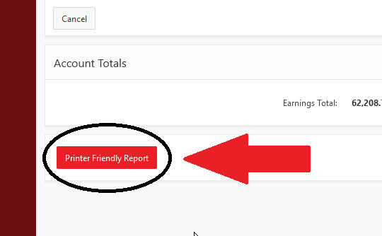
Viewing and Reviewing
Reviewing Current Payroll Certifications
To save the certification for review past the two-week expiration, use Printer Friendly Report to print a cleaner version to PDF
Printer Friendly versions of all reports are available before and after processing and expiration.
Notes:
To save a certification past the two week expiration, select printer friendly report for a PDF version.

Slide 19
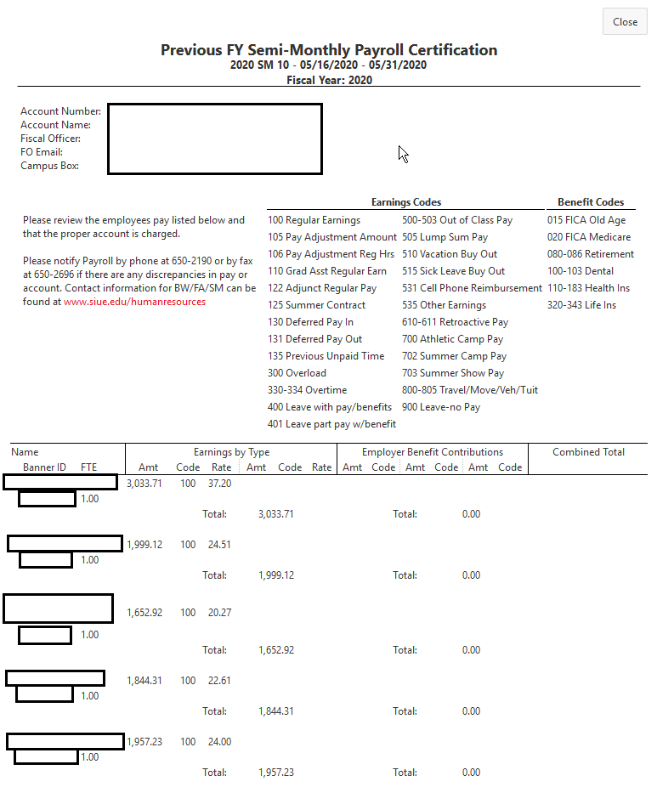
Viewing and Reviewing
Reviewing Current Payroll Certifications
Example certification
Notes:
This is an example of a payroll certification.

Slide 20
Viewing and Reviewing
Reviewing Unresolved Disputed Payroll Certifications
Any certifications with disputes show up in Unresolved Disputed Payroll Certifications after saving and processing
To view the records that were disputed in a given payroll, click the magnifying glass
You can view who disputed the record, what reason they gave, and when they disputed it
Notes:
Any certifications with disputes appear in Unresolved Disputed Payroll Certifications after saving and processing. To view the records that were disputed in a given payroll, click the magnifying glass. You can view who disputed the record, the reason for disputing, and when it was disputed.

Slide 21
Viewing and Reviewing
Reviewing Resolved Disputed Payroll Certifications
Once Payroll has resolved your dispute, it will appear in the Previously Process Payroll Certifications box with the Status of Resolved.
Notes:
Once payroll has resolved your dispute, it will appear under Previously Processed Payroll box with the status of resolved.

Slide 22
Viewing and Reviewing
Reviewing Resolved Disputed Payroll Certifications
After clicking the magnifying glass, the details screen has three more columns: Resolution, Resolved by, and Resolution Date
Notes:
After clicking the magnifying glass, the details screen has three more columns Resolution, resolved by and resolution date.

Slide 23
Viewing and Reviewing
Viewing Previous Payroll Certifications
To view past certifications, click the magnifying glass next to the certification in the Previously Processed Payroll Certifications
Notes:
To view past certifications, click the magnifying glass next to the certification under Previously Processed Payroll Certifications.

Slide 24
Viewing and Reviewing
Viewing Previous Payroll Certifications
Can view each record, who responded to each record and when
Notes:
In this section you can view each record, who responded to each record and when

Slide 25
Viewing and Reviewing
Viewing Previous Payroll Certifications
Can print the certification as it appeared before processing
Cannot see the fiscal officer/fiscal officer delegate that responded to each record or how they responded
Notes:
You have the ability to print the certification as it appeared before processing. In this view you cannot see the fiscal officer or fiscal officer delegate who responded to each record or how they responded.

Slide 26
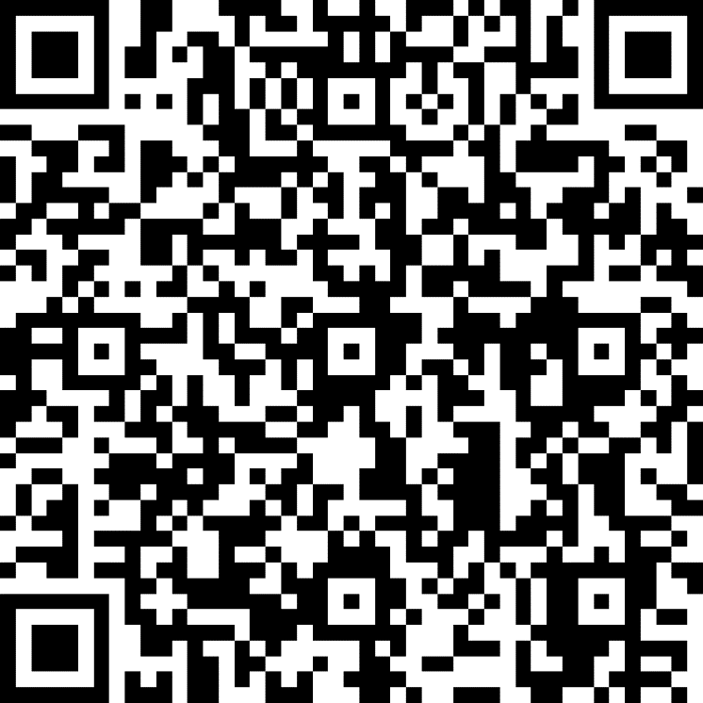
Payroll Certification Review Verification
Complete this form to confirm you’ve reviewed the training at the link below or can the QR code
https://forms.office.com/Pages/ResponsePage.aspx?id=IX3zmVwL6kORA-FvAvWuzyLfc-hUC3lFgkIKHsZ-R9xURjBQODYyM0NJMTIyMzdJTUFSQkVRM0o5RC4u
Notes:
Please complete the Payroll Training Certification Verification form at the link provided to confirm you have completed the training. Instructions on how to complete the training are on the next slide

Slide 27
Payroll Certification Review Verification
Enter your first and last name, 800 number, and confirm that you reviewed the training.
Scroll down and click Submit
That’s it! You’ve completed the new payroll certification training!
Notes:
To complete the form, please enter your first and last name, 800 number, and confirm you have reviewed the training. Scroll down to click submit.

Slide 28
Questions, Comments, Concerns?
Let us know!
Question/comment/concern can’t fit in the box?
Email PayrollHR@SIUE.edu, or call ext. 2190
Payroll Contacts:
Faculty Payroll
Chris McCawley, cmccawl@siue.edu
Robin Ermer, rermer@siue.edu
Semi-Monthly Payroll
Kayla Orban, kwidner@siue.edu
Laurie Eisenhauer, leisenh@siue.edu
Bi-Weekly Payroll
Cameron Bowman, cabowma@siue.edu
Notes:
For questions or concerns, please contact payroll at PayrollHR@ s i u e dot e d u or call Human Resources at 618-650-2190

