Slide 1
Foreign National / Non-Resident Alien (NRA) Taxes
1

Slide 2
This SIUE presentation…
Is intended to guide employees, students, and independent contractors with foreign-tax status through the most common university payment and related tax transactions.
Will help you prepare forms required by the Internal Revenue Service (IRS), federal and state government, and the university.
Provides an overview of the process and laws and may not provide tax advice specific for your needs. You will need to consult with your personal tax preparer or visit IRS.gov for your specific personal tax questions.
2

Slide 3
SIUE Foreign Tax Compliance Requirements…
Identify all payments made to a Foreign National/Non-Resident Alien or to a third party on his/her behalf
Apply the appropriate federal tax withholding and report the payments to the IRS.
Assist qualified individuals with applying for an Individual Tax Identification number and IRS treaty benefits if available.
3

Slide 4
Who is a Foreign National?
A person who is not a citizen of the host country in which he or she is temporarily residing.
An individual who is a citizen of any country other than the U.S.
4

Slide 5
Who is a Non-Resident Alien (NRA)?
Any person who is:
not a U.S. Citizen
not a lawful permanent resident (green card holder)
does not meet either the Green Card or the Substantial Presence Test
5

Slide 6
Who is a Resident Alien?
A permanent resident of the country in which he or she resides but does not have citizenship. To meet this U.S. classification, you must:
have a current green card or have had one within the last calendar year.
have been physically present in the U.S. for at least 31 days in the current year and 183 days over a three-year period that includes the current year.
6

Slide 7
What is the Green Card test?
The Green Card test is a U.S. residency status test used to determine whether a non-U.S. citizen will be treated as a resident alien for U.S. tax purposes.
The individual will be deemed to have this status if he/she:
has been granted lawful permanent residence status in the U.S.
has been issued or will receive an alien registration card (also known as a green card) by the Immigration and Naturalization Service (INS).
7

Slide 8
What is the Substantial Presence test (SPT)?
You will be considered a U.S. resident for tax purposes if you meet the Substantial Presence test for the calendar year. To meet this test, you must be physically present in the United States on at least:
31 days during the current year, and
183 days during the 3-year period that includes the current year and the 2 years immediately before that counting:
All the days you were present in the current year
1/3 of the days you were present in the first year before the current year
1/6 of the days you were present in the second year before the current year.
8

Slide 9
Substantial Presence Test Example
Mr. Zin was present in the U.S. 43 days in the current year (2015), 164 days in (2014) and 167 days in (2013).
The test is computed under the IRS formula as follows. Round up to the nearest whole number.
43 (days in 2015) X 1 = 43
164 (days in 2014) X 1/3 (33.33%) = 55
167 (days in 2013) X 1/6 (16.67% = 28
Total days in U.S. 126
In this example, Mr. Zin does not meet the Substantial Presence test for 2015 since he was not present for at least 183 days during the 3 years.
9

Slide 10
Who is a Resident Alien or Non-Resident Alien for Tax Purposes?
Resident Alien for Tax Purposes: Any foreign person who has been physically present in the US to pass the Substantial Presence test. Resident aliens for tax purposes are taxed in the same manner as US residents and may use the same filing statuses and claim tax allowances as US residents.
Non-Resident Alien for Tax Purposes: Any foreign person who has not been physically present in the US to pass the Substantial Presence test.
10

Slide 11
How Do I Get Started?
To determine your tax status and tax treatment begin by completing the following forms available at these links.
Foreign National/NRA Tax Status Form
http://www.siue.edu/humanresources/nra/
IRS Form W-8Ben
https://www.irs.gov/pub/irs-pdf/fw8ben.pdf
IRS Federal W-4 Form
https://www.irs.gov/pub/irs-pdf/fw4.pdf
Illinois State W-4 Form
http://www.tax.illinois.gov/taxforms/withholding/il-w-4.pdf
11

Slide 12
Additional forms you may need
If you need to apply for an Individual Tax Identification number or wish to use available treaty benefits, you need to complete these forms as well.
IRS Form 8233 for treaty benefits (is available)
https://www.irs.gov/pub/irs-pdf/f8233.pdf
IRS Form W-7 for Individual Tax Identification Number
https://www.irs.gov/pub/irs-pdf/fw7.pdf
11

Slide 13
What documents do I need to gather?
SIUE ID Card with photograph
Visa
Form I20
Form I94 DS-2019 that is applicable to your current and past Visa
Passport that contains an immigration stamp
Please attach copies of these documents to the SIUE Foreign National (NRA)Tax Status Form. Failure to attach copies may delay processing of forms.
12

Slide 14
Example of required documents : School ID
School ID Card with Photograph
Banner ID Number
13

Slide 15
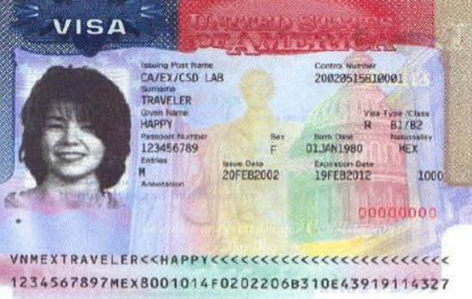
Example of required document:
Visa
Issue Date
Expiration Date
Visa Number
Visa Type
Stamps within the Visa
14

Slide 16
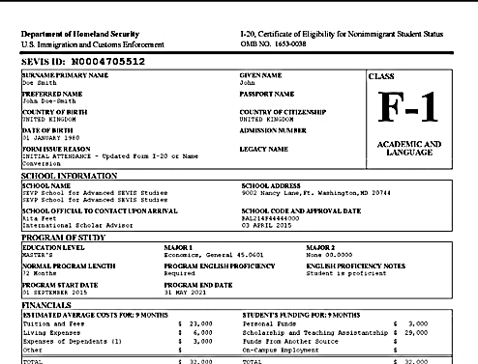
Example of required document:
Form I-20
15

Slide 17
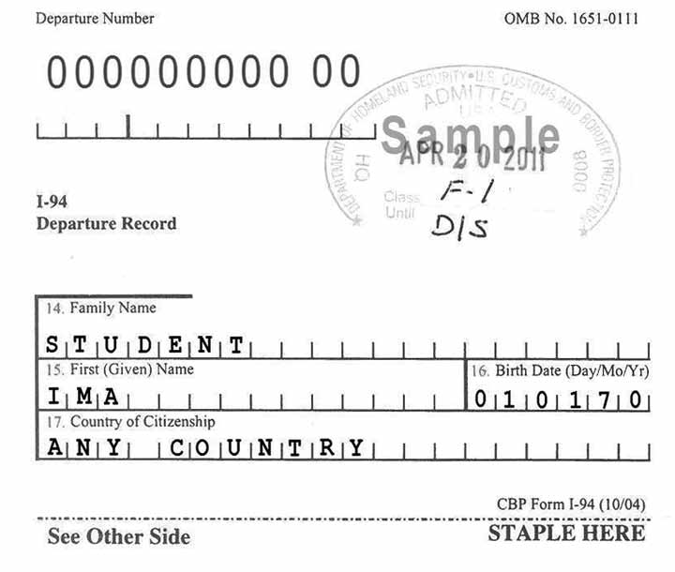
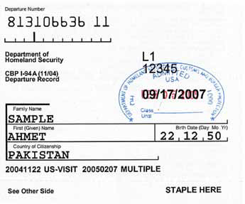
Example of Form I-94 or Form I-94A Arrival/Departure Record
Document Number
Arrival Date
Date of arrival shown on your current Immigration Form I-94, Arrival-Departure Record
16

Slide 18
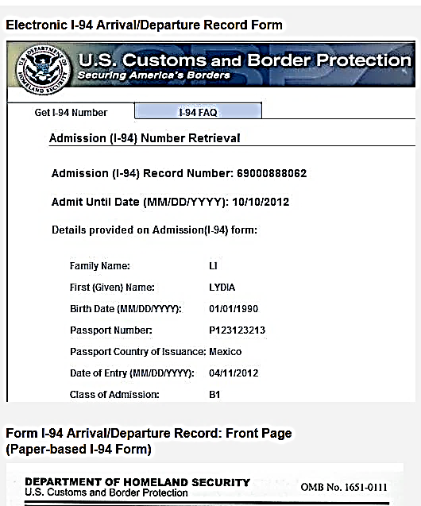
Example of Form I-94 Electronic Document: I-94 Arrival/Departure Form

Slide 19
Example of required document:
Passport
Passport Number
Passport Expiration Date
17

Slide 20
What is the Foreign National /NRA Tax Status Form?
A University form to gather information so that we may determine the proper tax status in compliance with IRS laws.
The fillable Foreign National / NRA Tax Status Information Form can be found at http://www.siue.edu/humanresources/nra/
18

Slide 21
Example of completed Tax Status Form:
Basic Info
Enter your Name, Date of Birth, Banner ID, and Status as shown on passport.
19

Slide 22
Tax Status Form: Personal Info
You must select 1 Personal Exemption and Single for Marital status.
Enter your SIUE position and the department in which you’ll be working,
if applicable.
20

Slide 23
Tax Status Form: Personal Info continued
Enter your telephone & e-mail information.
Enter the date you first entered the U.S. This could be found on form
I-94 or I-20.
Enter your first date of employment at SIUE.
21

Slide 24
Tax Status Form: U.S. Address
Enter your current U.S. home address.
22

Slide 25
Tax Status Form: Foreign Address
Enter your home address in your country.
23

Slide 26
Tax Status Form: Country – Passport Info
Enter your Passport information.
24

Slide 27
Tax Status Form: Visa Info
Enter your Immigration Status/Visa Type, Primary Purpose, Tax Residence, Visa number, click yes or no if you wish to use treaty benefits if available, I-20/DS2019 Start Date, First Day in U.S., Last Day in U.S., & Sevis ID number from I-20.
25

Slide 28
Tax Status Form: Visa Info continued
Enter this information if you have previously been in the U.S. under a different visa status.
26

Slide 29
Tax Status Form: Visa Info Continued
John Doe
08/11/12
Enter this information if you have previously been in the U.S. under a different visa status.
27

Slide 30
What is a W-8Ben Form?
Form W-8Ben
Form W-8Ben is an IRS form and must be completed to establish your foreign status and to claim an exemption from federal income tax withholding on scholarship, fellowship or stipend payments.
Form W-8Ben can be used to claim treaty benefits for foreign individuals or vendors.
Form W-8Ben is valid indefinitely unless a change in status occurrs.
28

Slide 31
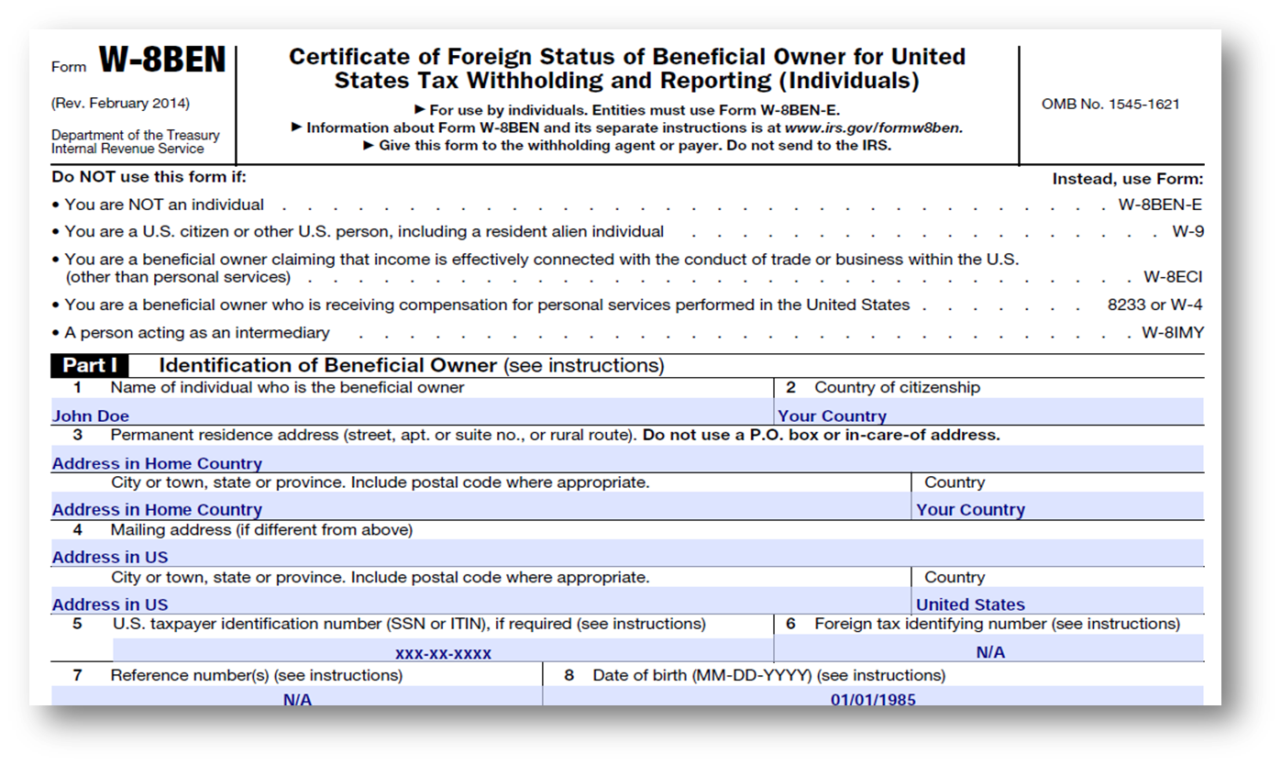
Example of completed W-8Ben Form
29

Slide 32
Example of completed W-8Ben Form continued
30

Slide 33
Federal and State W-4 Forms and allowances
The federal W-4 is an IRS form that determines the amount of federal tax withholding that will be deducted from your pay.
The Illinois W-4 is a state form that determines the amount of state tax withholding that will be deducted from your pay.
When completing the Federal W-4 or State W-4 , you must claim Single and 1 allowance, unless you are a resident of Canada, Japan, Mexico, or the Republic of Korea, in which case you may claim more than 1 allowance. The more allowances claimed, the less taxes will be withheld.
If Payroll does not receive these forms timely, your initial tax withholding may be at a higher default rate.
31

Slide 34
Where to find and complete Federal and State W-4 Forms
Form and instructions are available at the following link: http://www.siue.edu/humanresources/nra/index.shtml
Select Federal Form W-4 and a new window will open for you to complete the Federal W-4.
Select Illinois Form W-4 and a new window will open for you to complete an Illinois W-4.
Remember these must be turned in to Payroll.
32

Slide 35
Example of a Completed Federal W-4 Form
33

Slide 36
Example of a Completed Illinois W-4 Form
34

Slide 37
What is a Tax Treaty and how will this benefit me?
A treaty is a legal agreement between two nations to address concerns about double taxation of individuals and companies doing business, living, and earning income in two or more nations.
Under the terms of the treaty, some individuals may qualify for reduced tax rates on selected kinds of income if they provide the required documentation.
Using treaty benefits may reduce or elimate taxes withheld from your pay.
35

Slide 38
Where can I find Tax Treaty Information?
Access the IRS website, see: http://www.irs.gov/
Search for Publication 901 and locate your home country.
If your home country is listed, your country has an active income tax treaty with the U.S.
If your home country is not listed, your country does not have an active income tax treaty with the U.S., and treaty benefits are not available.
36

Slide 39
How can I claim tax treaty benefits?
To claim treaty benefits, you must complete IRS Form 8233, have a valid Social Security number or Individual Tax Identification number(ITIN).
Form 8233 is valid only for the calendar year for which it is filed.
The form can be found at: https://www.irs.gov/pub/irs-pdf/f8233.pdf
37

Slide 40
Example of completed 8233 form
38

Slide 41
Example of completed 8233 form continued
39

Slide 42
What is a W-7 Form and an ITIN?
A W-7 Form is an IRS form and is used to obtain an Individual Tax Identification Number (ITIN) .
An ITIN is issued to individuals required to have a U.S. taxpayer identification number but do not have one and are not eligible to obtain a Social Security Number (SSN).
An ITIN is a nine-digit number that always begins with the number 9 and has a 7 or 8 in the fourth digit, for example: 9XX-7X-XXXX.
40

Slide 43
Example of completed W-7 Form
41

Slide 44
Example of completed W-7 Form continued
42

Slide 45
What type of funds are taxable?
Wages/Stipends paid to employees and students who have not claimed tax treaty benefits.
Payments made to independent contractors for work performed.
Student financial aid received in excess of tuition and fees, supplies required for courses, or book allowance, are taxable and this includes funds for items such as housing and meal plans.
43

Slide 46
Non-Qualified Scholarship Payments (taxable)
Internal Revenue Code, Section 117:
Any portion of the scholarship, fellowship, stipend or grant that does not directly pay for "tuition and fees paid to enroll in or attend an educational institution“.
Any portion of the scholarship, fellowship, stipend or grant that does not directly pay for "fees, book, supplies, room, board, dorms, meal plans, and equipment required for the courses at the educational institution.
These are considered non-qualified, and is included in gross income and subject to withholding.
44

Slide 47
Qualified Scholarship Payments (non-taxable)
Internal Revenue Code, Section 117:
A "qualified scholarship" is defined as one used for "tuition and fees paid to enroll in, or to attend, an educational institution" or "fees, book, supplies, and equipment required for the courses at the educational institution.“
Qualified scholarship payments made to Non-Resident Aliens are not subject to withholding and not reportable as payments to the IRS.
45

Slide 48
What tax forms will I receive from SIUE for tax reporting to the IRS?
If you apply for and use available treaty benefits you will receive a Form 1042-S which is mailed by March 15th or before of each year.
If you do not use treaty benefits you will receive a Form W-2 which is mailed by January 31st of each year or this form is available earlier through Cougar Net.
46

Slide 49
What is Form 1042-S
Form 1042-S is used to report annual taxable income for Foreign National/ Non-Resident Aliens who :
claimed treaty benefits for wages/stipends earned
Received non-qualified education (financial aid) payments for items such as travel, room and board, research and meal costs
Received pay for independent personal services performed in the US
47

Slide 50
Example of 1042-S form
48

Slide 51
What is a W-2?
The W-2 is used to report annual taxable wages and stipends and the amount of federal and state tax withheld during the year.
The W-2 may also be referred to as a Wage and Tax Statement. This form will help you calculate your income tax liability.
49

Slide 52
Example of W-2 form
50

Slide 53
Where to find more information on Foreign National/Non-Resident Alien taxation?
The Internal Revenue Service (IRS) has numerous publications and forms at irs.gov. The follow Publications may be helpful:
519 - United States Tax Guide for Aliens
515 – Withholding of Tax on Non-Resident Aliens, and Foreign Entities
901 – U.S. Tax Treaties
51

Slide 54
Links of Interest
The SIUE Foreign National (NRA) web page http://www.siue.edu/humanresources/nra/index.shtml
Within this website you may access the following links:
IRS – Internal Revenue Service: www.irs.gov
International Student Services: www.siue.edu/iss/
Foreign National (NRA) FAQs
52

Slide 55
Who can I call for help?
For additional information concerning Foreign National/NRA Taxes, please contact in the Office of Human Resources at 618-650-2190 or at the emails below:
Denise Hunt – Payroll Compliance Manager (dhunt@siue.edu)
Robyn Courtway – Human Resource Officer (rcourtw@siue.edu)
53

