Slide 1
2019 Service Awards

Slide 2
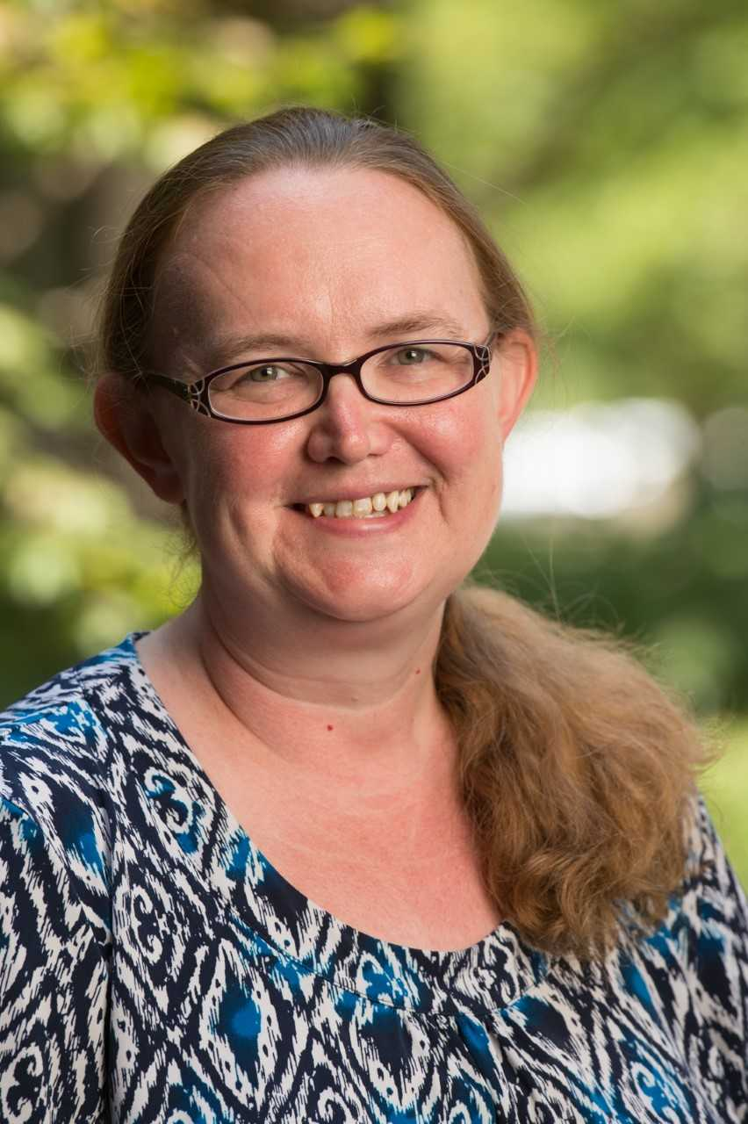
Employees of the Month
March 2018
Kelly Lasiter
Social Work

Slide 3
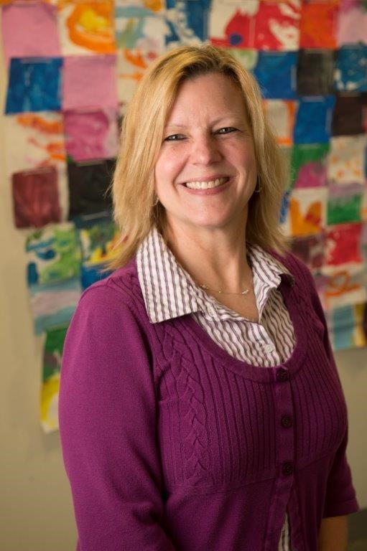
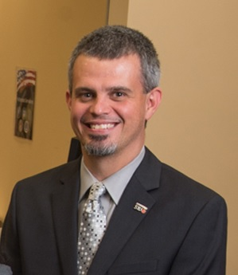
Employees of the Month
April 2018
May 2018
Kevin Wathen
Veteran Services
Trish Scheibal
Early Childhood Center

Slide 4
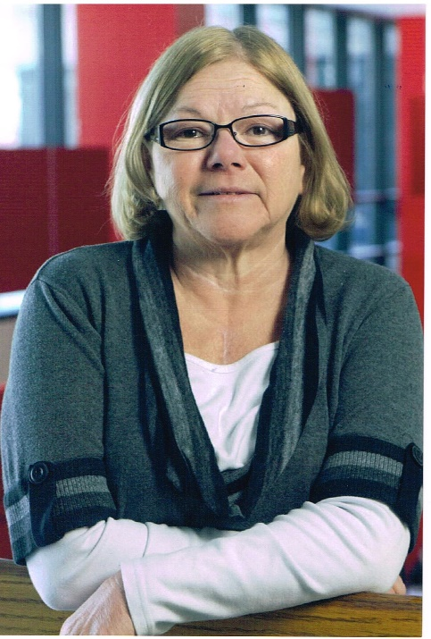
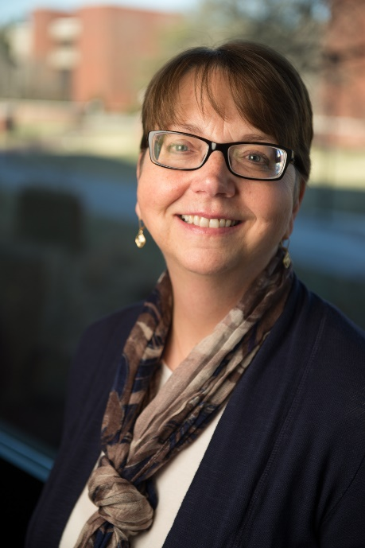
Employees of the Month
September 2018
October 2018
Cathy Foland
Bursar
Gail Erb
Student Financial Aid

Slide 5
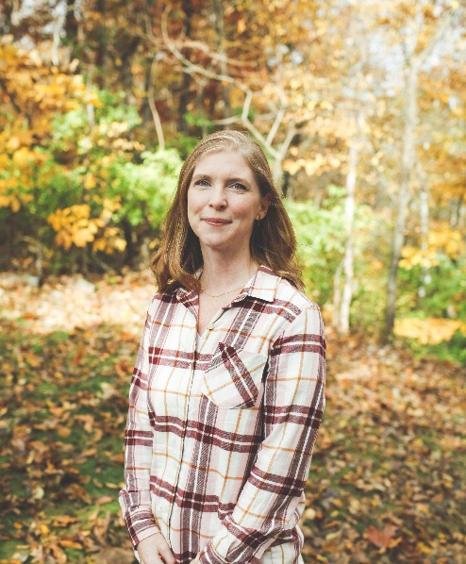
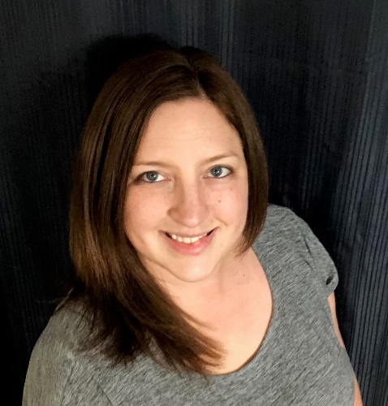
Employees of the Month
November 2018
December 2018
Sally Boutelle
Enrollment Management
Tori Reany
Information Technology
Services

Slide 6
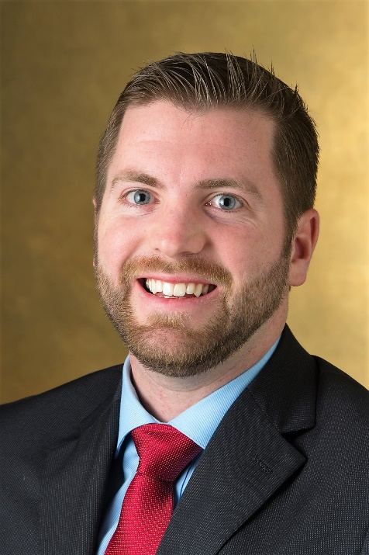
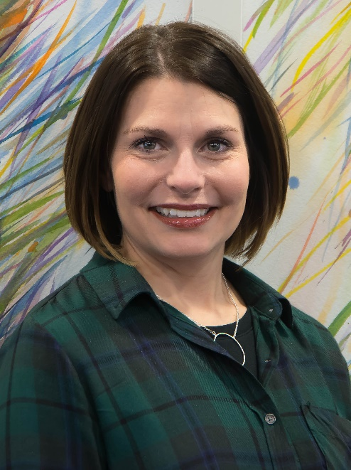
Employees of the Month
January 2019
February 2019
Angela Pritchett
School of Dental Medicine
Tom Dougherty
Campus Recreation

Slide 7
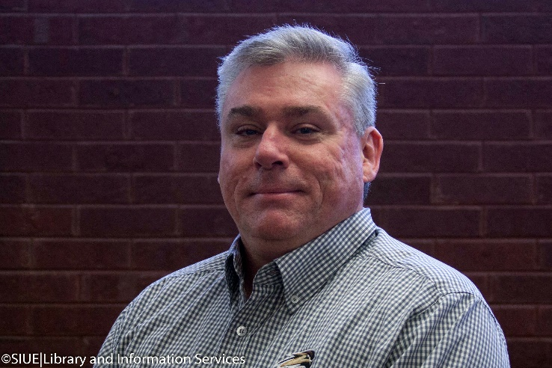
Employees of the Month
March 2019
Bill Weidler
Lovejoy Library

Slide 8
Chancellor
Randy Pembrook
2019 Service Awards
Address

Slide 9
10 Year
Service Award
Honorees

Slide 10
Group 1
10 Year Honorees
Dr. Ariel Belasen
Virginia Bell
Kristin Best Kinscherff
Darla Borror
Dustin Brueggemann

Slide 11
Group 2
10 Year Honorees
Jennifer Caumiant
Jason Coomer
Dorothy Crews
Kris Crosby
Ruby D'Angelo-Joiner

Slide 12
Group 3
10 Year Honorees
Carol Dappert
Dr. Jessica Despain
Dr. Jing Fan
Christine Gallagher

Slide 13
Group 4
10 Year Honorees
Gene Goldsand
Dr. Misty Gonzalez
Cynthia Horn
Brandi Hudson
Curtricia Hudson

Slide 14
Group 5
10 Year Honorees
Rex Jackson
Adrienne Kaesberg
Ricky Lallish
Mark Lankford
Dr. Bryan Lueck

Slide 15
Group 6
10 Year Honorees
Kimberly McClellan
Melissa McEldowney
Dr. Jennifer Miller
Summer Murphy
Kirt Ormesher

Slide 16
Group 7
10 Year Honorees
Joe Pott
Phil Ragsdale
Darren Rhodes
Dr. Carolina Rocha
Susan Shanks

Slide 17
Group 8
10 Year Honorees
Abby Stephens
Virginia "Ginger” Stricklin
Roberta Studnicki
Gary Traylor

Slide 18
Group 9
10 Year Honorees
Dr. Wendy Weber
Dennis Wobbe
Dr. Yu-Ping Zeng

Slide 19
15 Year
Service Award
Honorees

Slide 20
Group 1
15 Year Honorees
Dr. Alicia Alexander
Keith Becherer
Phil Brown
Todd Burrell
Jackie Candela

Slide 21
Group 2
15 Year Honorees
Tronda Cunningham
Dr. Ann Dirks-Linhorst
Leasa Ferry
Dr. Jack Glassman
Dr. Gireesh Gupchup

Slide 22
Group 3
15 Year Honorees
Anne Kates
Chris Knetzer
David Kries
Katherine Ledford
Dr. Mark Luer

Slide 23
Group 4
15 Year Honorees
Dr. Florence Maatita
Edward Matecki
Bonnie McNeil
Gail Munneke
Nathaniel O'steen

Slide 24
Group 5
15 Year Honorees
Dr. Terri Poirier
Sherry Pomatto
Jeffrey Price
Reginald Randolph Jr.
Kimberly Robinson
Trisha Simmons

Slide 25
Group 6
15 Year Honorees
Lea Tompkins
Diana Ward
Dr. Susan Wiediger
Kathy Woulfe
Amanda Wright

Slide 26
20 Year
Service Award
Honorees

Slide 27
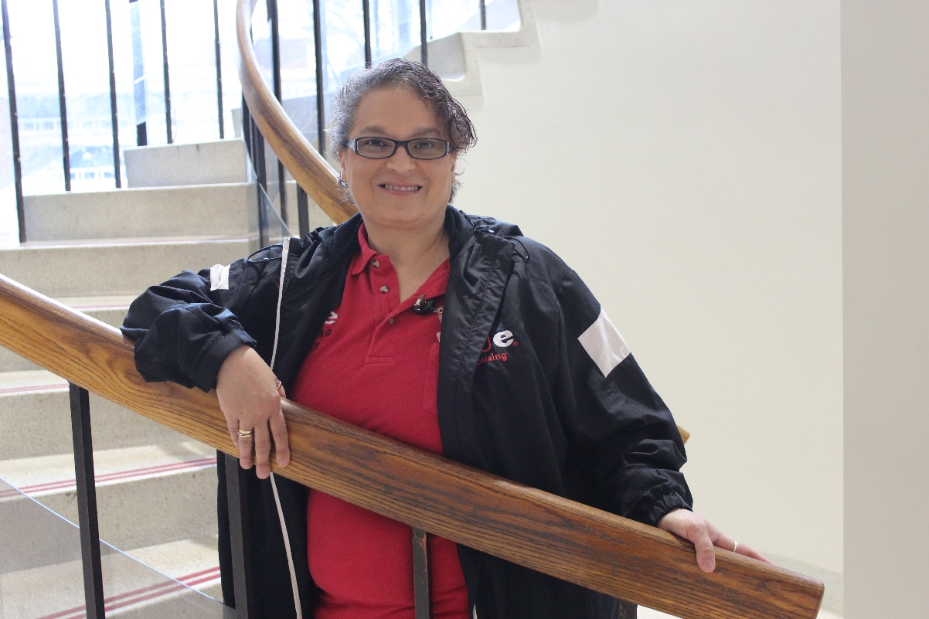
Wendy Bunker
20 Years of Service
University Housing

Slide 28
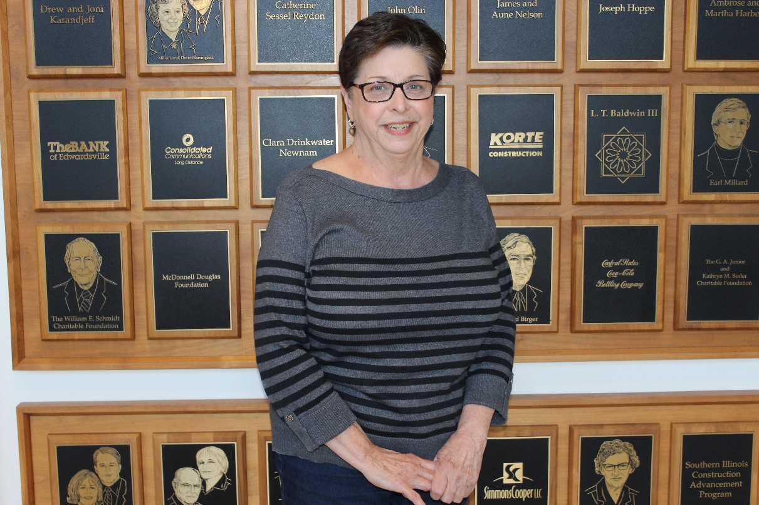
Sue Cavaletti
20 Years of Service
Bursar
Psychology
Department

Slide 29
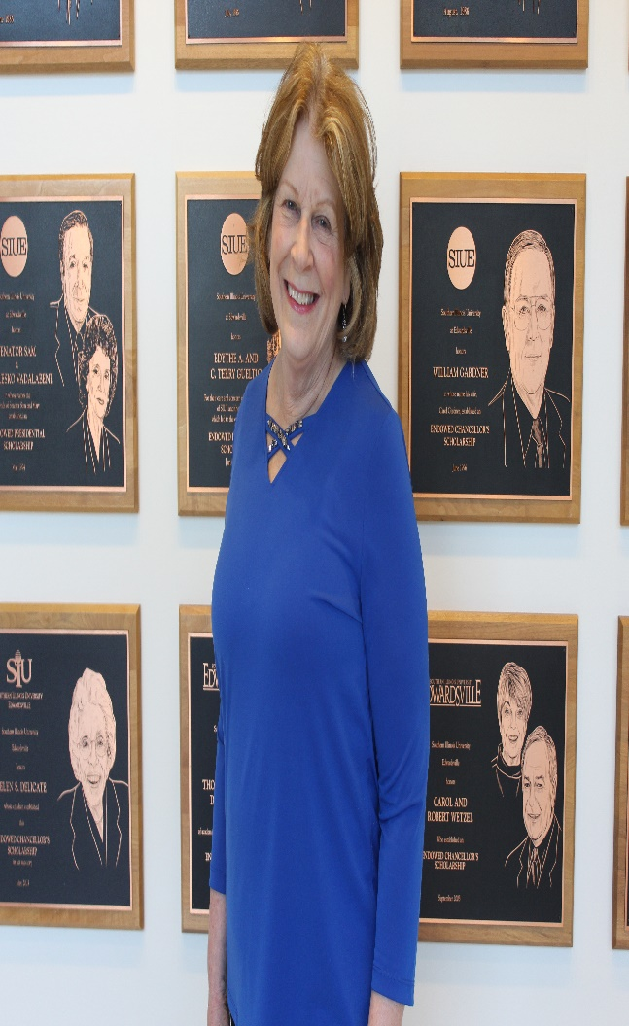
Diane Chappel
20 Years of Service
Office of Vice Chancellor for Administration

Slide 30
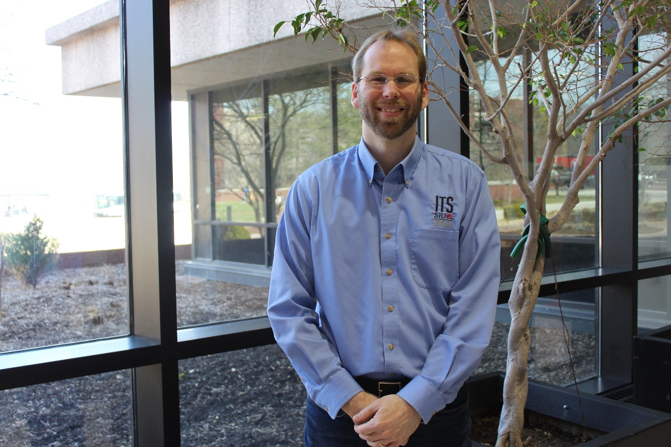
Kade Cole
20 Years of Service
Information Technology Services

Slide 31
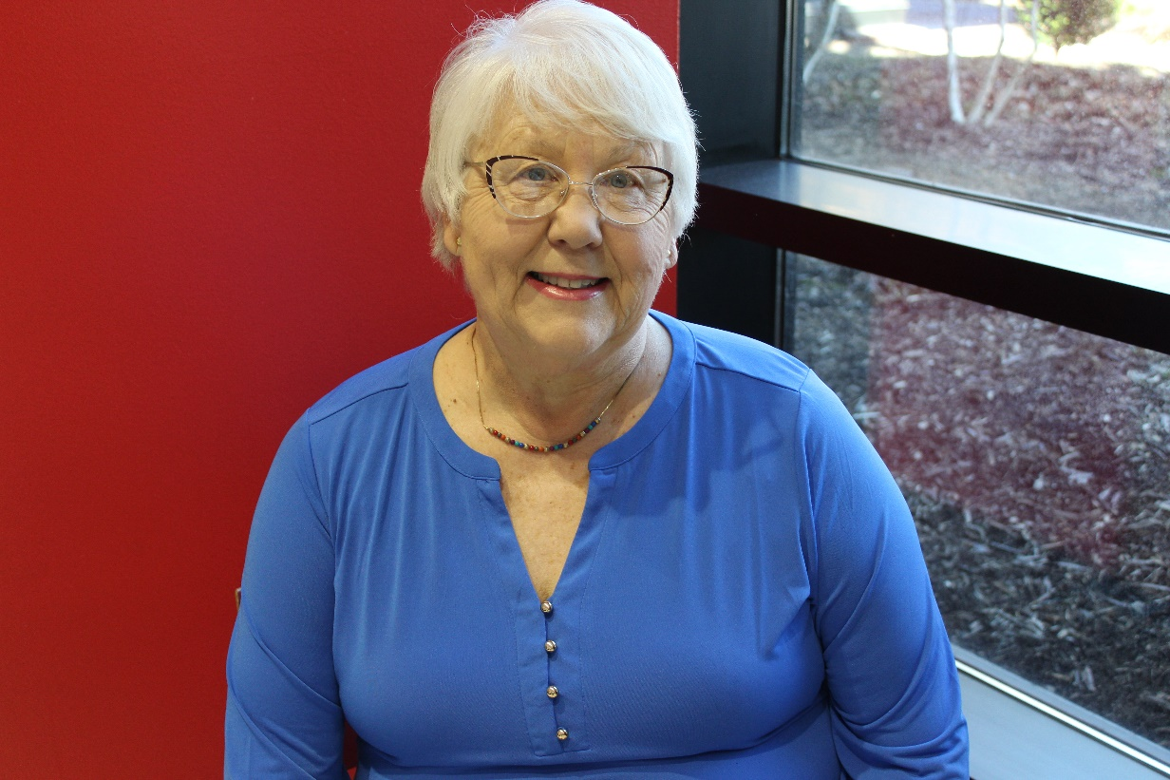
Veronica Corradini
20 Years of Service
Bursar

Slide 32
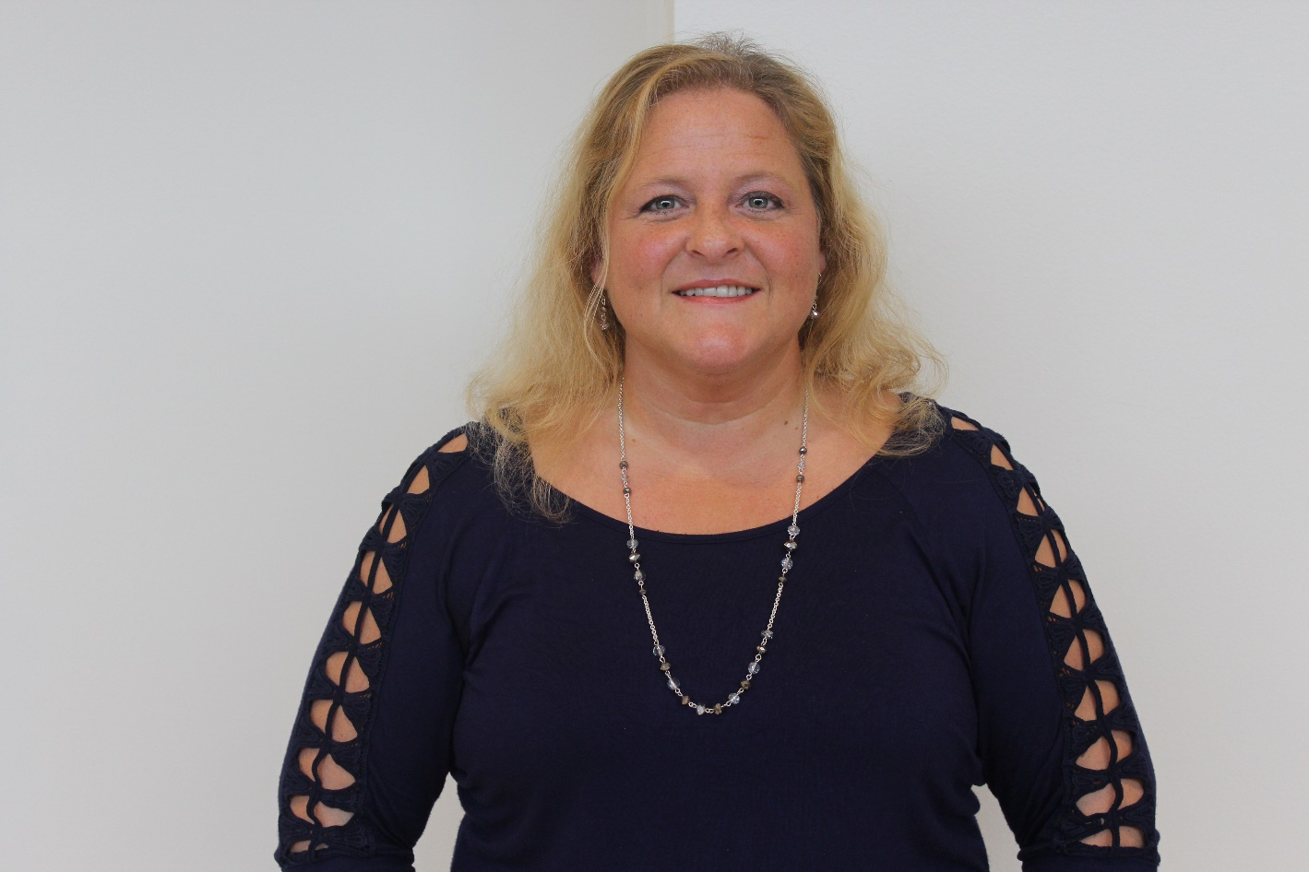
Xanthe Emerick
20 Years of Service
Registrar

Slide 33
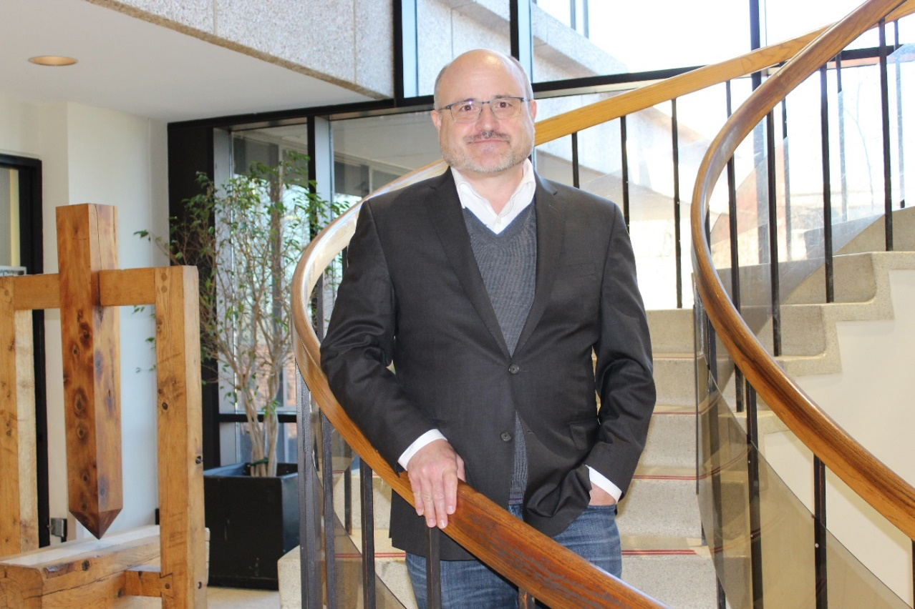
Dr. Gary Hicks
20 Years of Service
Mass Communications

Slide 34
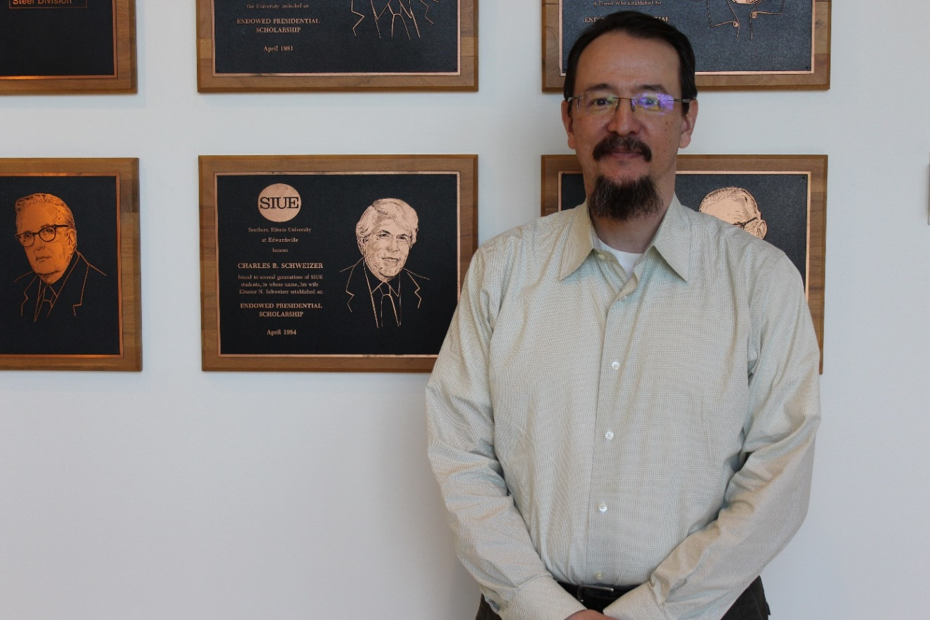
Michael Huddle
20 Years of Service
Information Technology Services

Slide 35
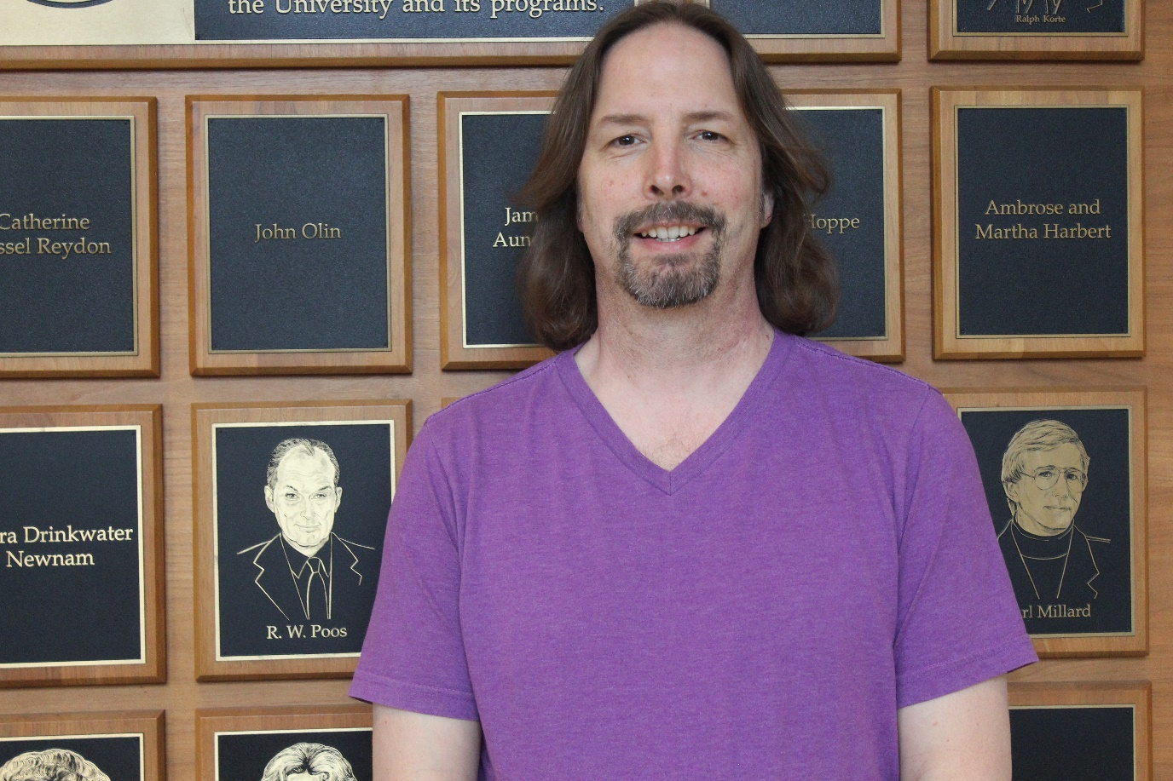
Steve Klein
20 Years of Service
Computer Science

Slide 36
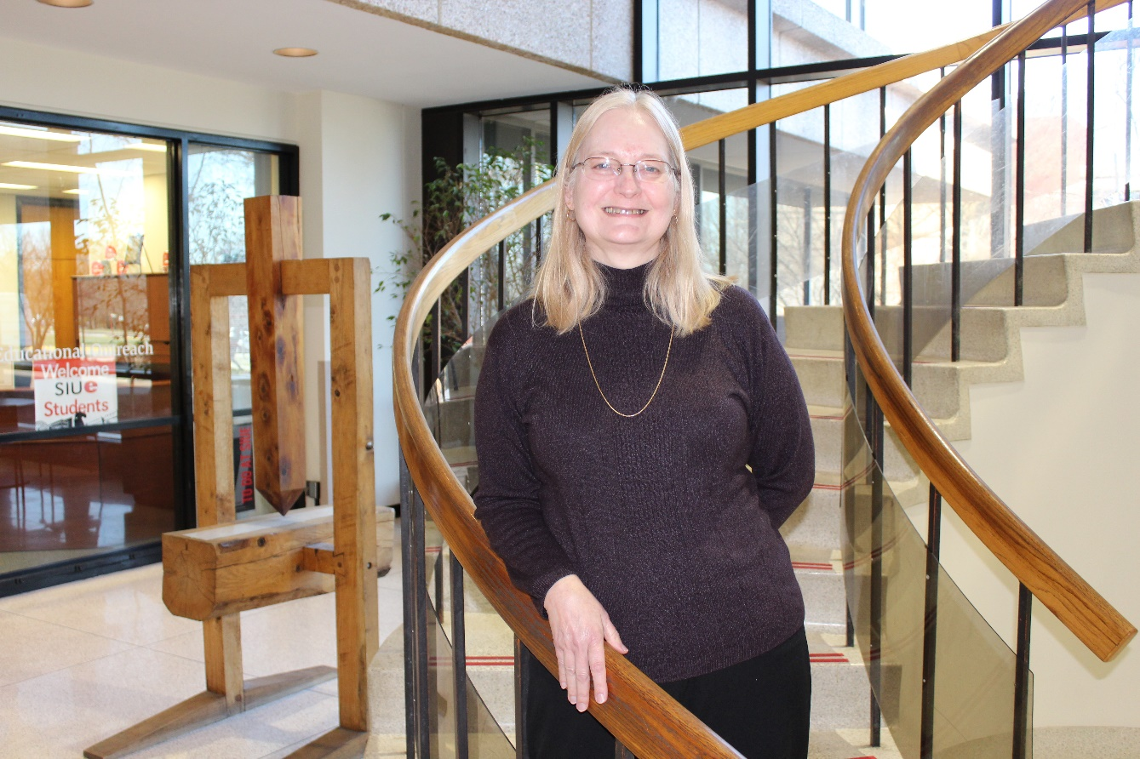
Patti Koertge
20 Years of Service
Administrative Accounting

Slide 37
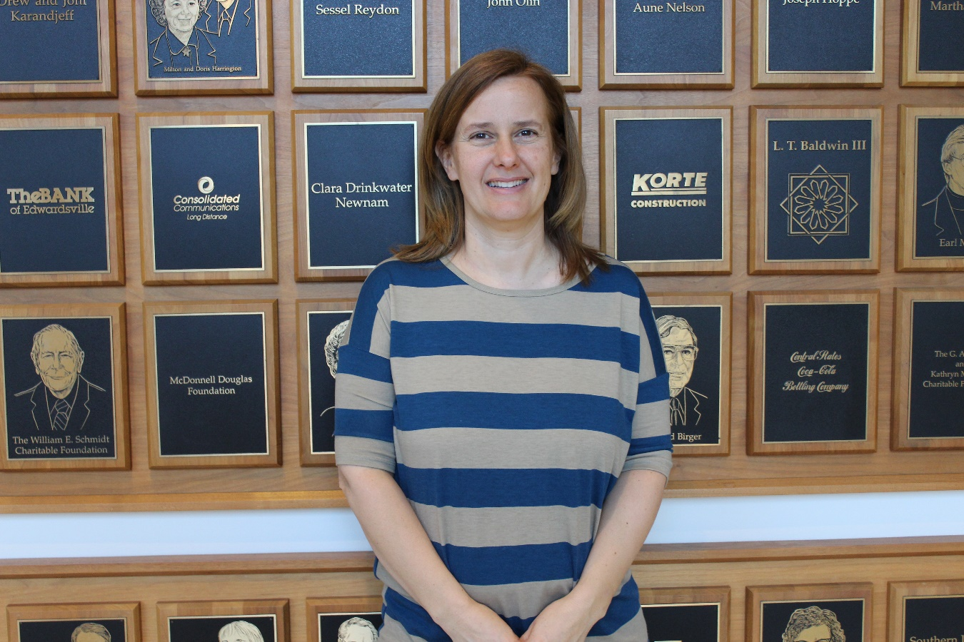
Trisha McCulloch
20 Years of Service
Early Childhood Center

Slide 38
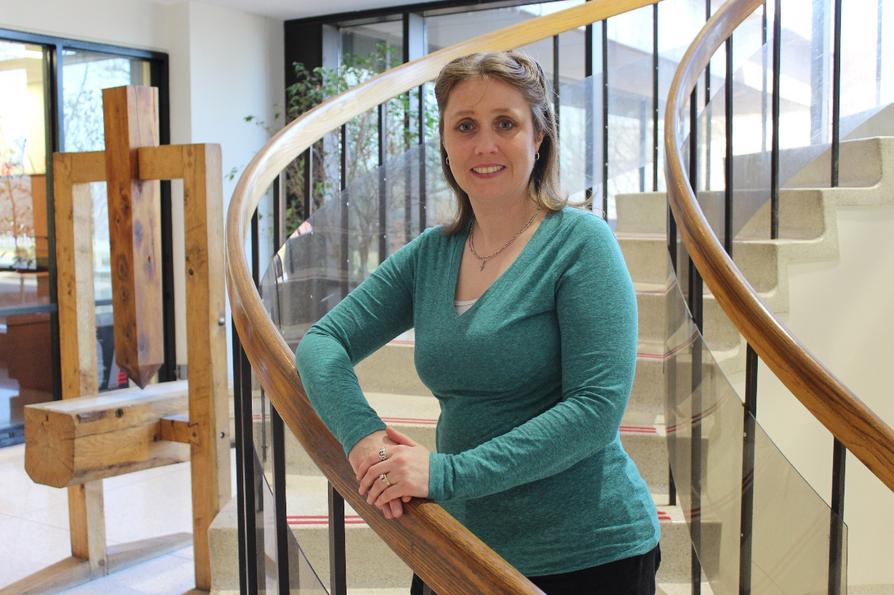
Christy McDougal
20 Years of Service
MUC Business Office

Slide 39
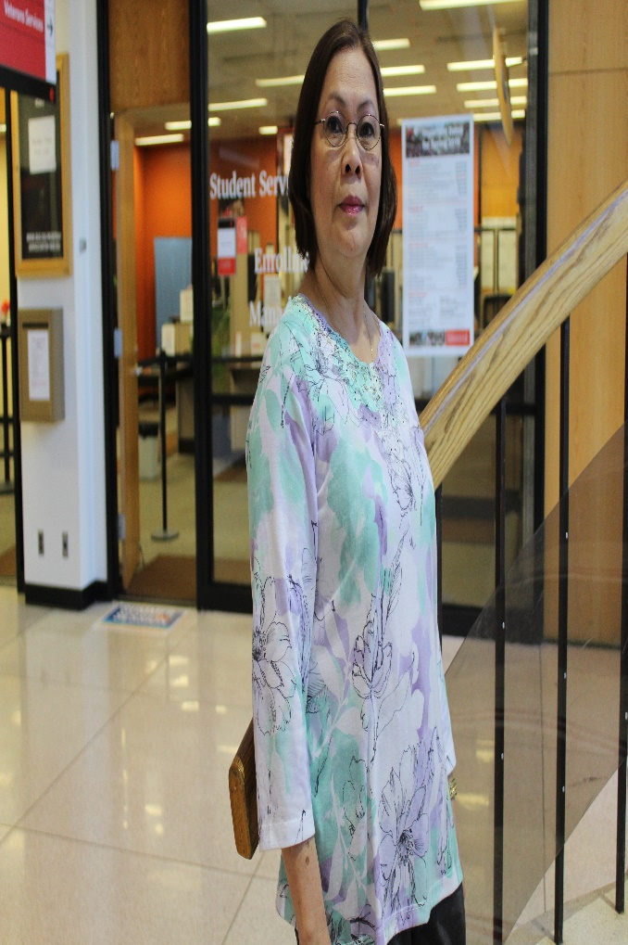
Josephine Morris
20 Years of Service
Mass Communications

Slide 40
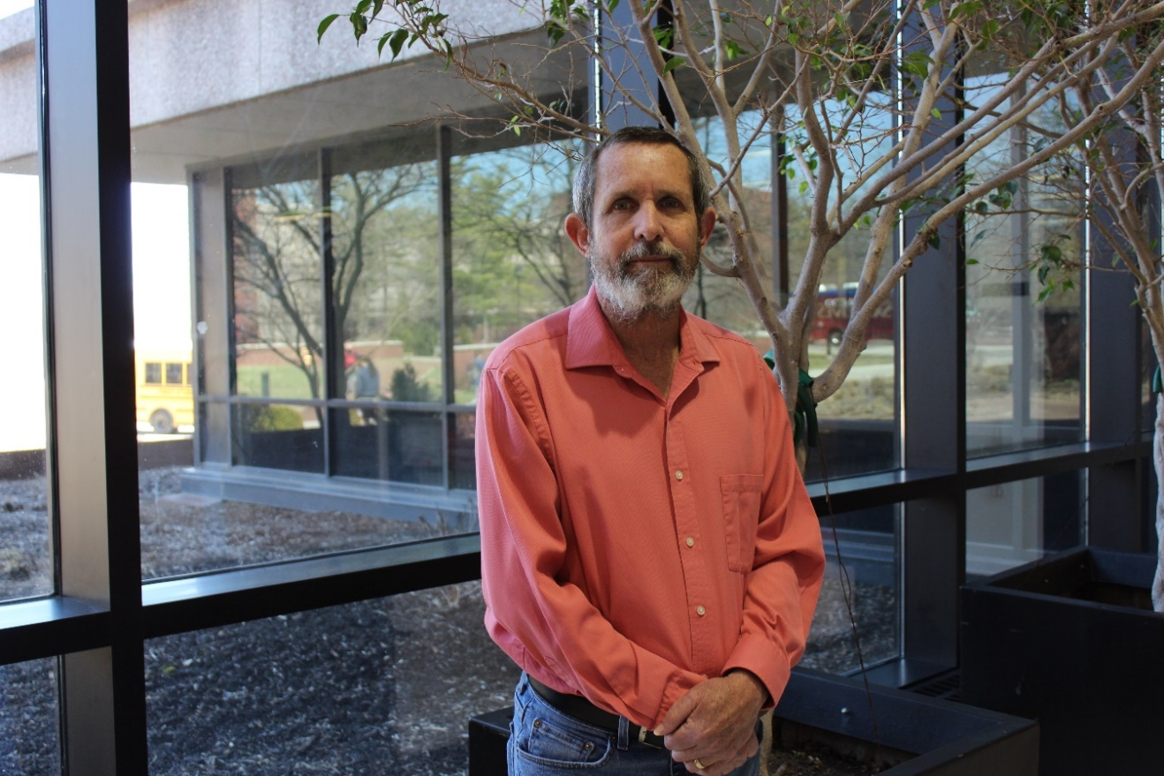
Dr. Jerry O'Brien
20 Years of Service
Social Work

Slide 41
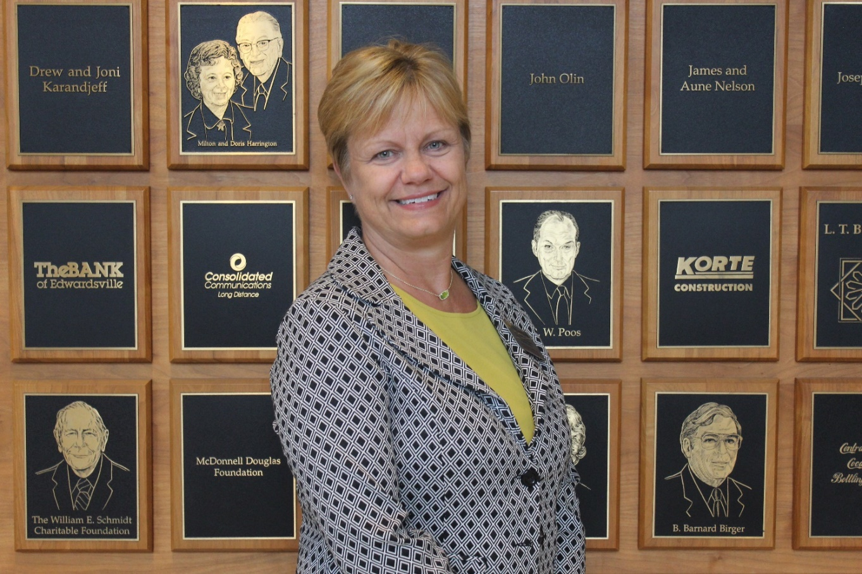
Dr. Ann Popkess
20 Years of Service
School of Nursing

Slide 42
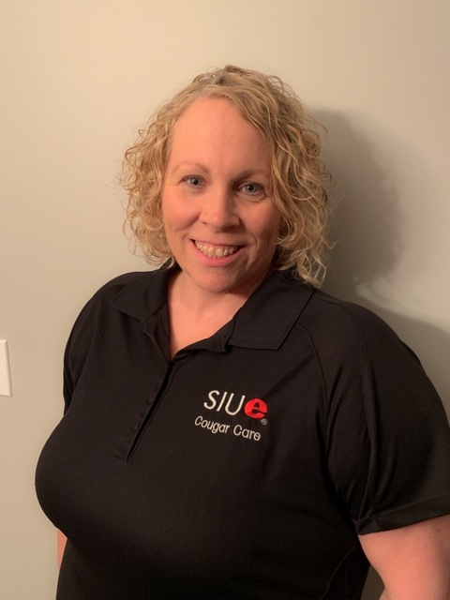
Angela Pulliam
20 Years of Service
Health Services

Slide 43
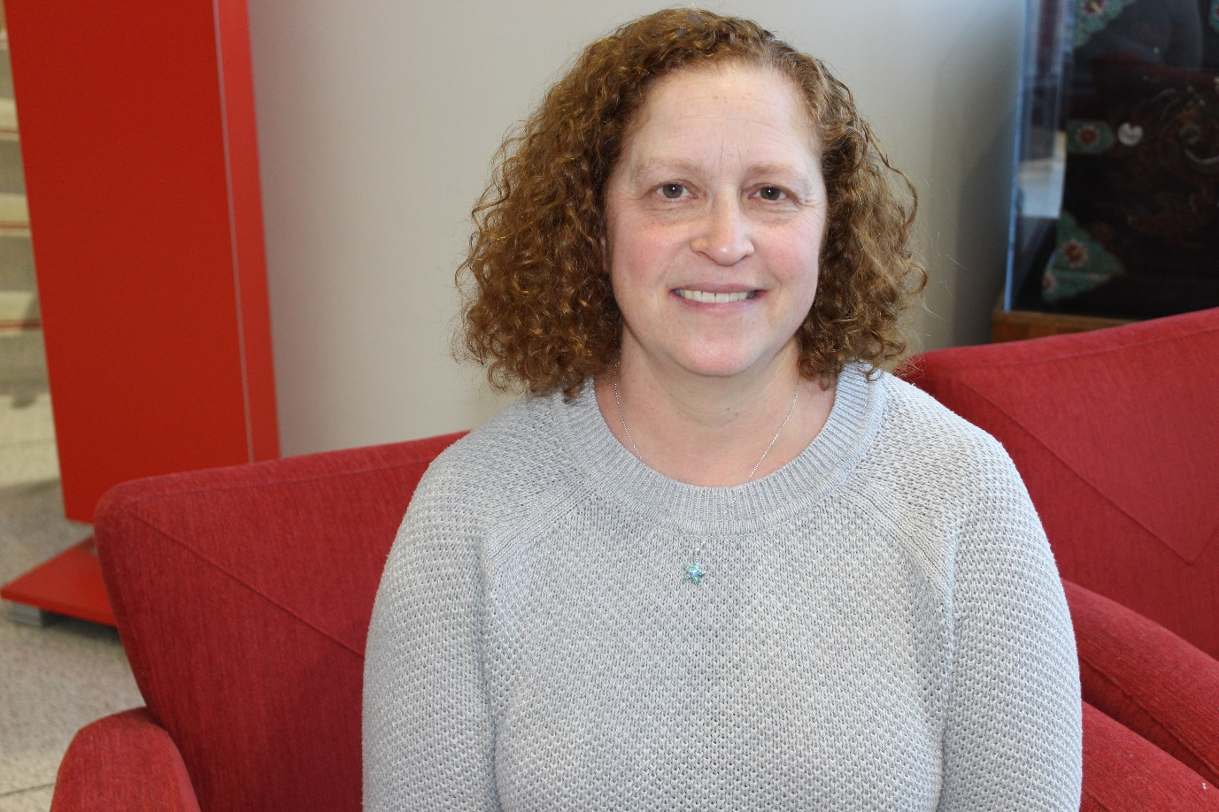
Dr. Allison Thomason
20 Years of Service
Historical Studies

Slide 44
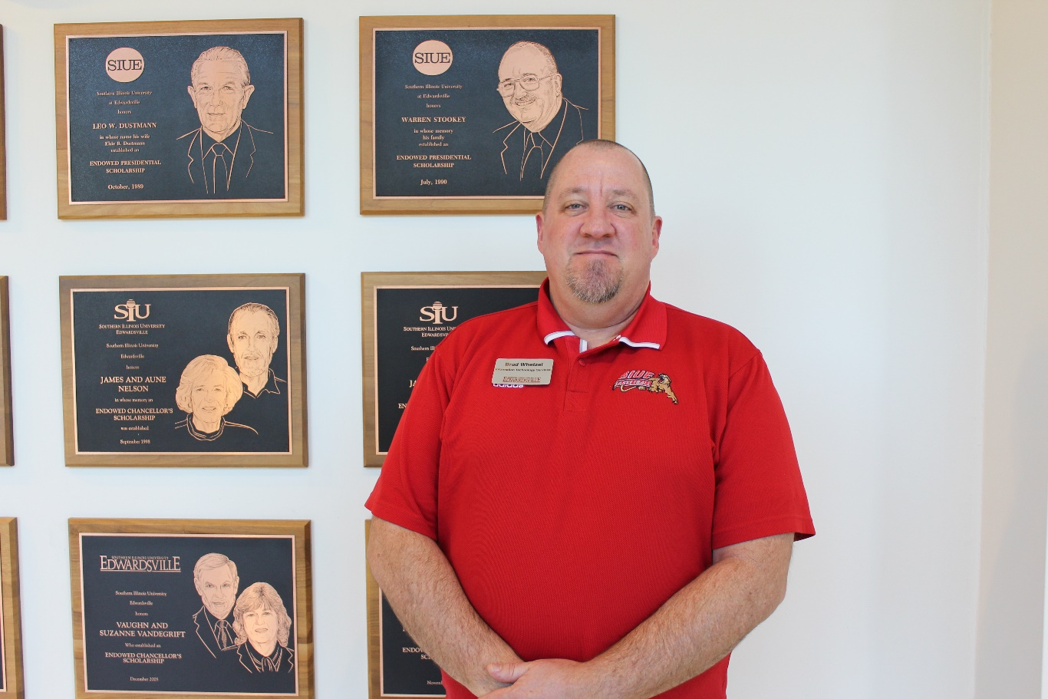
Brad Whetzel
20 Years of Service
Information Technology Services

Slide 45
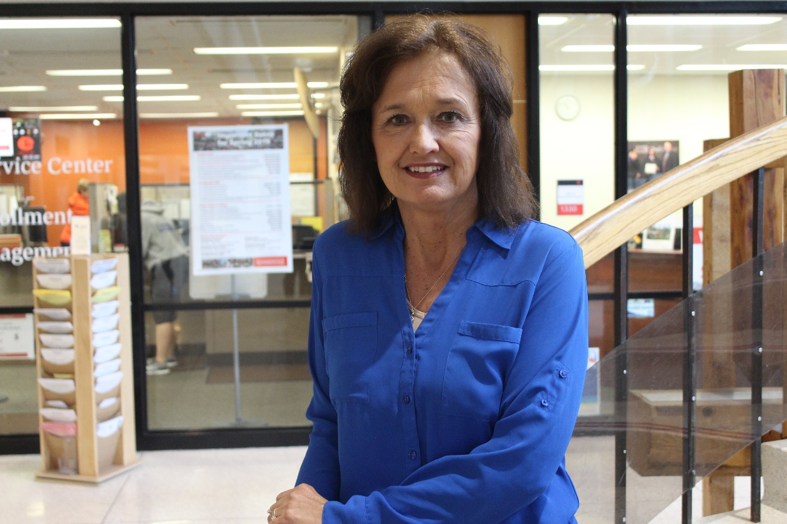
Beth Winet
20 Years of Service
Bursar

Slide 46
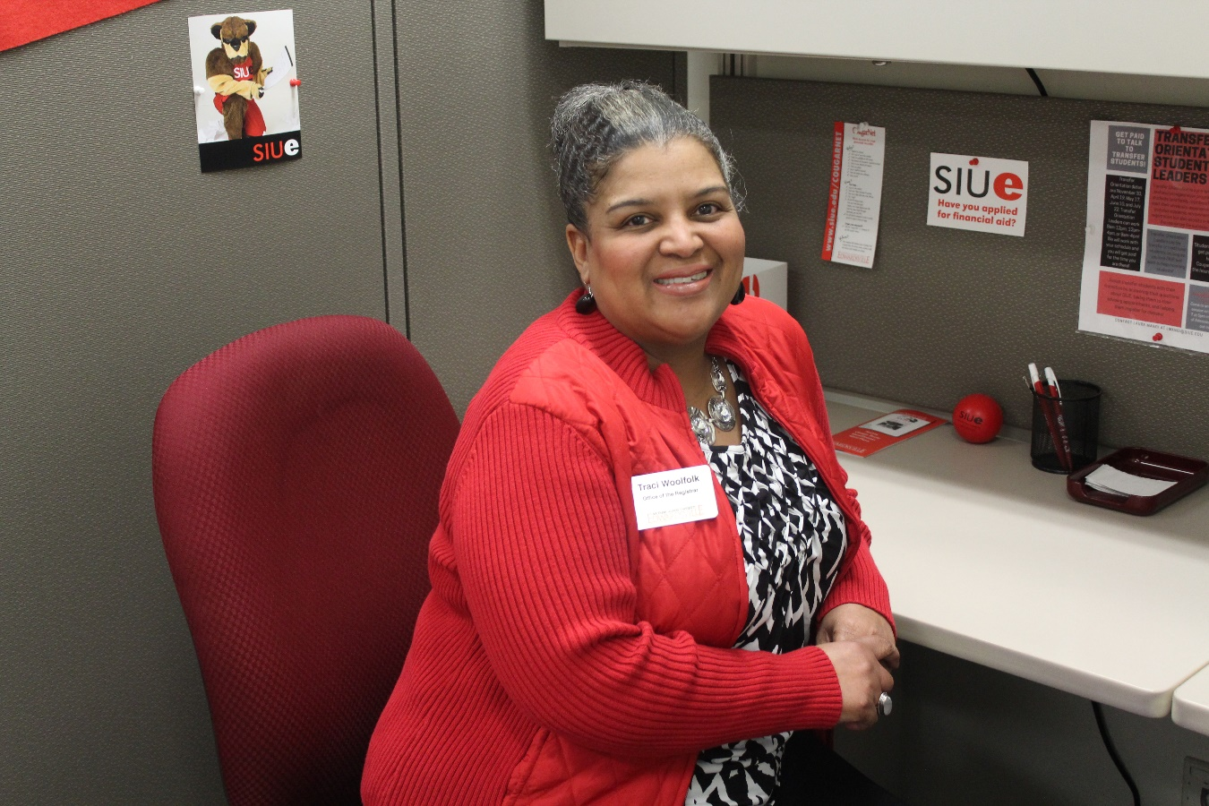
Traci Woolfolk
20 Years of Service
Registrar

Slide 47
25 Year
Service Award
Honorees

Slide 48
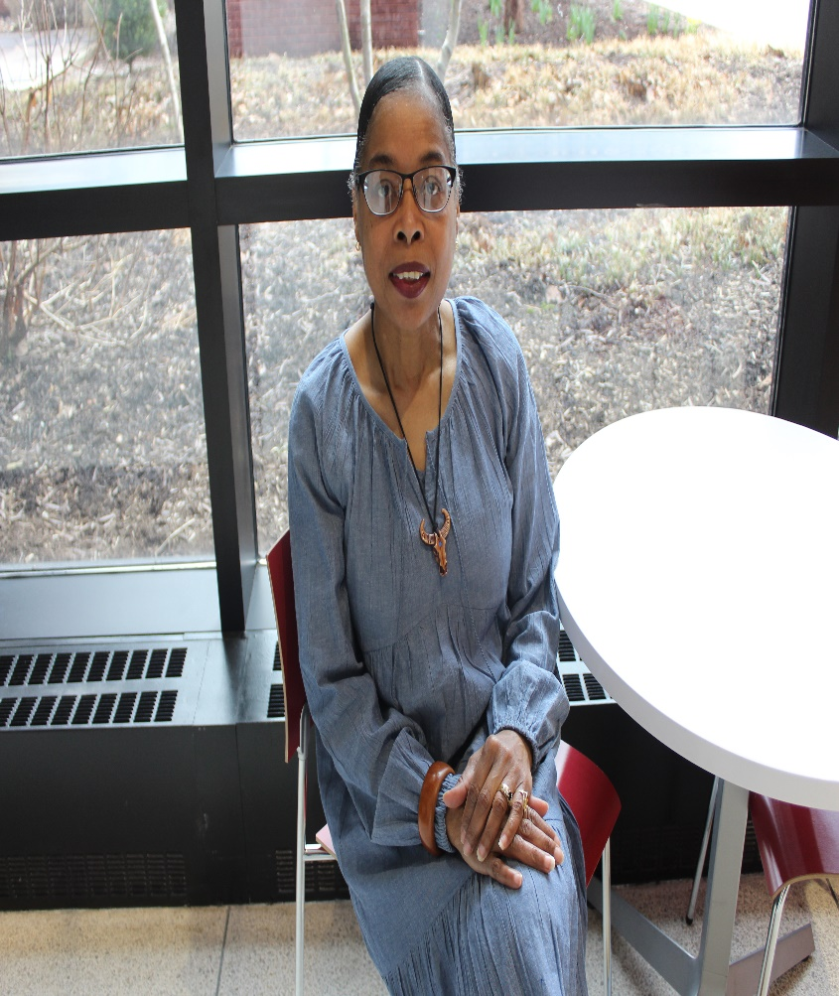
Lollie Cotten
25 Years of Service
Head Start

Slide 49
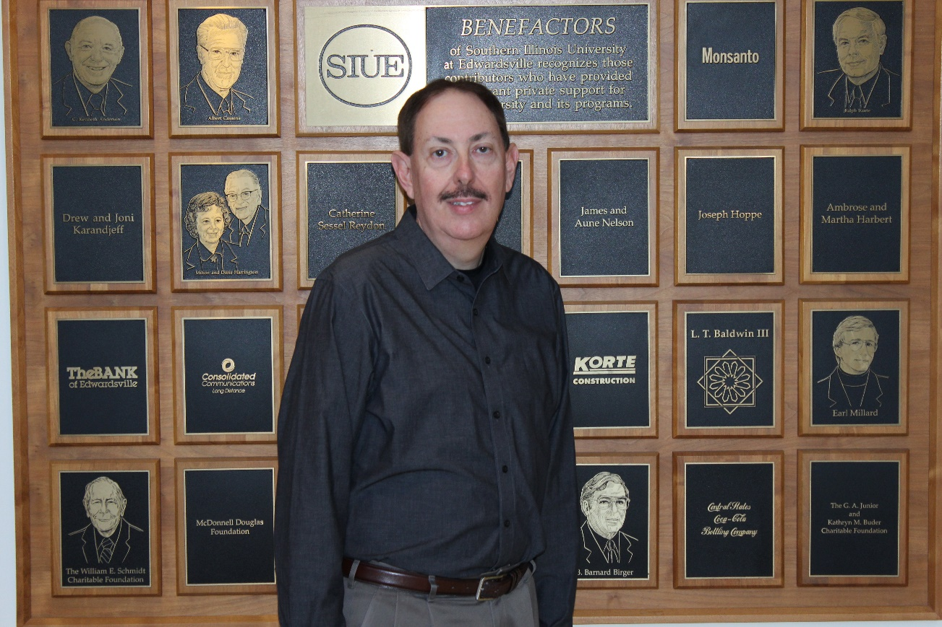
Dr. George Engel
25 Years of Service
Electrical & Computer Engineering

Slide 50
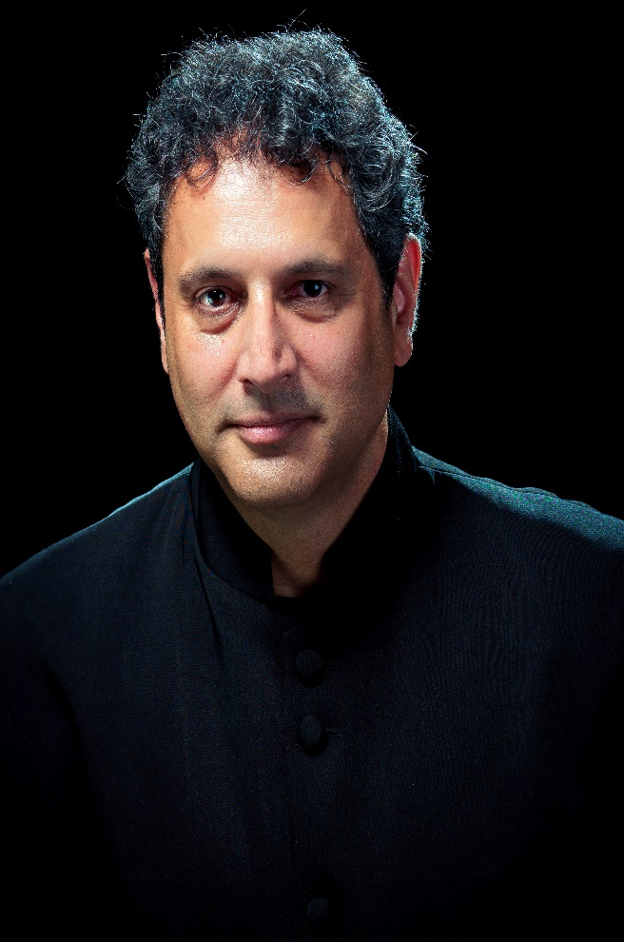
Dr. Michael Mishra
25 Years of Service
Music

Slide 51
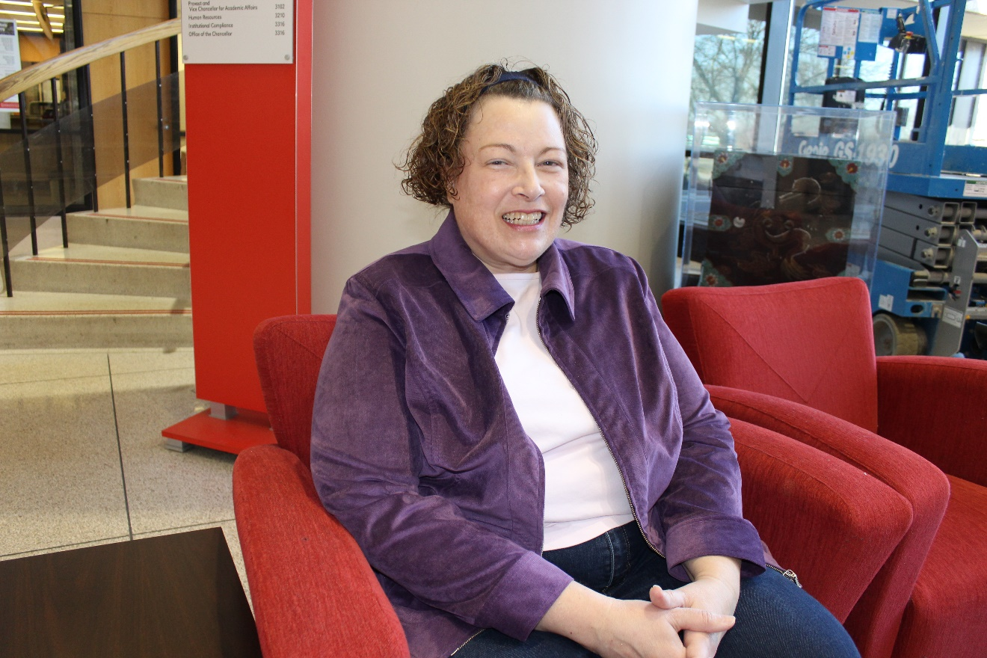
Annette Musenbrock
25 Years of Service
Mathematics &
Statistics

Slide 52
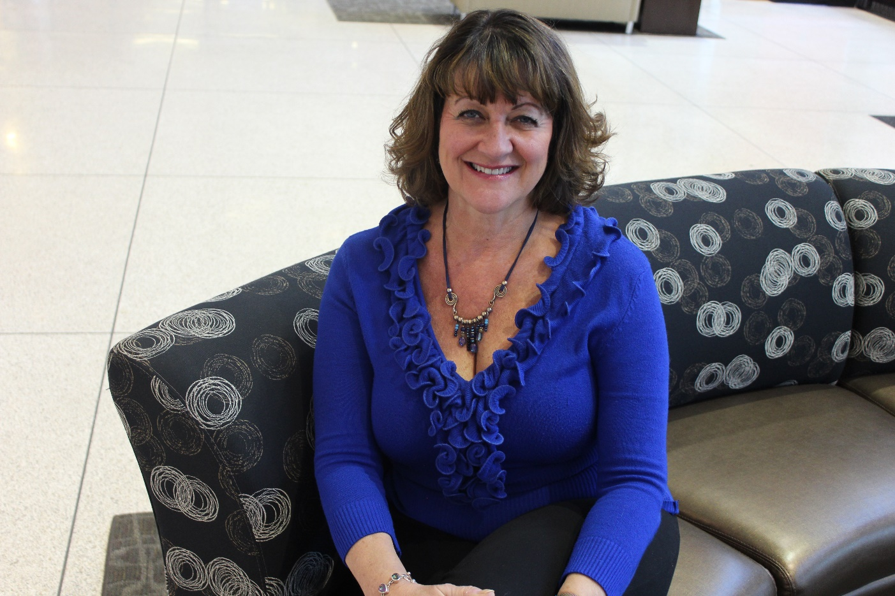
Dr. Catherine Santanello
25 Years of Service
School of Pharmacy

Slide 53
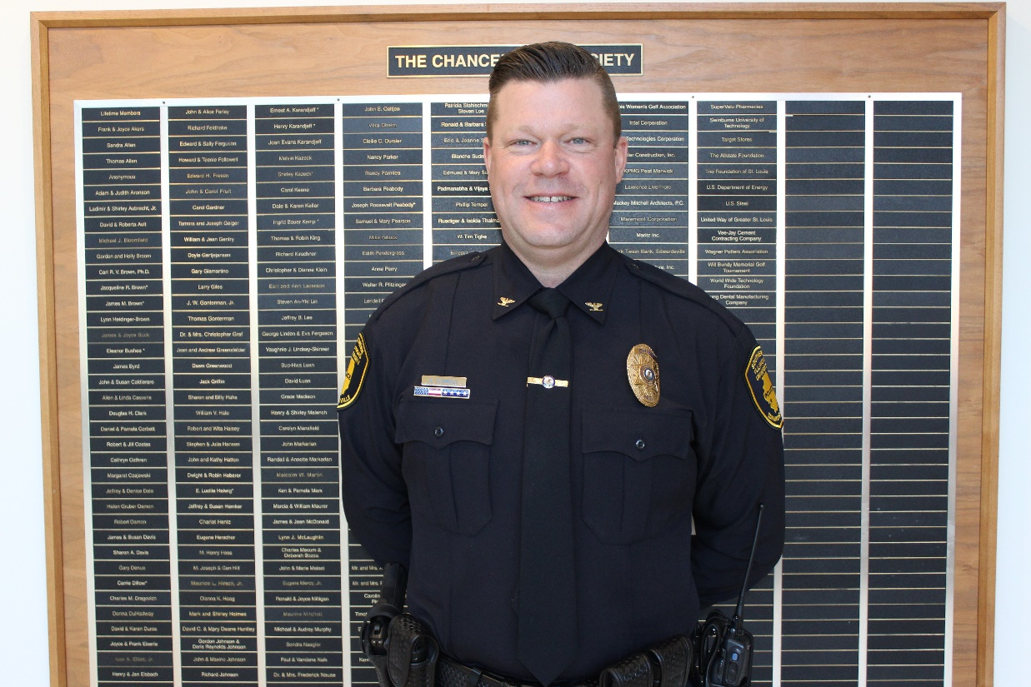
Chief Kevin Schmoll
25 Years of Service
Police Services

Slide 54
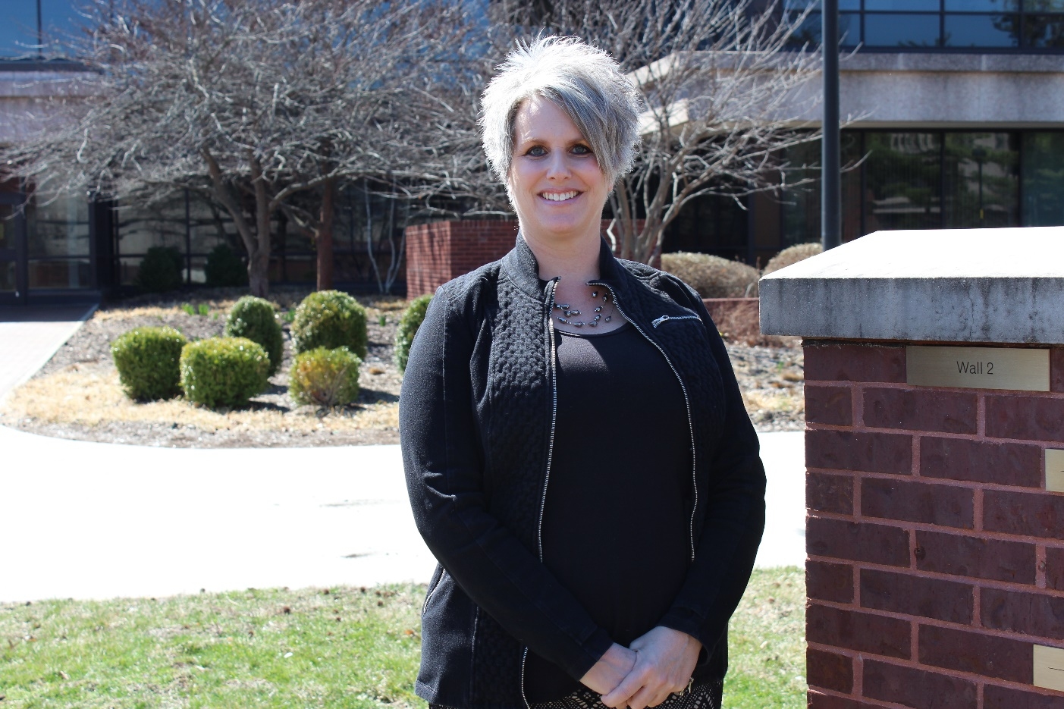
Kara Shustrin
25 Years of Service
Office of the Vice Chancellor of Student Affairs

Slide 55
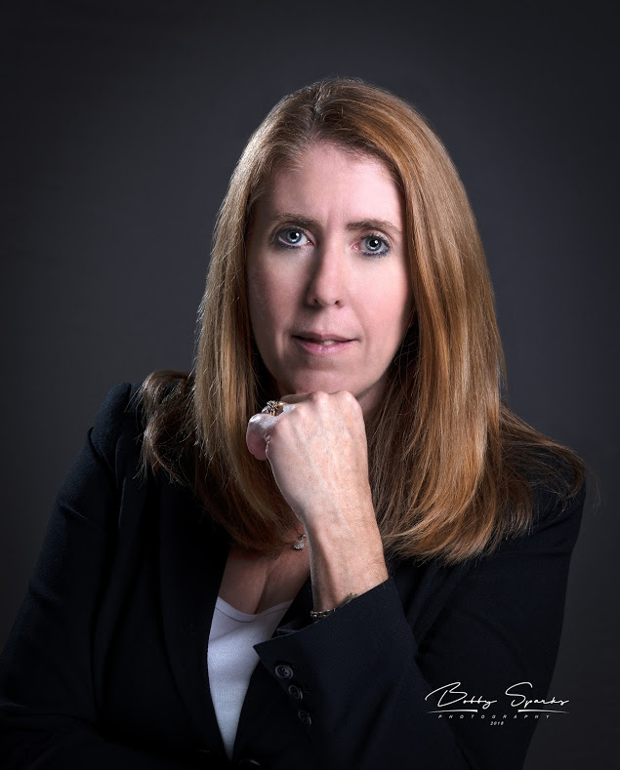
Dawn Sparks
25 Years of Service
Bursar

Slide 56
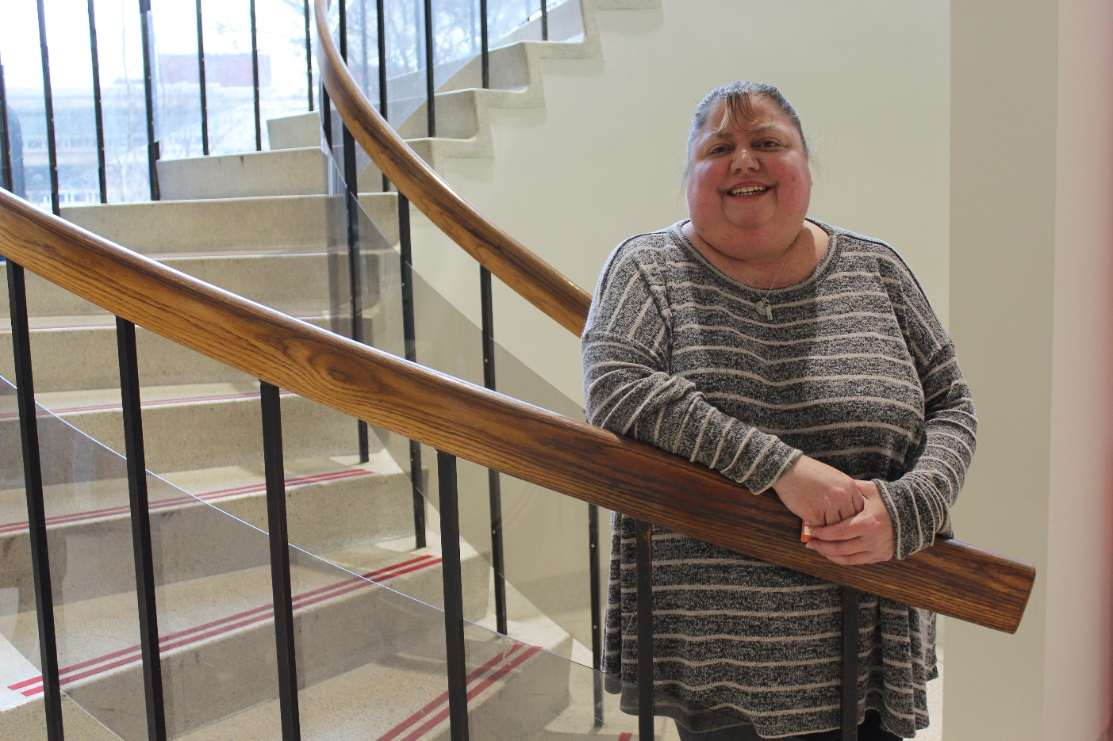
Tracy Wall
25 Years of Service
Student Financial Aid

Slide 57
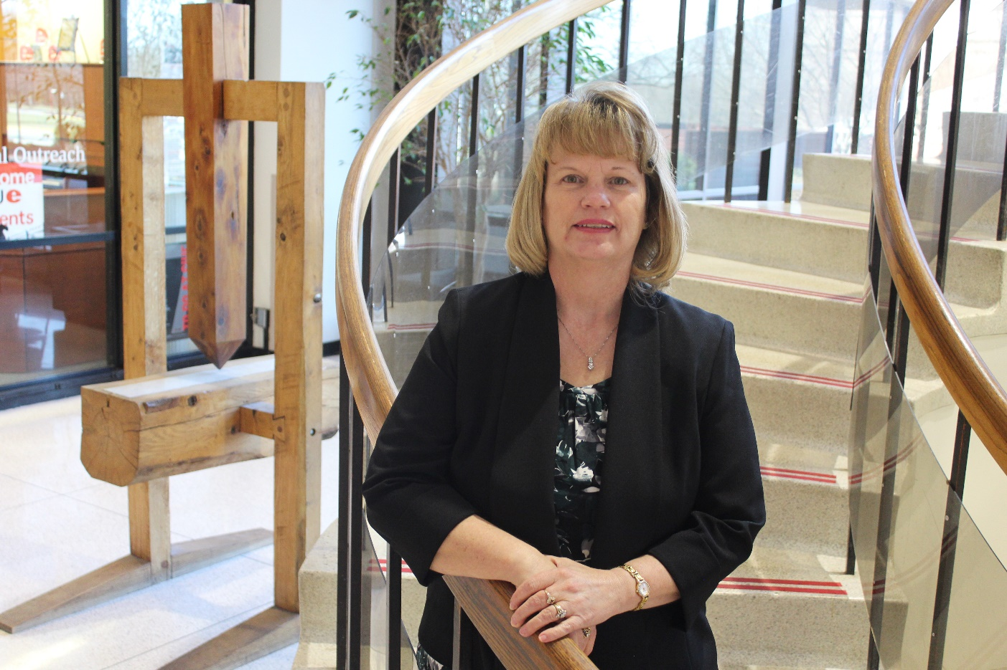
Angela White
25 Years of Service
Education, Health & Human Behavior

Slide 58
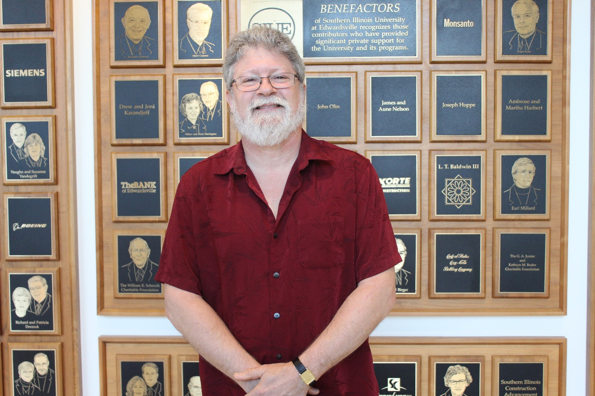
Dr. Duff Wrobbel
25 Years of Service
Applied Communication Studies

Slide 59
30 Year
Service Award
Honorees

Slide 60
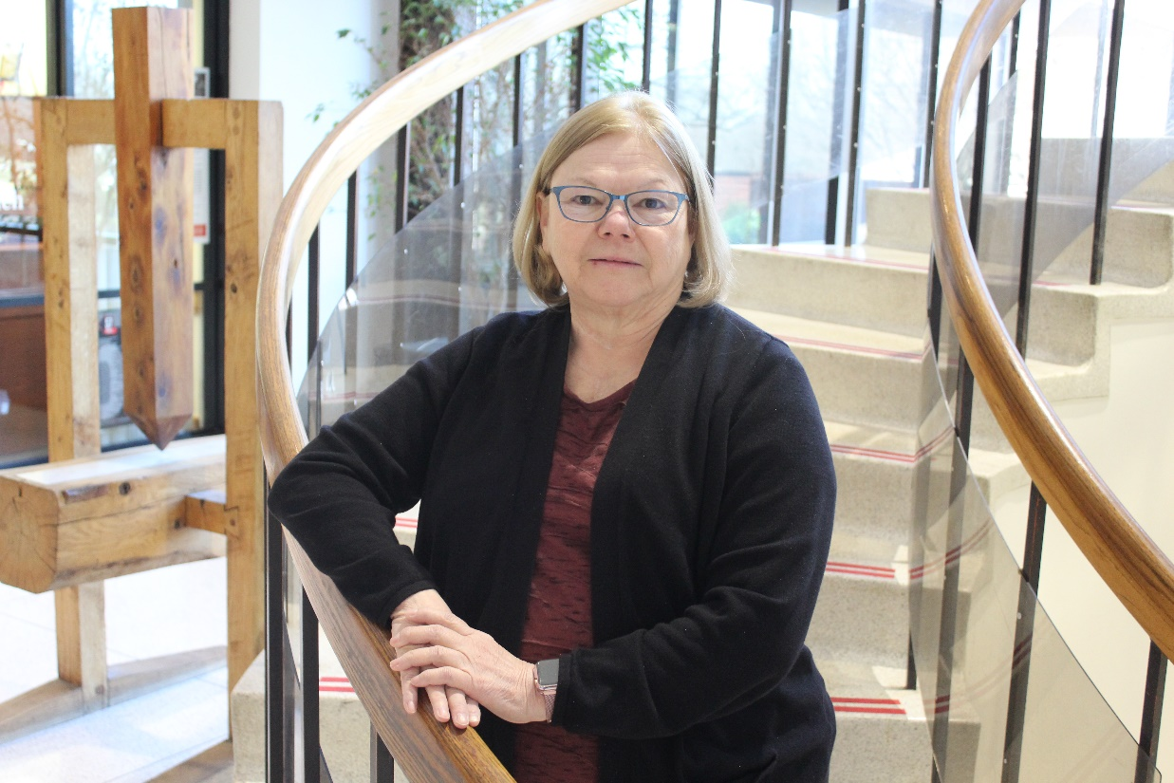
Gail Erb
30 Years of Service
Student Financial Aid

Slide 61
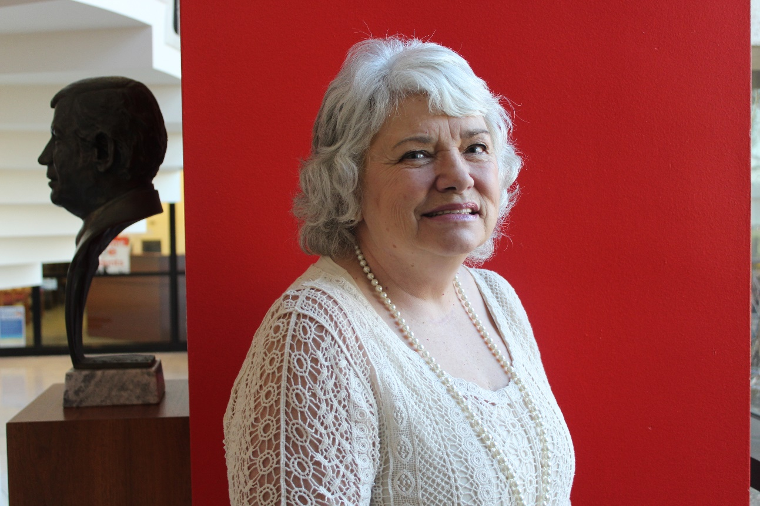
Linda Hahn
30 Years of Service
Student Financial Aid

Slide 62
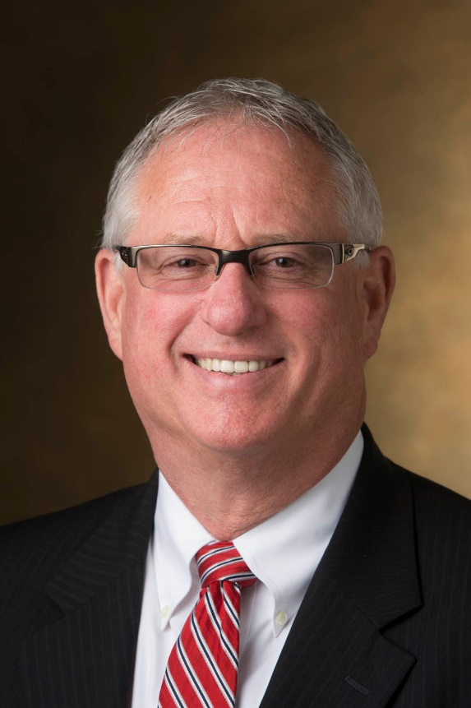
Dr. Brad Hewitt
30 Years of Service
Intercollegiate Athletics

Slide 63
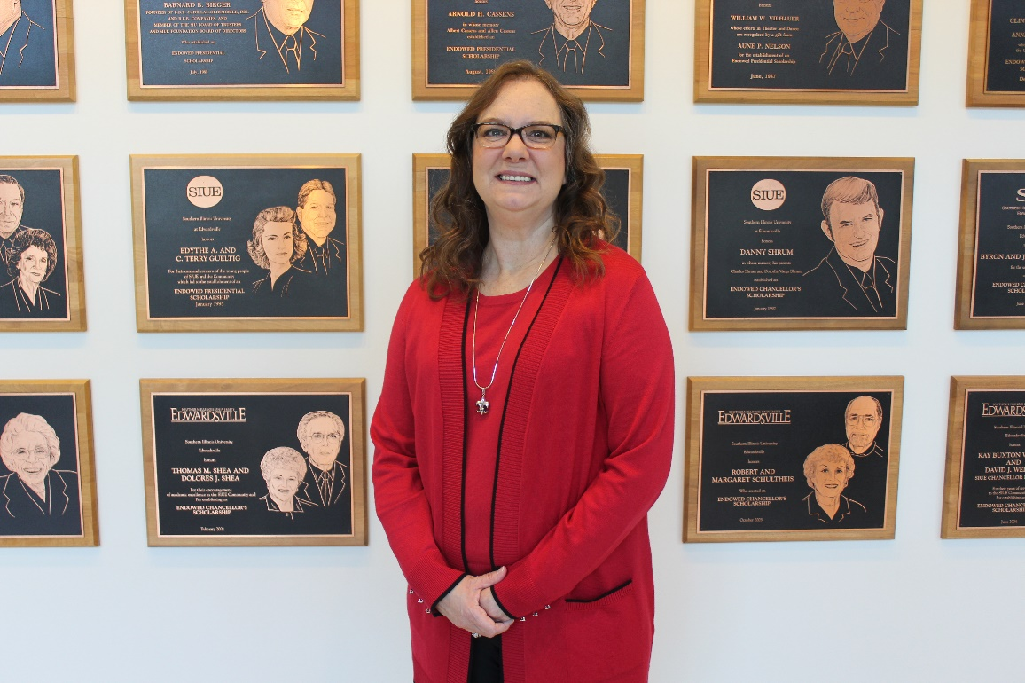
Sally Mullen
30 Years of Service
Student Financial Aid

Slide 64
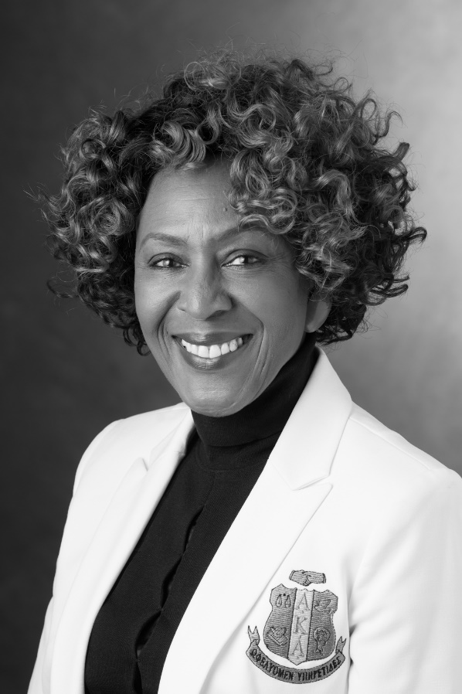
Dr. Earleen Patterson
30 Years of Service
Student Opportunities for Academic Results

Slide 65
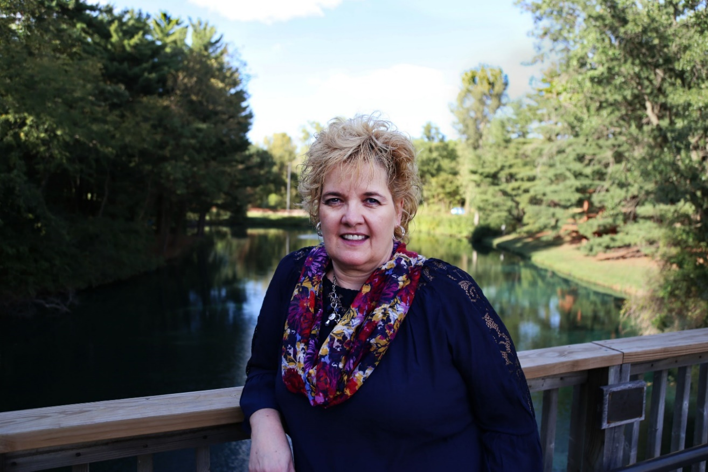
Mary Kay Rehkemper
30 Years of Service
Office of the Vice Chancellor of Administration

Slide 66
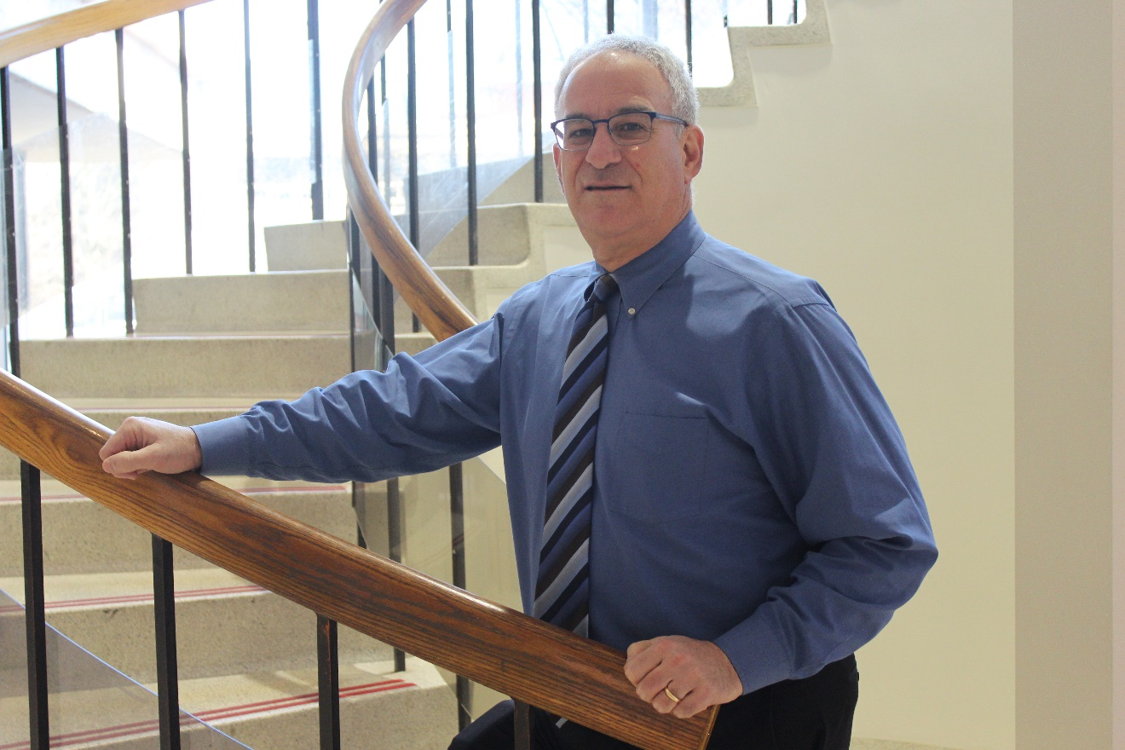
Michael Schultz
30 Years of Service
University Housing

Slide 67
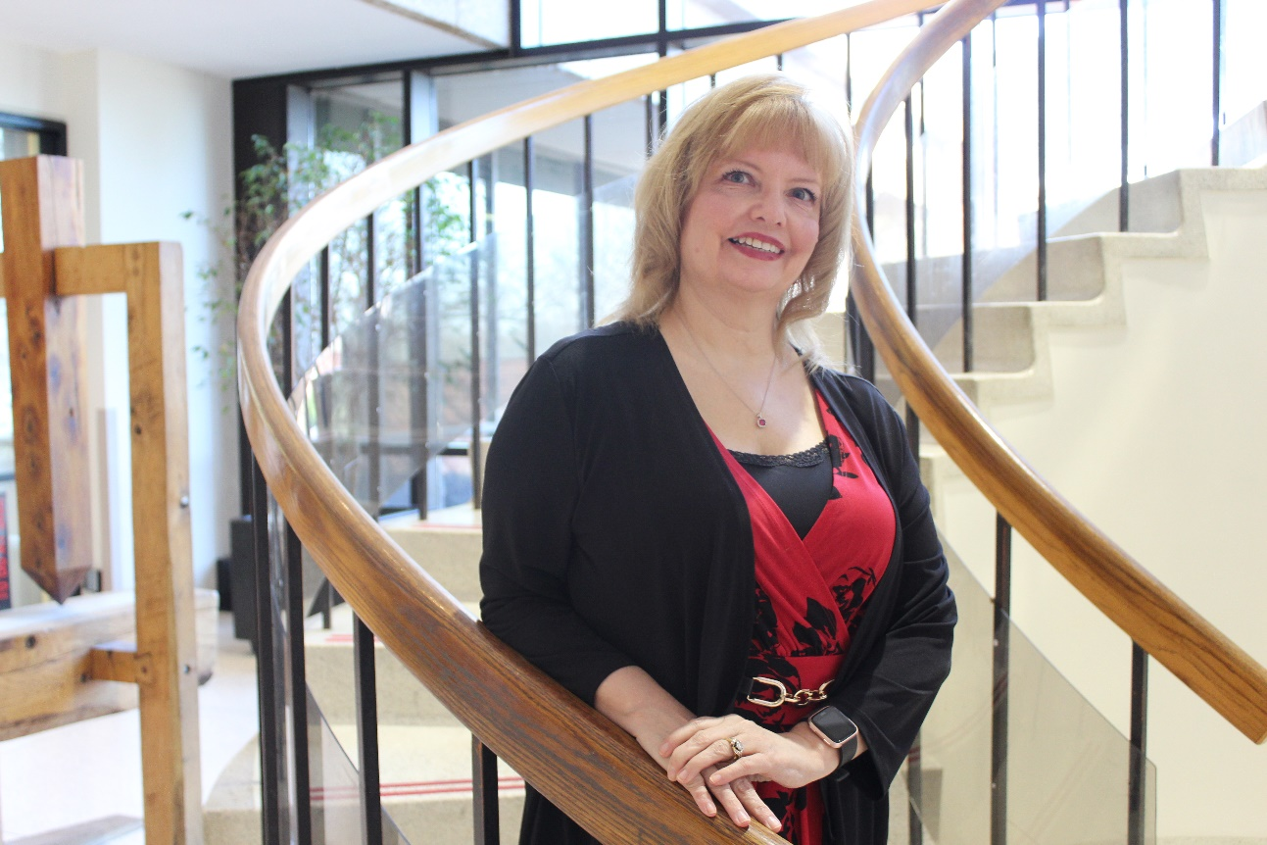
Toni Taylor
30 Years of Service
Student Financial Aid

Slide 68
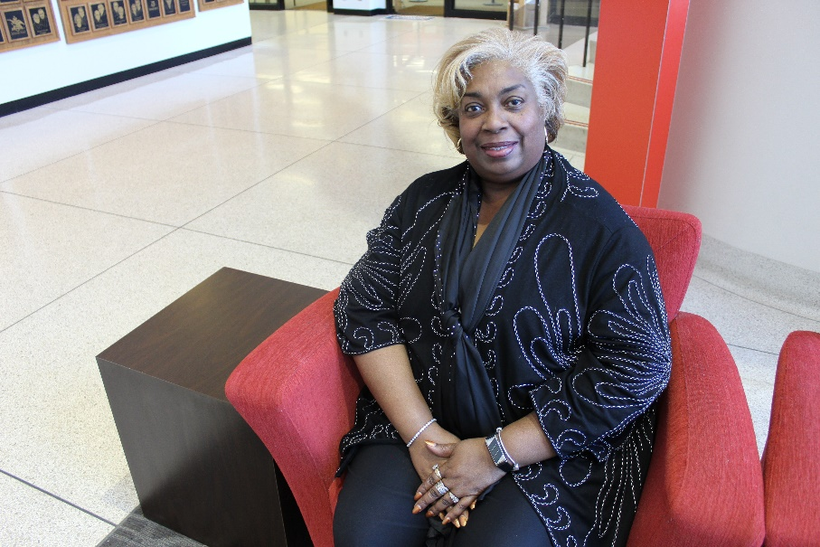
Curtiseena Wilson
30 Years of Service
Head Start

Slide 69
35 Year
Service Award
Honorees

Slide 70

Angela Cotton
35 Years of Service
Head Start

Slide 71

Edward Knowles
35 Years of Service
Information Technology Services

Slide 72

Shari Renken
35 Years of Service
Information Technology Services

Slide 73
Congratulations to all
Honorees!

