Slide 1
2018 Service Awards

Slide 2
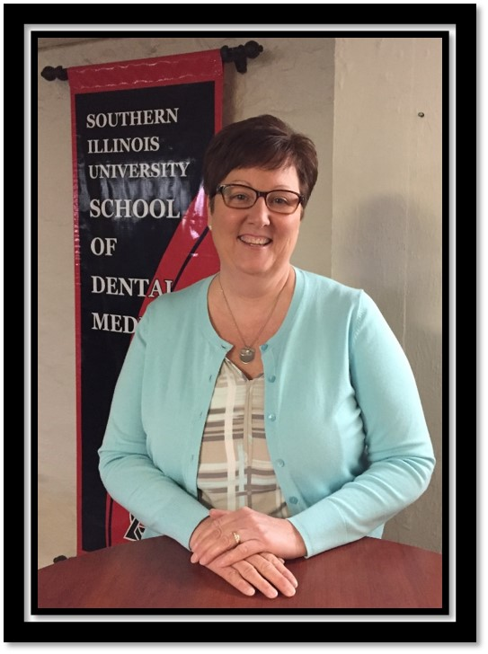
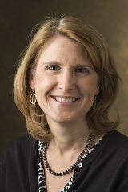
Employees of the Month
March 2017
February 2017
Lisa Landers
School of Dental Medicine
Gretchen Fricke
School of Education

Slide 3
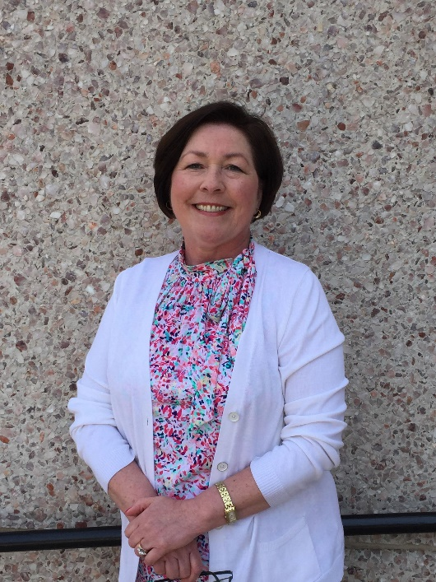
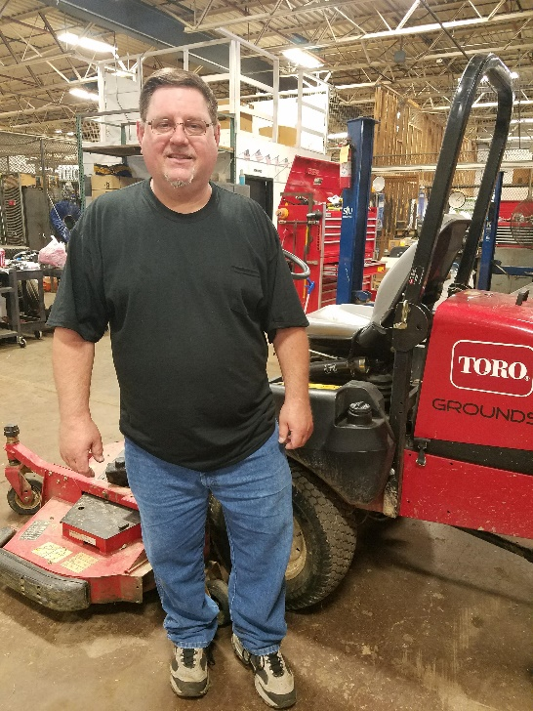
Employees of the Month
April 2017
May 2017
Janice Sunderland
CMIS and Accounting
Steve Varady
Facilities Management

Slide 4
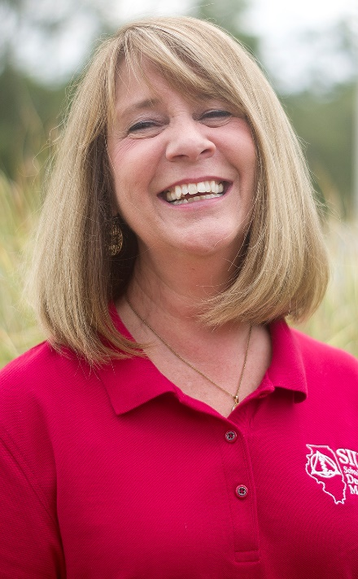
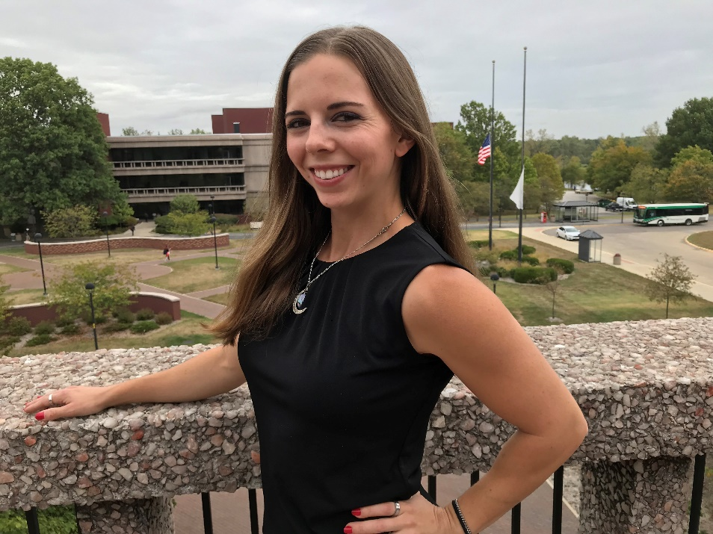
Employees of the Month
September 2017
October 2017
Bonnie Brueggemann
Human Resources
Julie Devine
School of Dental Medicine

Slide 5
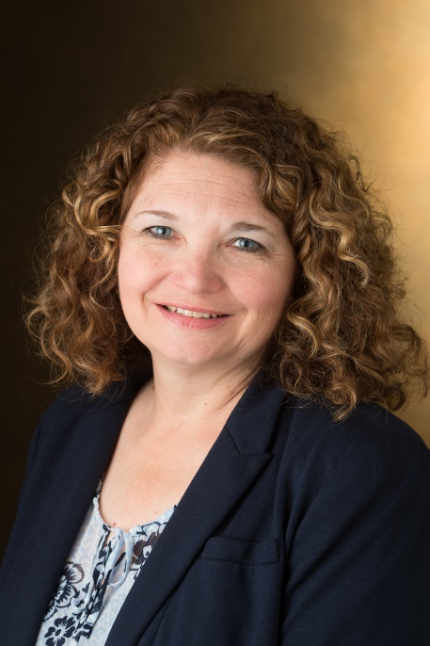
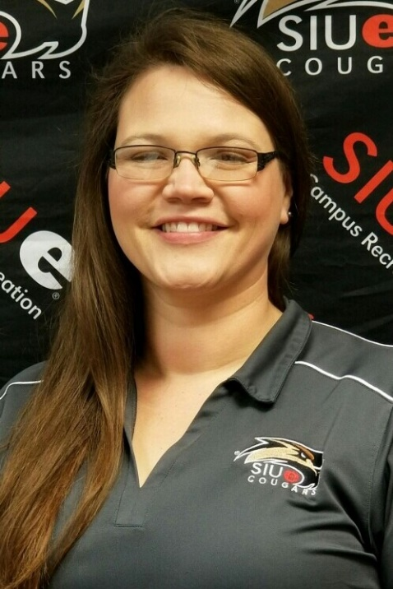
Employees of the Month
November 2017
December 2017
Denyse Anderson
Pharmacy
Nina Whiteside
Campus Recreation

Slide 6
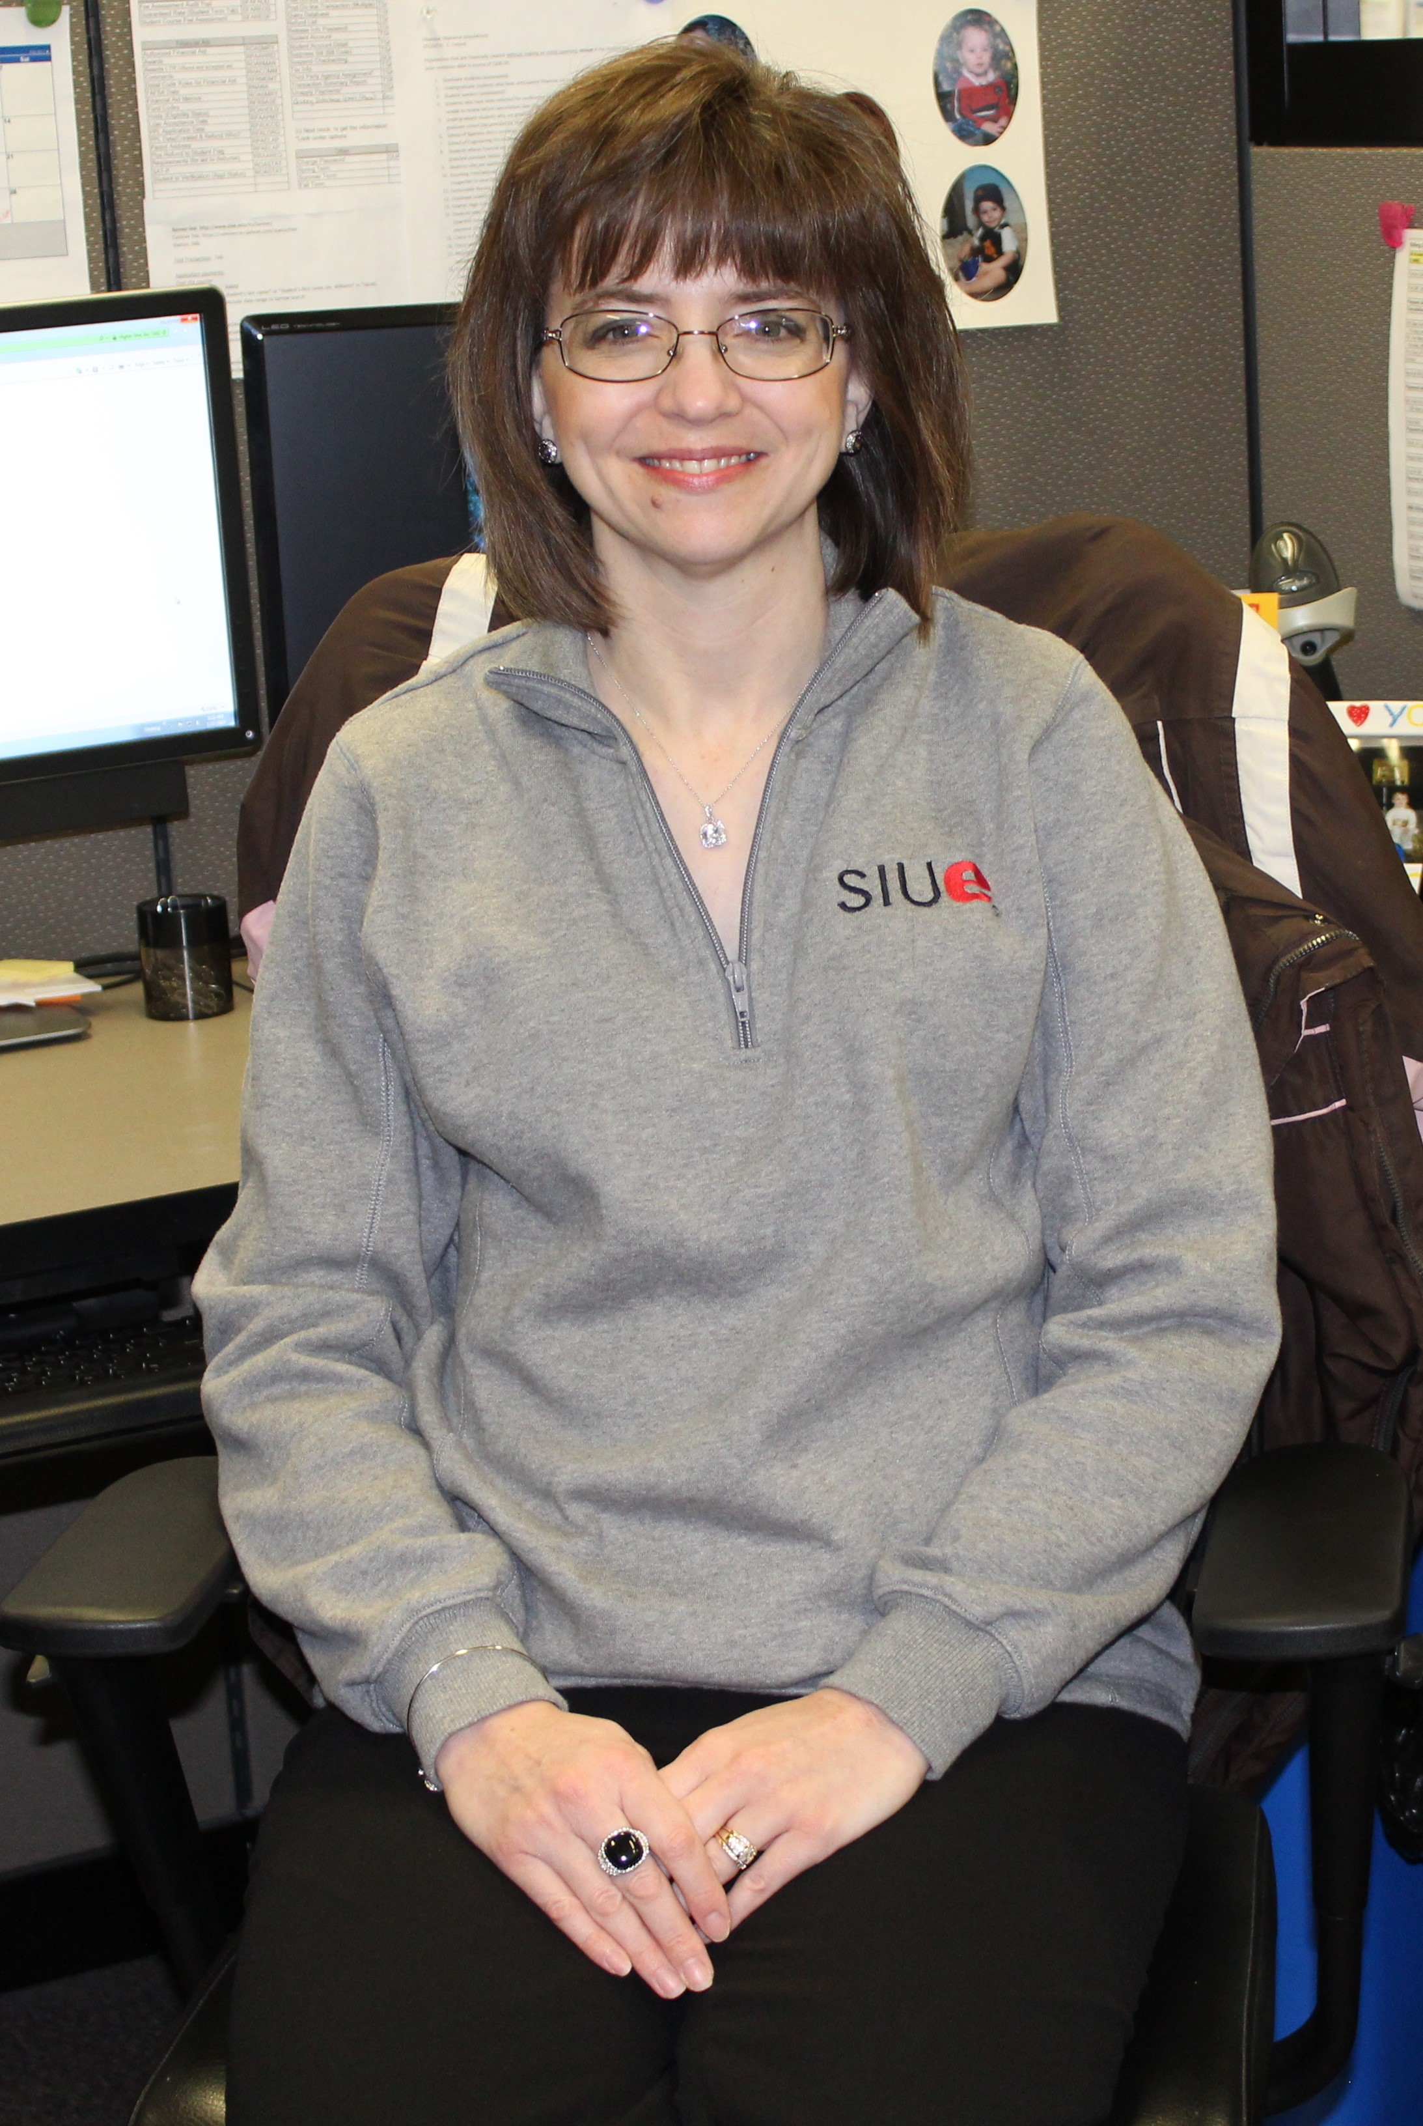
Employees of the Month
February 2018
Karen Straube
Bursar’s Office

Slide 7
Chancellor
Randy Pembrook
2018 Service Awards
Address

Slide 8
10 Year
Service Award
Honorees

Slide 9
Group 1
10 Year Honorees
Michele Bachmann
Stephen Bond
Kim Bozark
Sue Caban
Elizabeth Caldieraro

Slide 10
Group 2
10 Year Honorees
Dr. Heidy Cuervo Carruthers
Dr. Serdar Celik
Angela Davison
Barbara Dixon
Toni Faccin

Slide 11
Group 3
10 Year Honorees
Melissa Fenton
David Franke
Sherie Gottlob
Dr. Helena Gurfinkel
Dave Hagedorn

Slide 12
Group 4
10 Year Honorees
Linda Hampton
Tracy Hancock
Dr. Diane D. Hayes
Debra Hicks
Dr. Tom Holovics

Slide 13
Group 5
10 Year Honorees
Angela Howard
Anne Hunter
Dr. Musonda Kapatamoyo
Dr. Stacie Kirk
Vicki L. Kruse

Slide 14
Group 6
10 Year Honorees
Joan Lame
Ellie Lovellette
Dr. Rebecca Luebbert
Tammy Merrett
Wayne Mills

Slide 15
Group 7
10 Year Honorees
Kayla Orban
Nick Paskus
Tyler Phelps
Dr. Alison Reeves
Dr. Katie Ronald

Slide 16
Group 8
10 Year Honorees
Dr. Jeffrey Sabby
Elizabeth Sanders
Sherrie Senkfor
Tammy Taylor
Dr. Geet Vanaik

Slide 17
Group 9
10 Year Honorees
Cynthia Warden
Kevin Wathen
Dr. Miranda Wilhelm
Dr. Clay Williams
Mary Willis

Slide 18
15 Year
Service Award
Honorees

Slide 19
Group 1
15 Year Honorees
Patricia Apponey
Flea Bodine
Tim Caniff
Robyn Courtway
Kristin Cruz

Slide 20
Group 2
15 Year Honorees
Thad Duhigg
Riane Greenwalt
Dr. Andrew Griffin
Kristine Heather
Dr. Stephen Hupp

Slide 21
Group 3
15 Year Honorees
George Johnson
Rasheda King
Laura A. Koch
Dr. ZQ Lin
Dr. Stephen Marlette

Slide 22
Group 4
15 Year Honorees
Dr. Betsy Meinz
Jean Nasello
Jeanette Parmenter
Dr. Jonathan Pettibone
William Porter

Slide 23
Group 5
15 Year Honorees
Laura Strom
Lisa Tate
Chad Verbais
Kay Weis
Dr. Jianpeng Zhou

Slide 24
20 Year
Service Award
Honorees

Slide 25
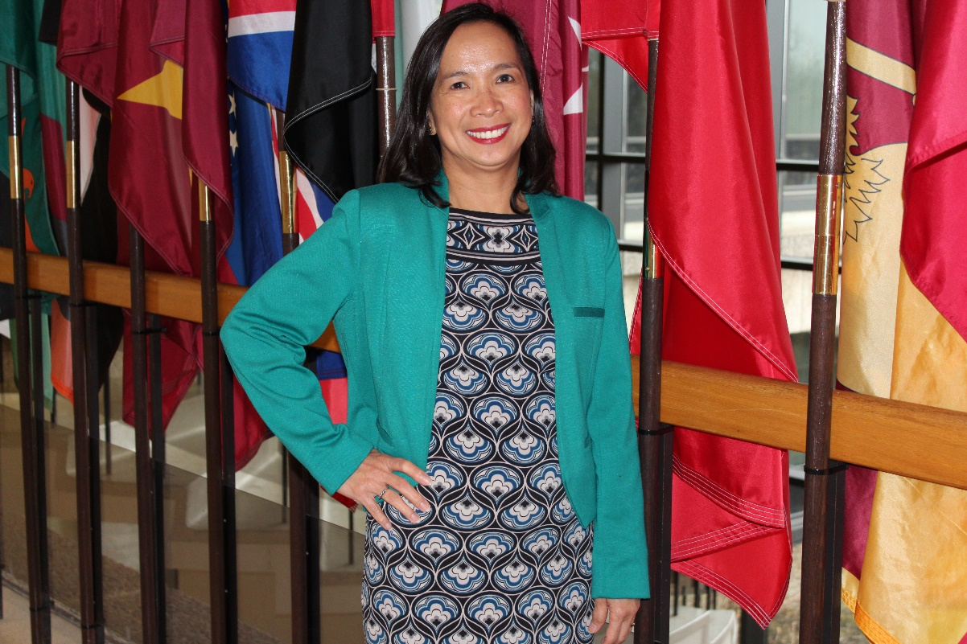
Dr. Zenia Agustin
20 Years of Service
Mathematics
&
Statistics

Slide 26
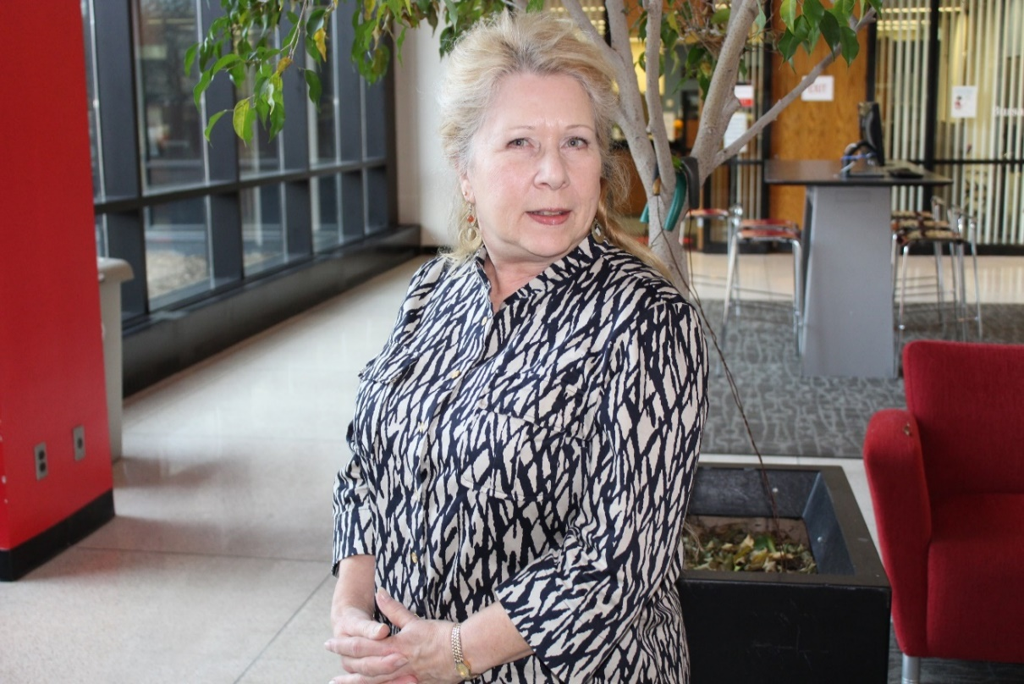
Dianne Albl
20 Years of Service
VC
Student Affairs
Psychology
Department

Slide 27
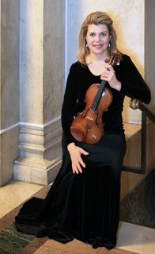
Dr. Lenora Marya Anop
20 Years of Service
Music

Slide 28
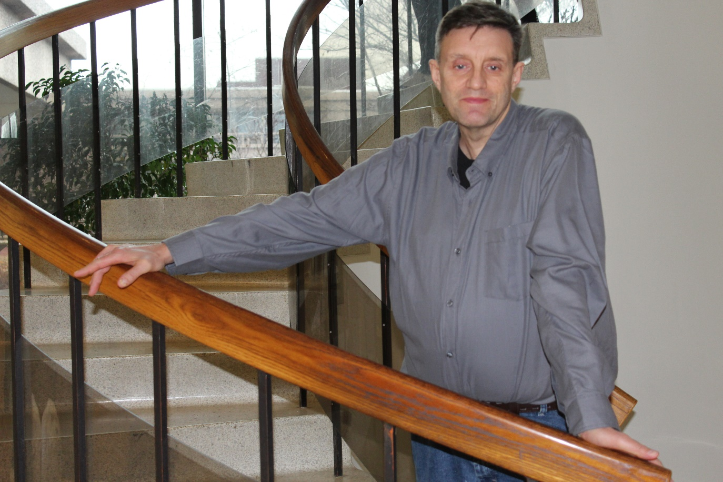
James Ballhurst
20 Years of Service
Facilities Management

Slide 29
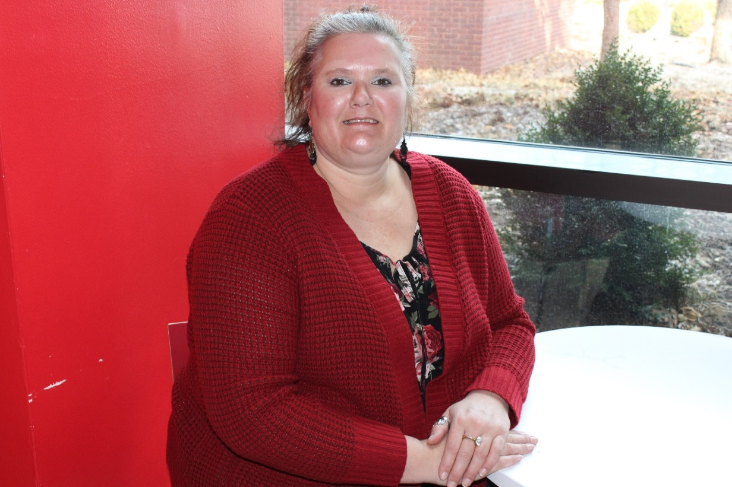
Kathleen Belden
20 Years of Service
Student Financial Aid

Slide 30
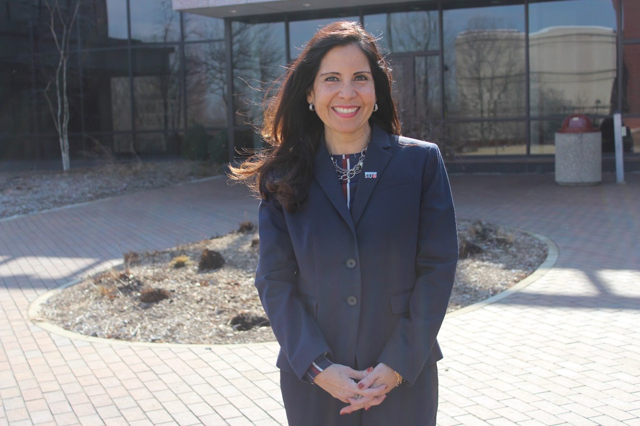
Silvia Torres Bowman
20 Years of Service
School of Business

Slide 31
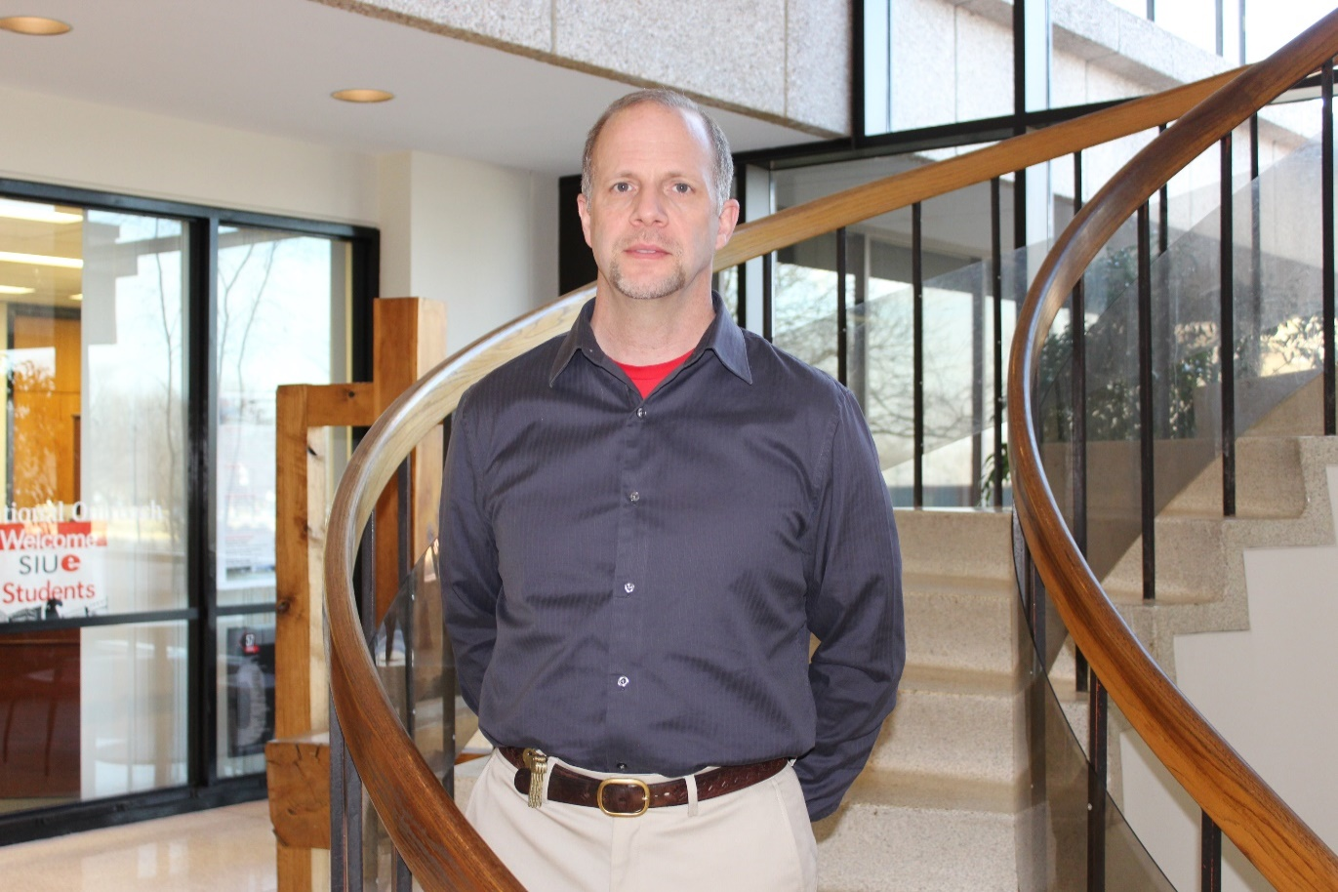
Dr. Paul Brunkow
20 Years of Service
Biological Sciences

Slide 32
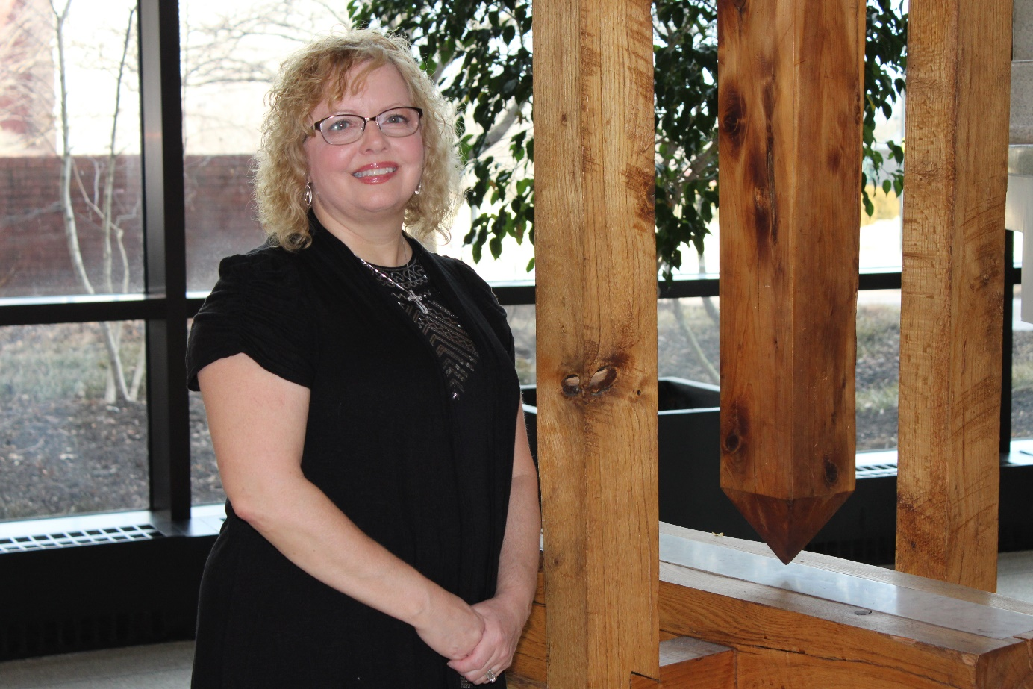
Traci Castevens
20 Years of Service
Information Technology Services

Slide 33
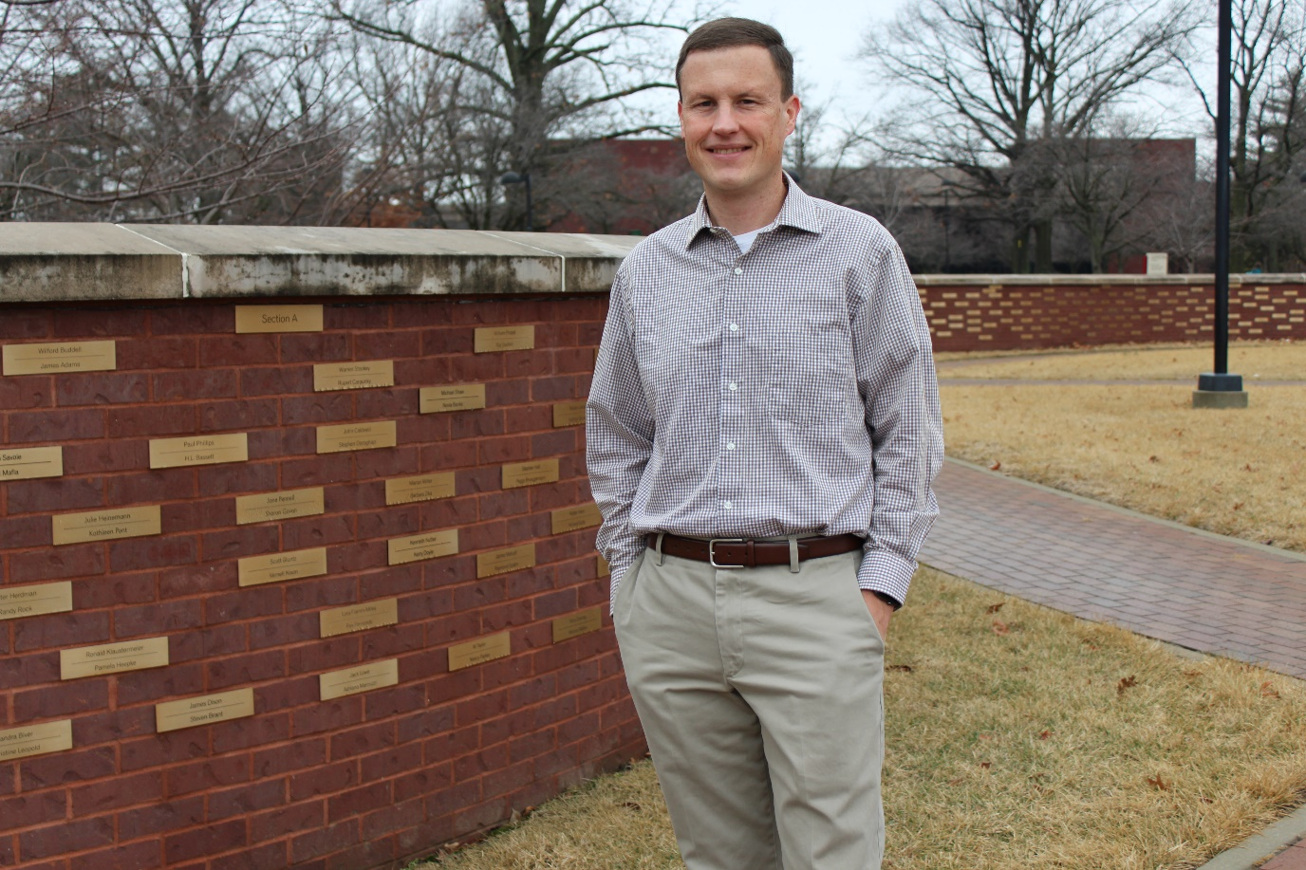
Daniel Chace
20 Years of Service
Information Technology Services

Slide 34
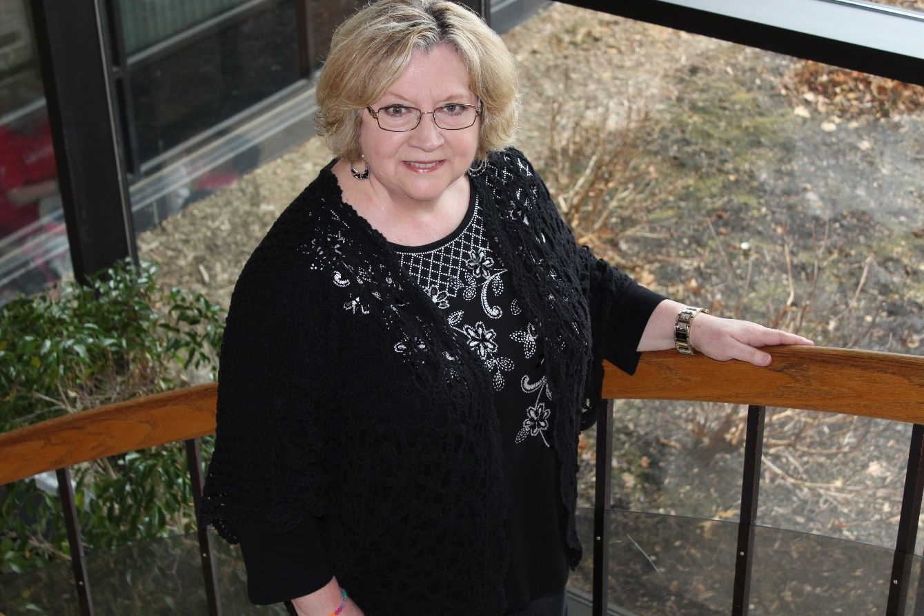
Gay Cummins
20 Years of Service
Computer Science

Slide 35
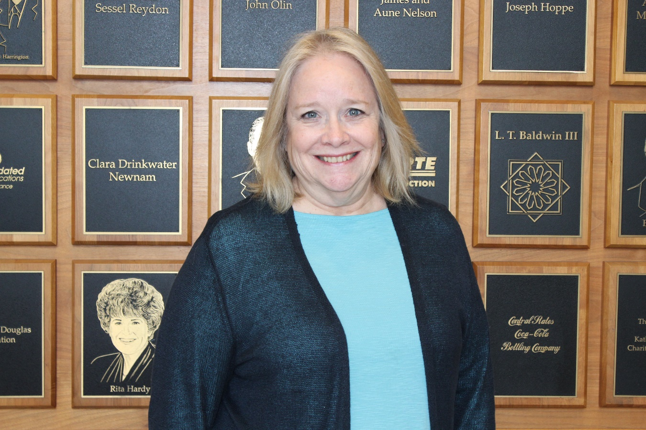
Dr. Christine Durbin
20 Years of Service
Primary Care Health Systems Nursing

Slide 36
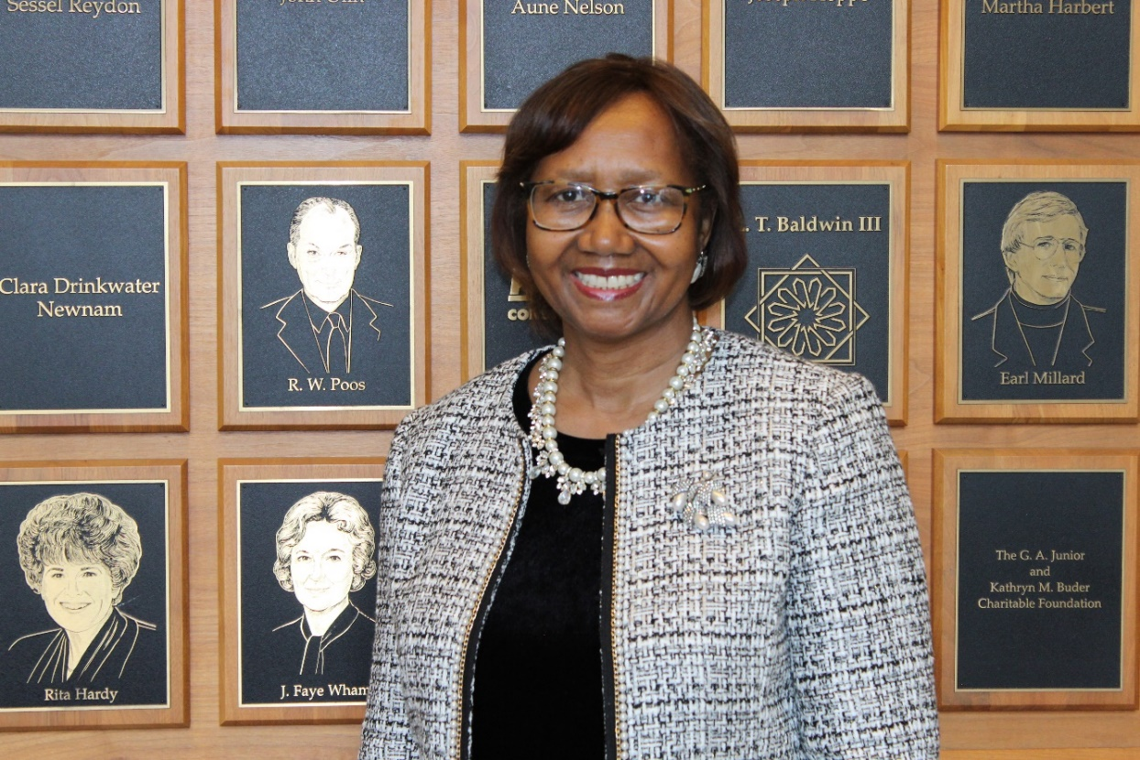
Renee Fussell
20 Years of Service
Applied Communication Studies

Slide 37
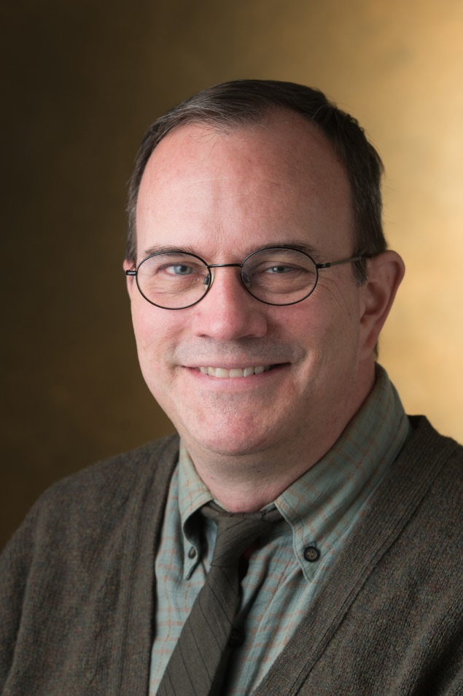
Dr. Joel Hardman
20 Years of Service
English Language & Literature

Slide 38
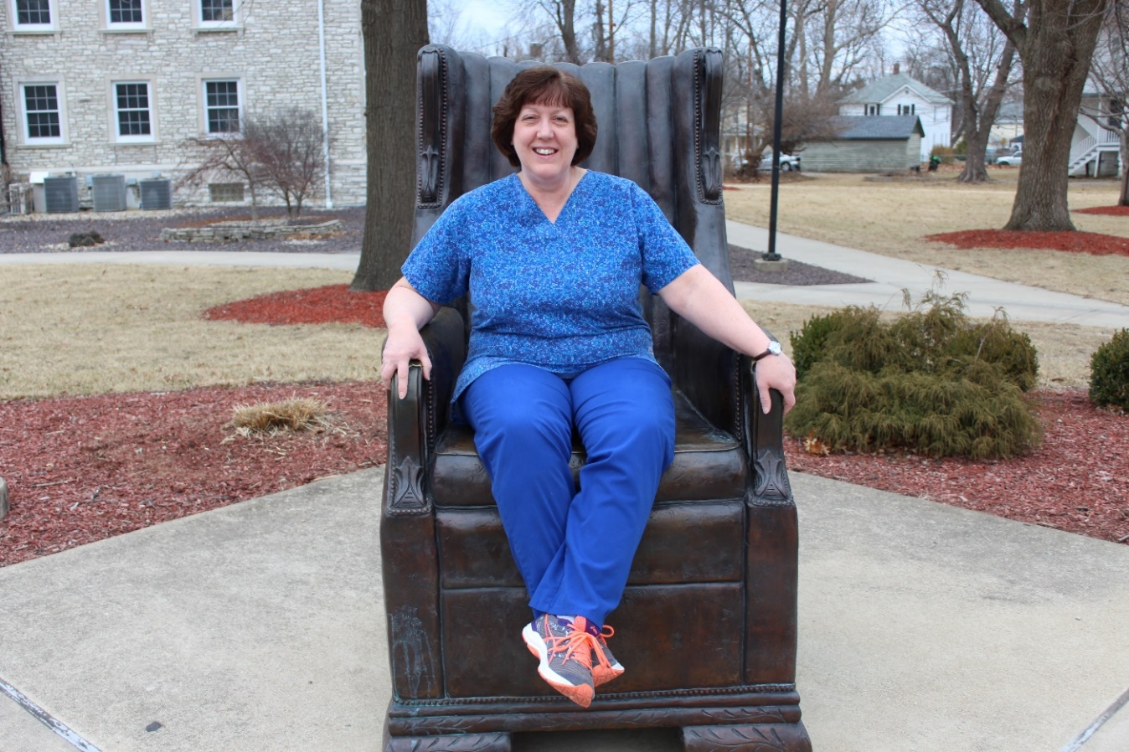
Nancy Inlow
20 Years of Service
School of Dental Medicine

Slide 39
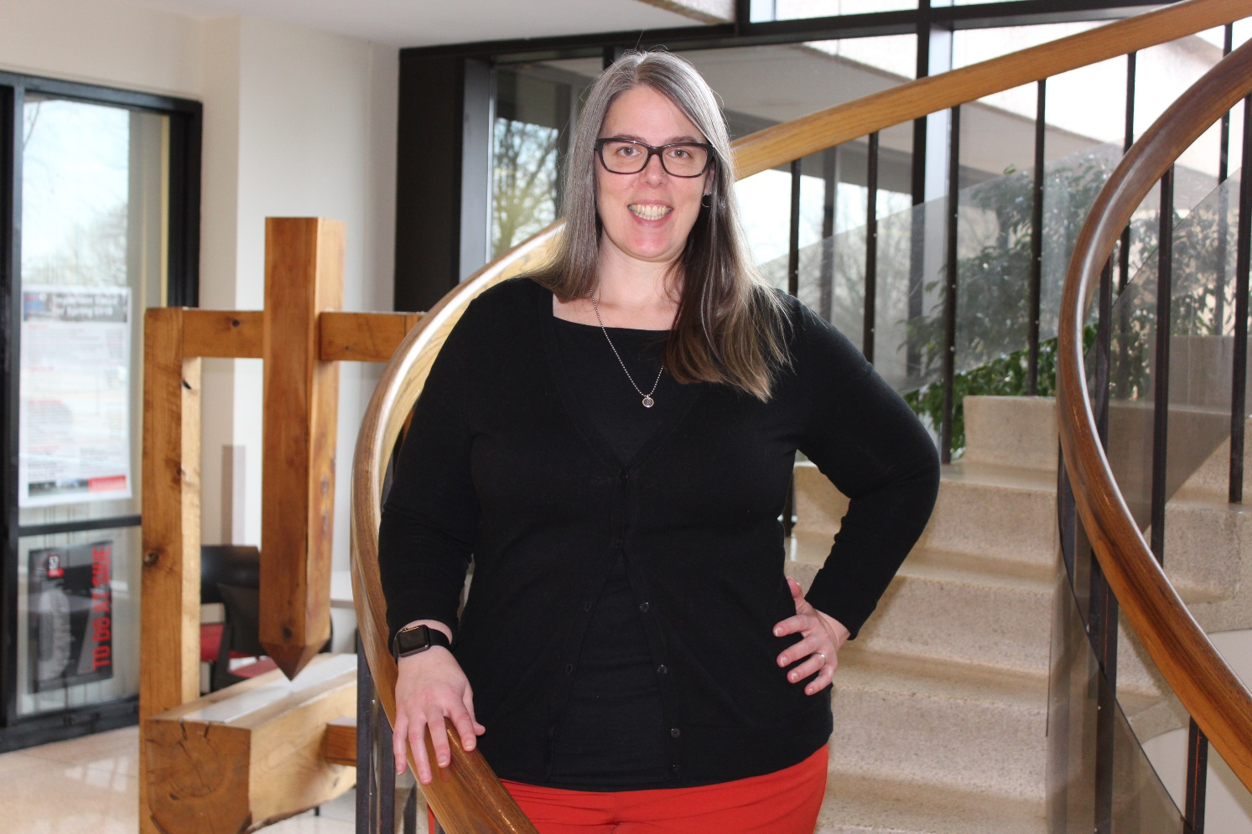
Chris Leopold
20 Years of Service
Registrar

Slide 40
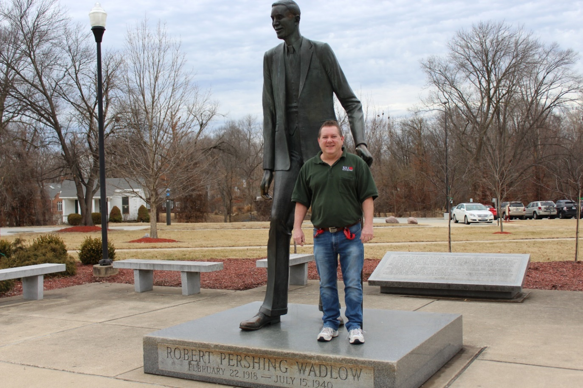
Jack Lowe
20 Years of Service
Facilities Management

Slide 41
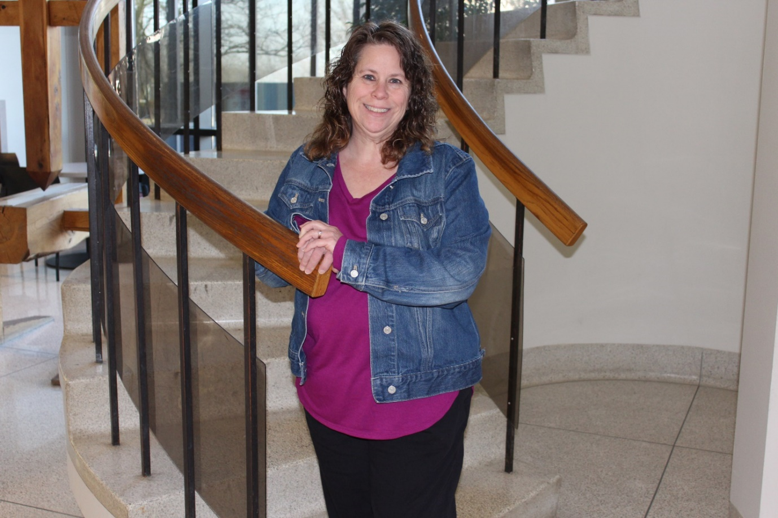
Trisha Markulakis
20 Years of Service
Morris University Center

Slide 42
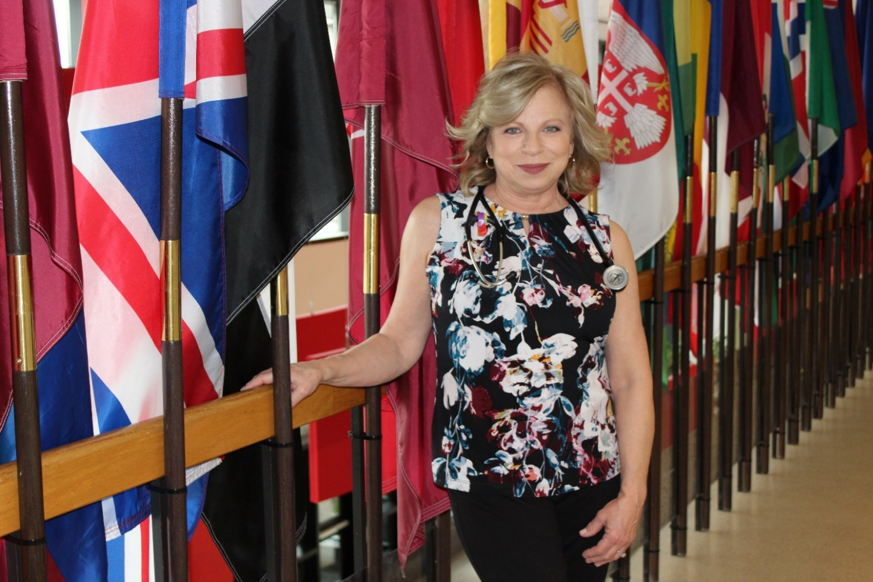
Margaret Montibeller
20 Years of Service
Health Services

Slide 43
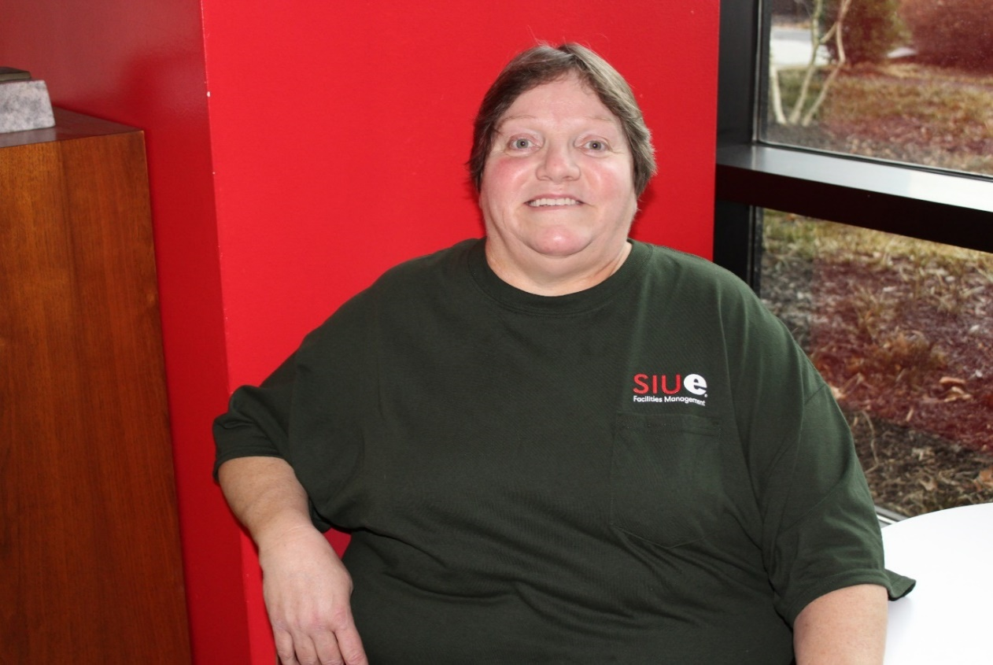
Georgia Ratliff
20 Years of Service
Facilities Management

Slide 44
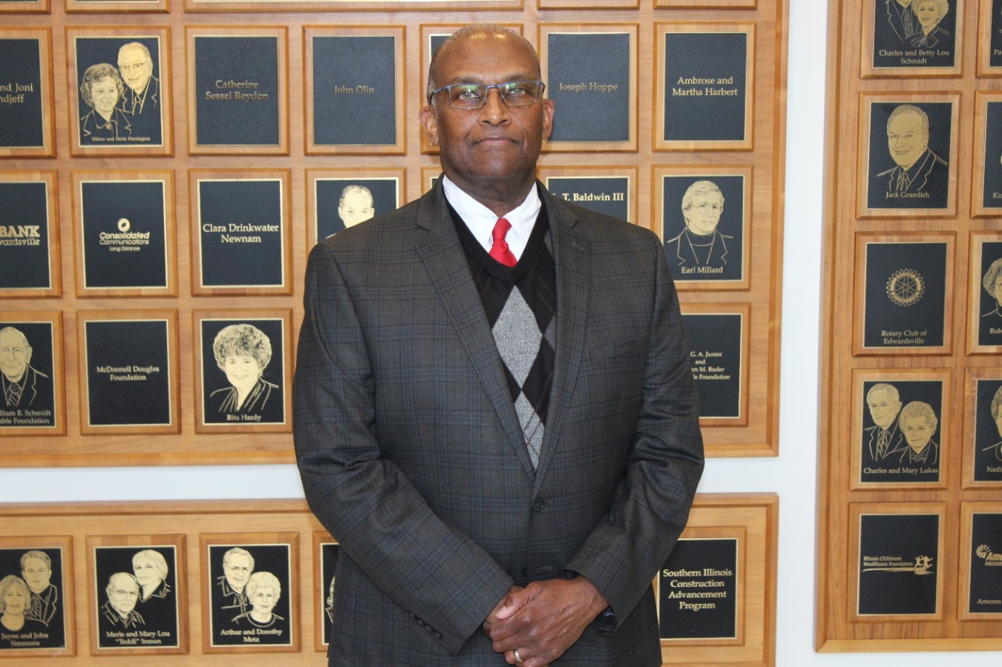
Dr. Morris Taylor
20 Years of Service
Public Administration & Policy Analysis

Slide 45
25 Year
Service Award
Honorees

Slide 46
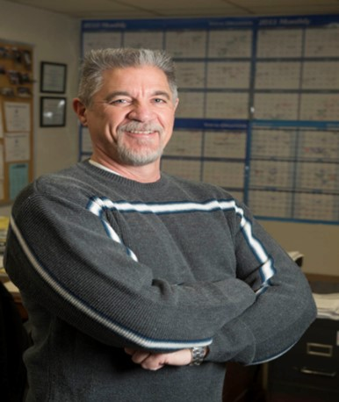
Kim Bateman
25 Years of Service
Environmental Research Training Center

Slide 47
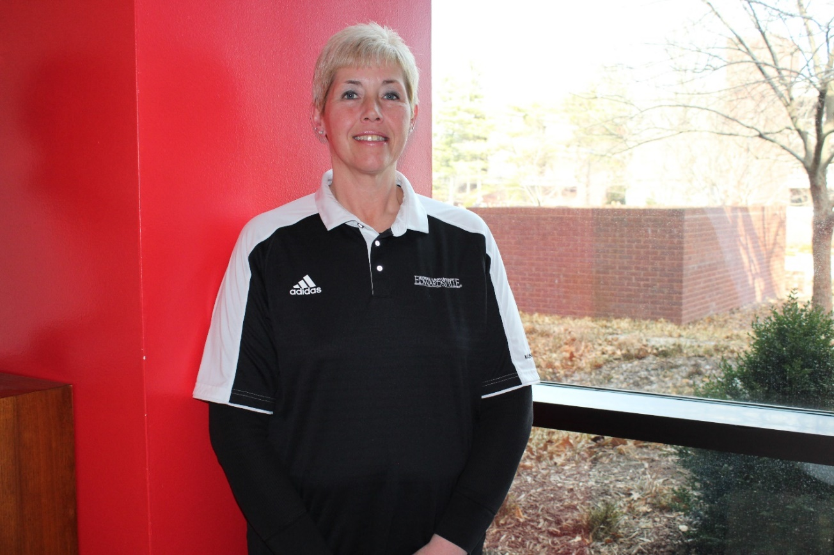
Kelly Lowder
25 Years of Service
Post Office

Slide 48
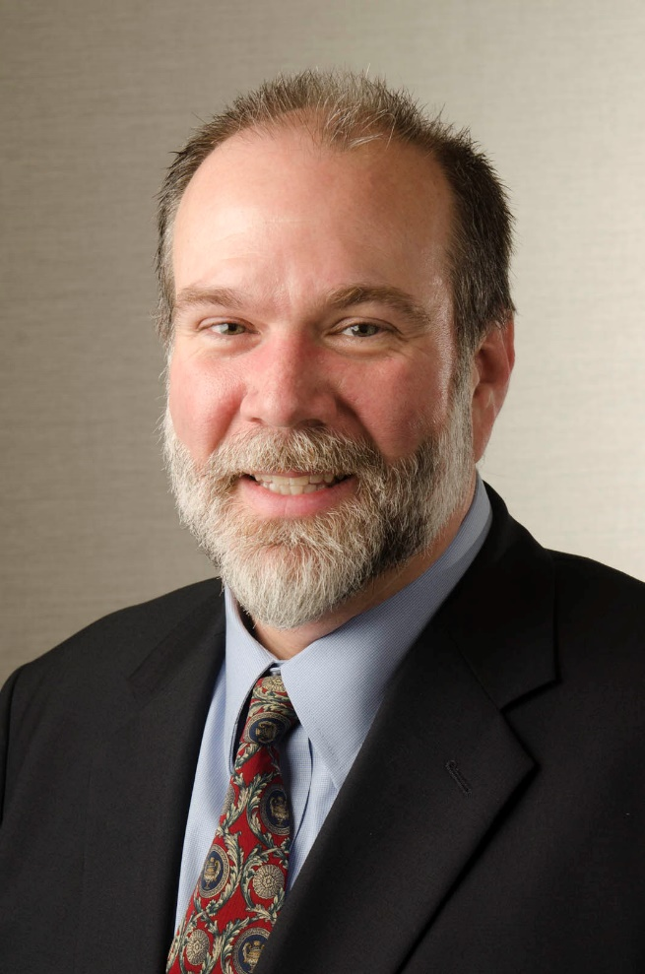
Norris Manning
25 Years of Service
School of Business

Slide 49
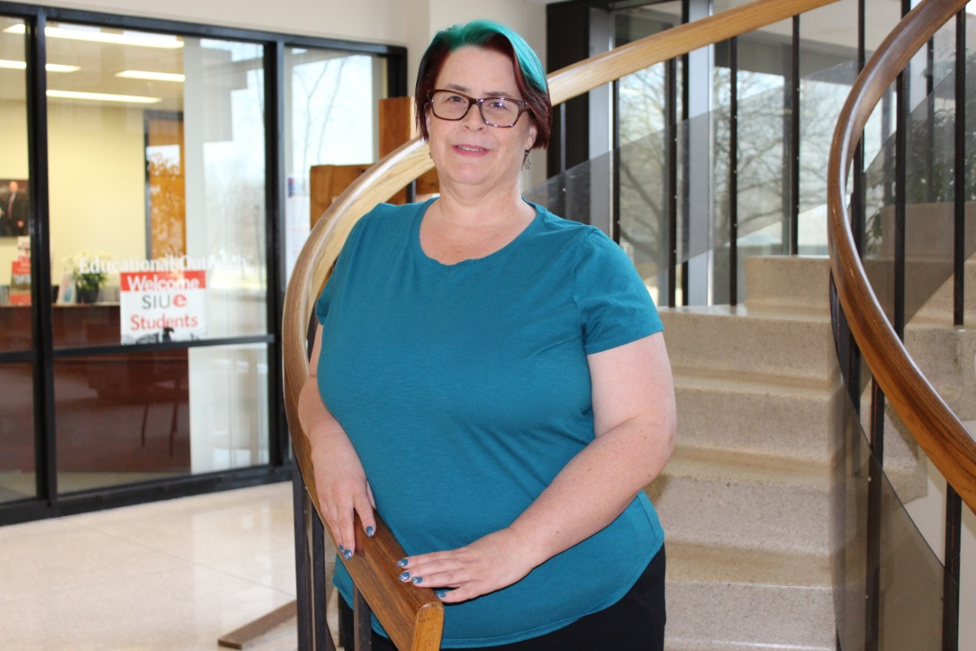
Dawn Olive
25 Years of Service
STEM Center

Slide 50
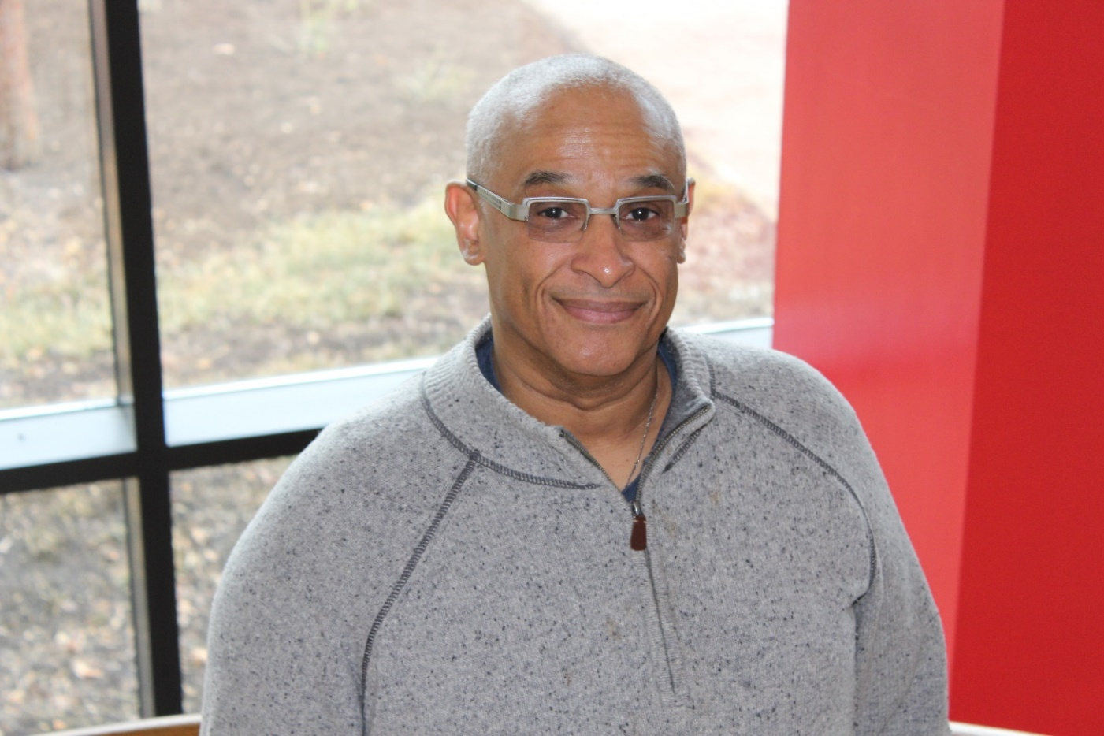
Prince Wells, III
25 Years of Service
Music

Slide 51
30 Year
Service Award
Honorees

Slide 52
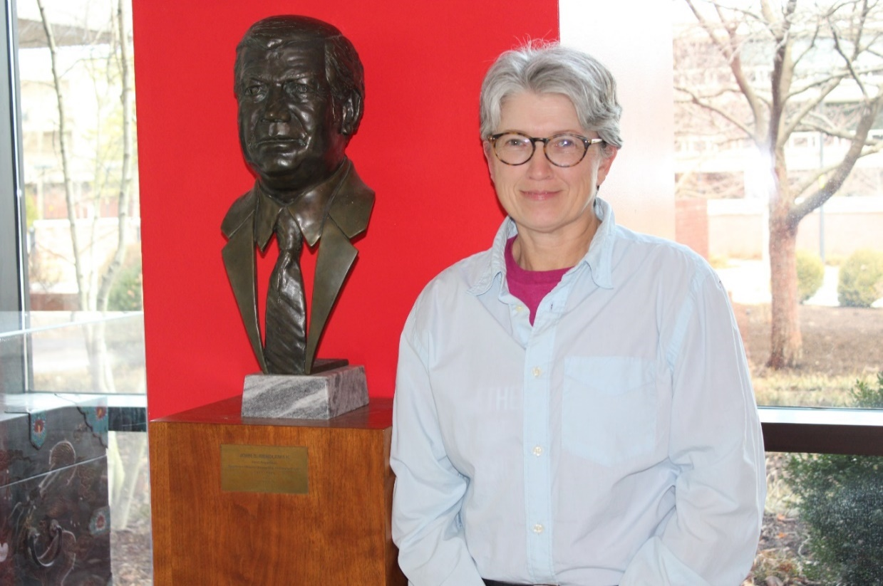
Debbie Dial
30 Years of Service
Information Technology Services

Slide 53
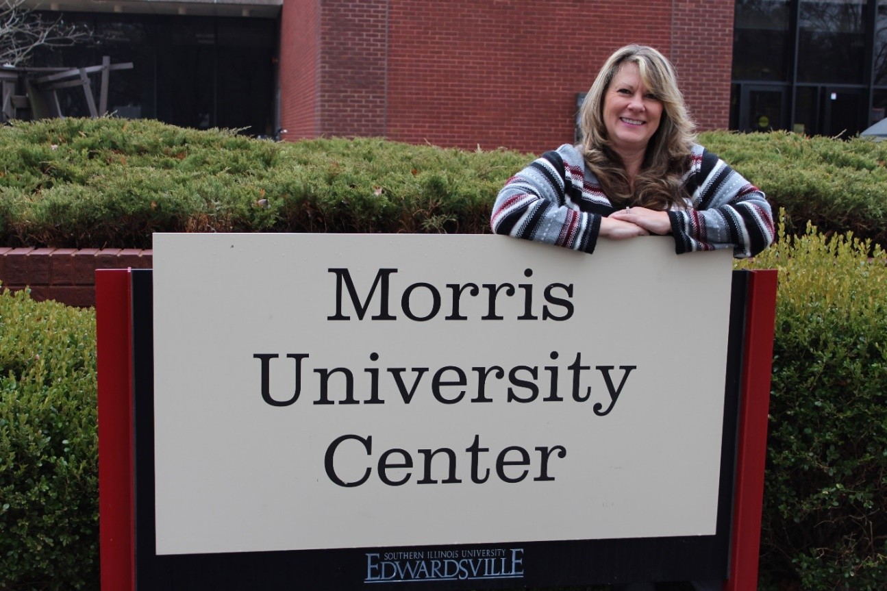
Karla Ellsworth
30 Years of Service
Morris University Center

Slide 54
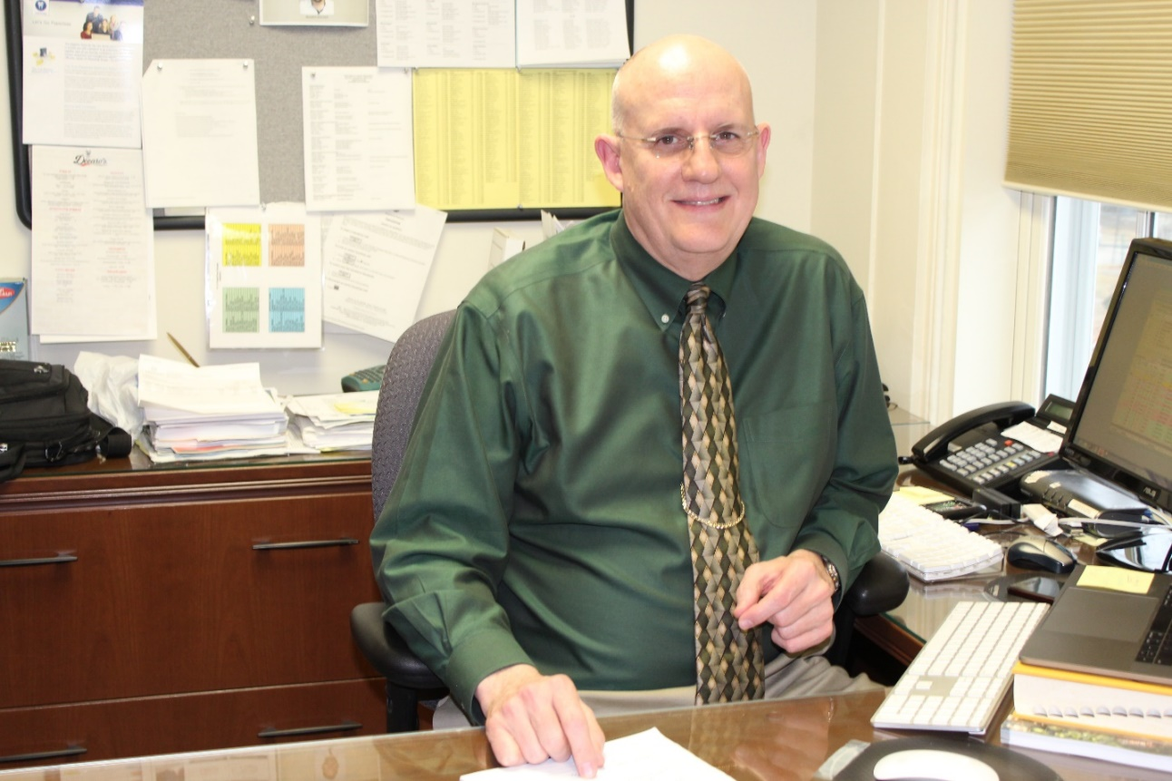
Dr. Eric Langenwalter
30 Years of Service
School of Dental Medicine

Slide 55
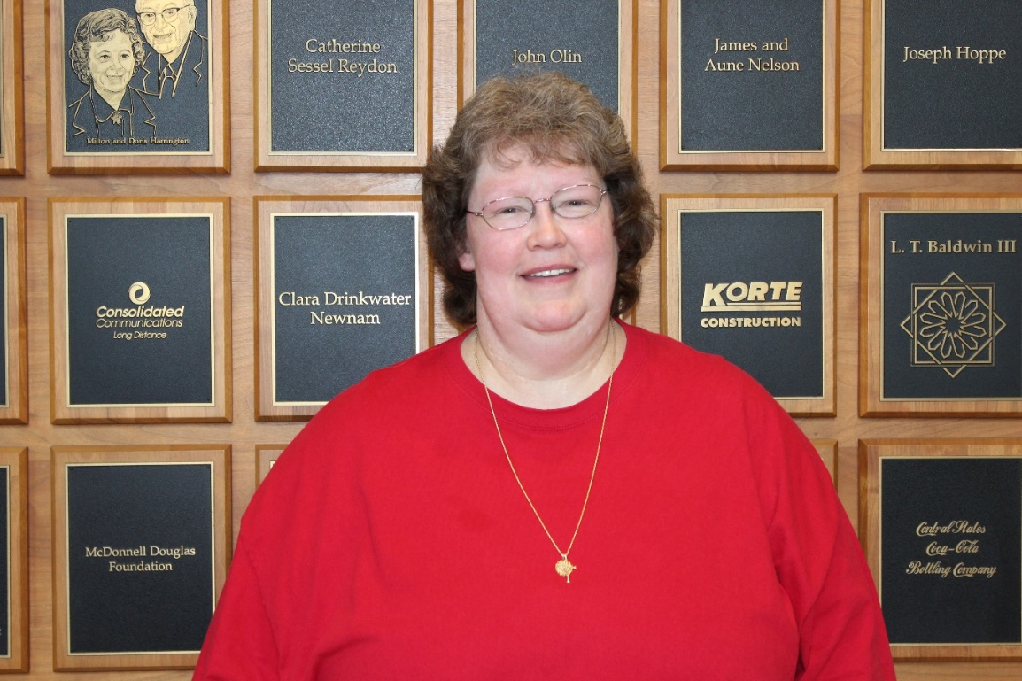
Anngie Mosby
30 Years of Service
Information Technology Services

Slide 56
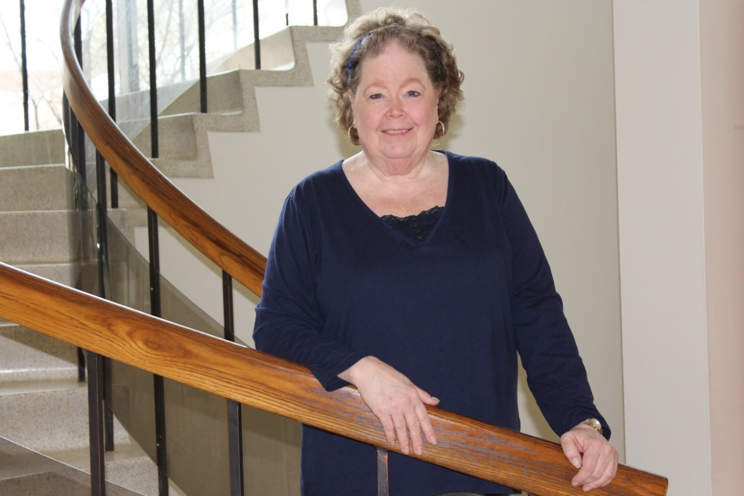
Lynda Pavia
30 Years of Service
Facilities Management

Slide 57
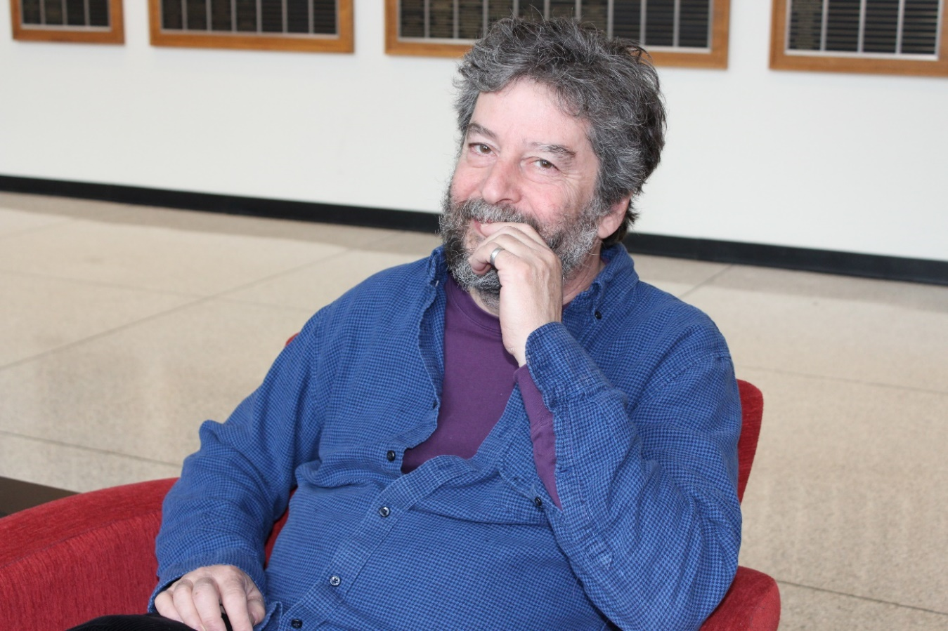
Dr. Jeffrey Skoblow
30 Years of Service
English Language & Literature

Slide 58
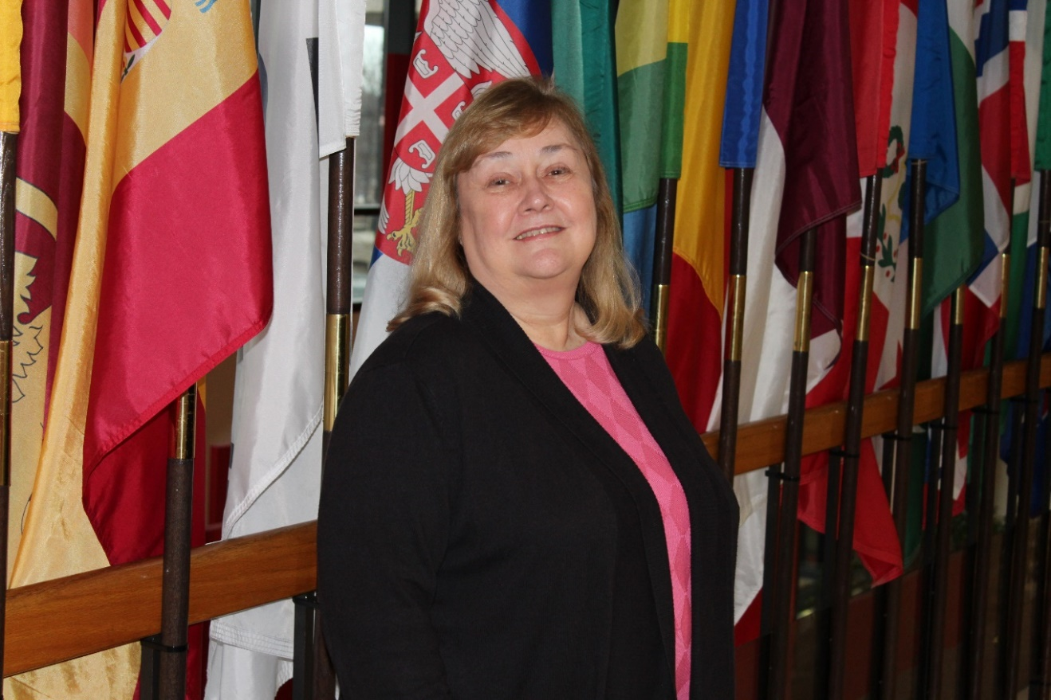
Roberta Stanford
30 Years of Service
Institutional Research & Studies

Slide 59
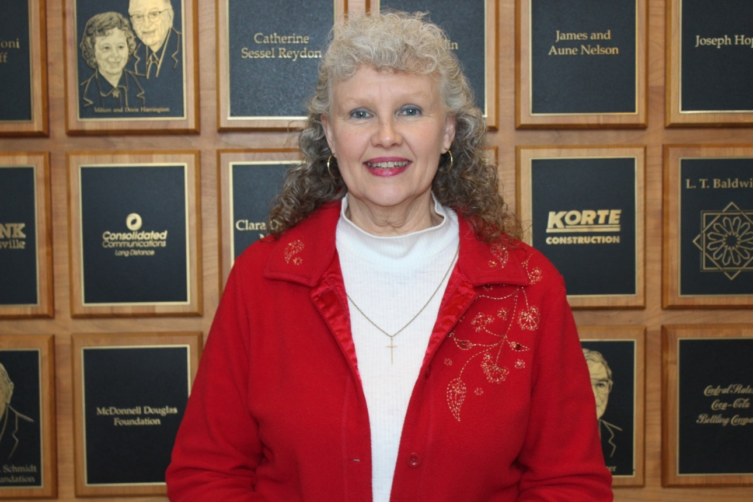
Theresa Wasylenko
30 Years of Service
School of Engineering

Slide 60
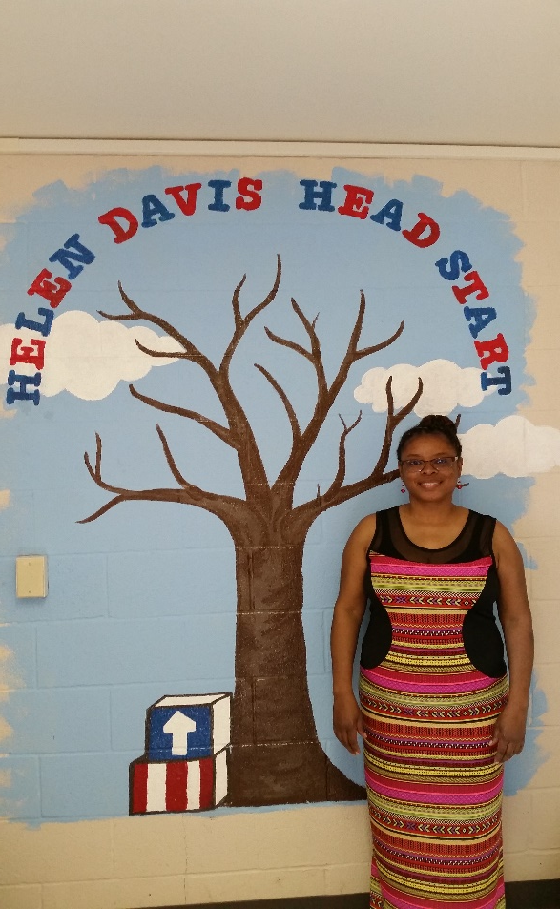
Jacqueline Young
30 Years of Service
Head Start

Slide 61
Congratulations to all
Honorees!

