Slide 1
How to Increase Student Engagement with
Unusual Methods, Strange Ideas, and Pseudoscience
Stephen Hupp
Professor, Southern Illinois University Edwardsville
Editor, Skeptical Inquirer: The Magazine for Science and Reason

Slide 2
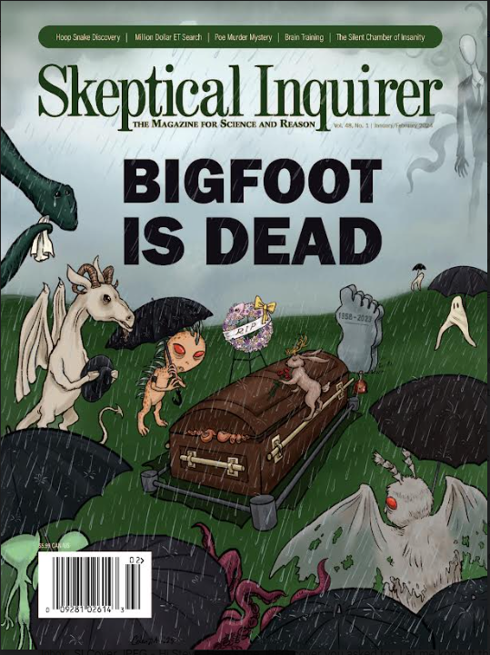
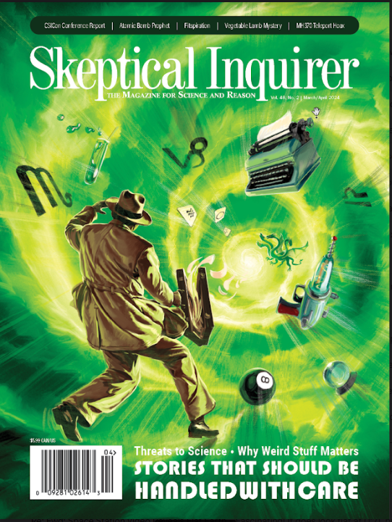

Slide 3
WRONG ANSWERS ONLY!
What’s A GREAT way
to encourage
student participation?

Slide 4

Clue

Slide 5
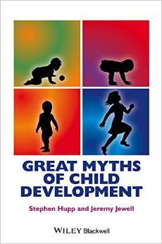
“Science must begin with myths and the criticism of myths.”
~ Sir Karl Popper (1957)

Slide 6
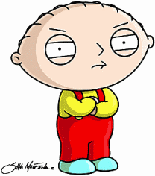

The Truth or Myth Game
Please stand (you can also play from the seated position)
Decide if statements are “truths” or “myths.
If you get one wrong, please sit down.
Winner is the person standing at the end (tie-breaker may be used)
Fabulous prize!

Slide 7
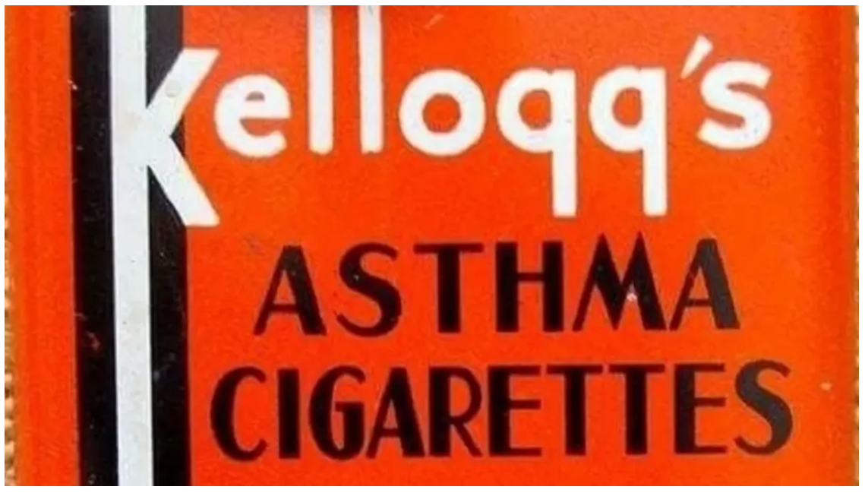
“Cigarettes were once used to treat asthma.”

Slide 8
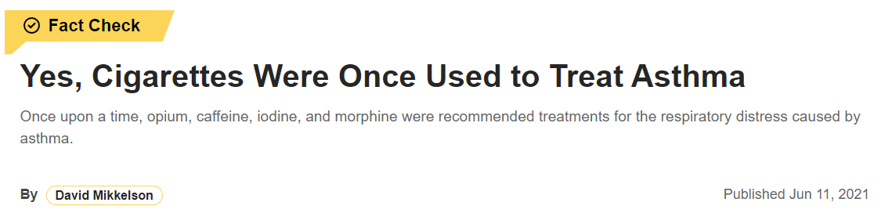
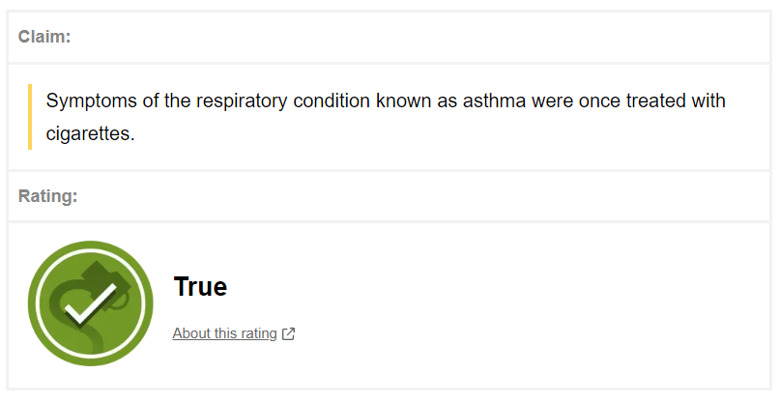

TRUTH

Slide 9
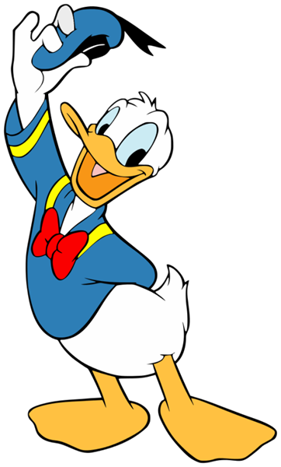
“Donald Duck comics were once banned in Finland because he wears no pants.”
CENSORED

Slide 10

“Donald Duck comics were once banned in Finland because he wears no pants.”
MYTH

Slide 11
Tie Breaker
(Closest without going over)
How many episodes were made of Bill Nye the Science Guy?*
100
(Not including the pilot episode)
*According to Wikipedia
Notes:
100

Slide 12
OVER or
UNDER
What year was
Martin Luther King Jr. born?
1939
?

Slide 13
OVER or
UNDER
What year was
Martin Luther King Jr. born?
1939
?
1929

Slide 14
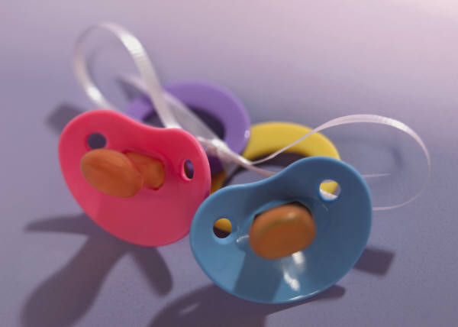
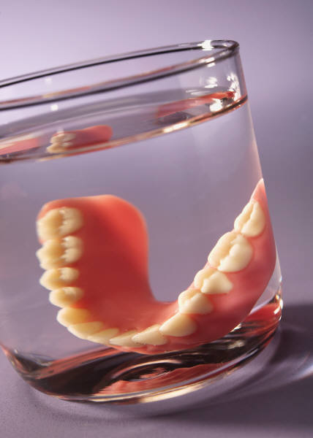
World Records ?
“Oldest Mother to Conceive Naturally” (and give birth)
  59 years-old (1997: accident)
“Oldest Woman to Give Birth” (In vitro fertilization)
  66 years-old (2006)
“Oldest Father”
  92 years-old (9th child)

Slide 15
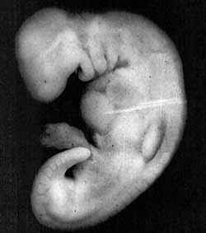
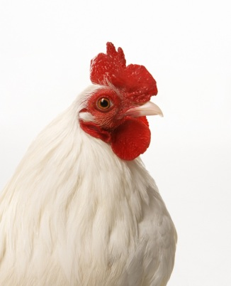

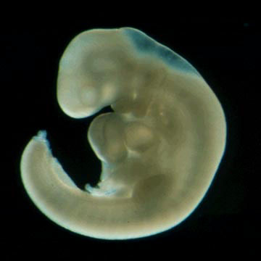
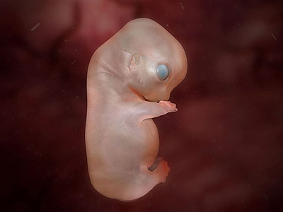
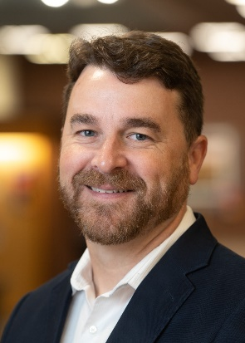
Matching Game
(Draw Lines)

Slide 16


Matching Game
(Draw Lines)
19,000 genes
24,000 genes
32,000 genes

Slide 17

SKEPTICROSS
ACROSS
What stories should be handled with
A good type of mind
What Hucksters do to you by your nose
On Medusa's head, perhaps
DOWN
Product that started as snake oil
If real, Bigfoot's family, with great
What Death does with a scythe
Justifies the means for a huckster

Slide 18
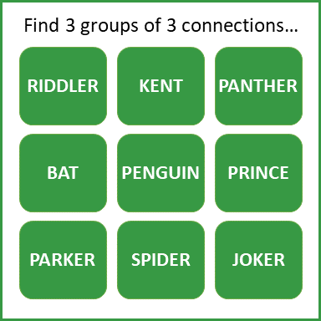
CONNECTIVITY

Slide 19

ONE

Slide 20

Where is the green light on a stop light?
TOP
BOTTOM

Slide 21
Which way is Lincoln’s head facing on a penny?
LEFT
RIGHT

Slide 22
In which hand is the statue of liberty holding up the torch?

Slide 23
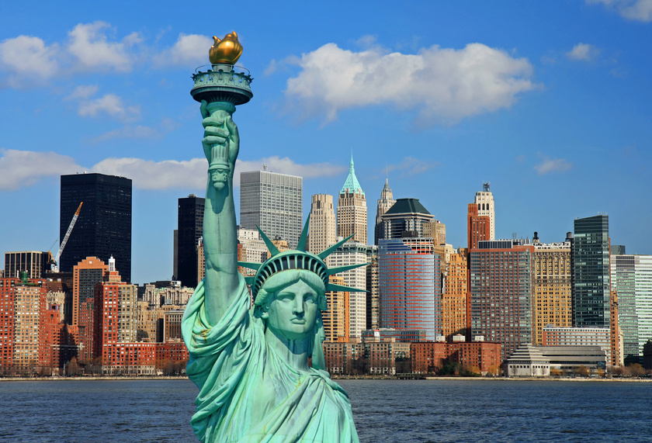

Slide 24
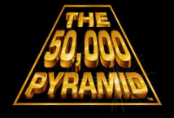
It’s time to play!
CENT
(1 Volunteer and the class yells out examples)

Slide 25
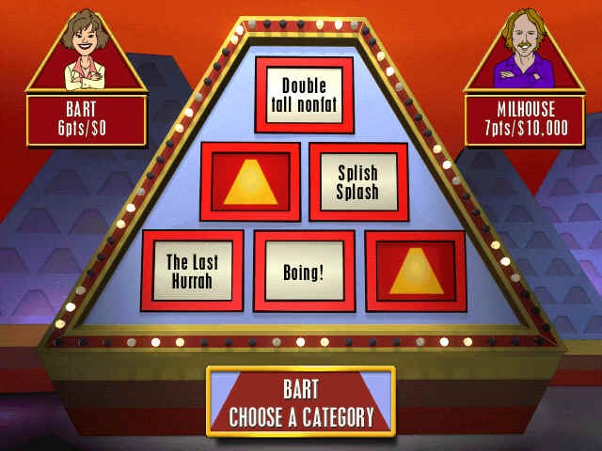
WORDS
STARTING
WITH “E”
SMELL
ARE
BAD
HAIRY
SIT
EAT
READ
ON

Slide 26

Who Wants to Be a Dollaraire?
Linguistic
Logico-mathematical
Spatial
Musical
Bodily-kinesthetic
Interpersonal
Intrapersonal
Naturalistic
Existential

Slide 27
Who Wants to Be a Dollaraire?
Linguistic 1 cent
Logico-mathematical 5 cents
Spatial 7 cents
Musical 10 cents
Bodily-kinesthetic 20 cents
Interpersonal 30 cents
Intrapersonal 40 cents
Naturalistic 50 cents
Existential $1.00

Slide 28
Linguistic
Which of these words is usually considered poor
grammar?
A. Don’t
B. Won’t
C. Can’t
D. Ain’t

Slide 29
Existential
What is the book’s definition of Existential?
A. considering “Paradoxical” issues
B. considering “Zeitgeit” issues
C. considering “Ultimate” issues
D. considering “Fulfillment” Issues

Slide 30



Slide 31
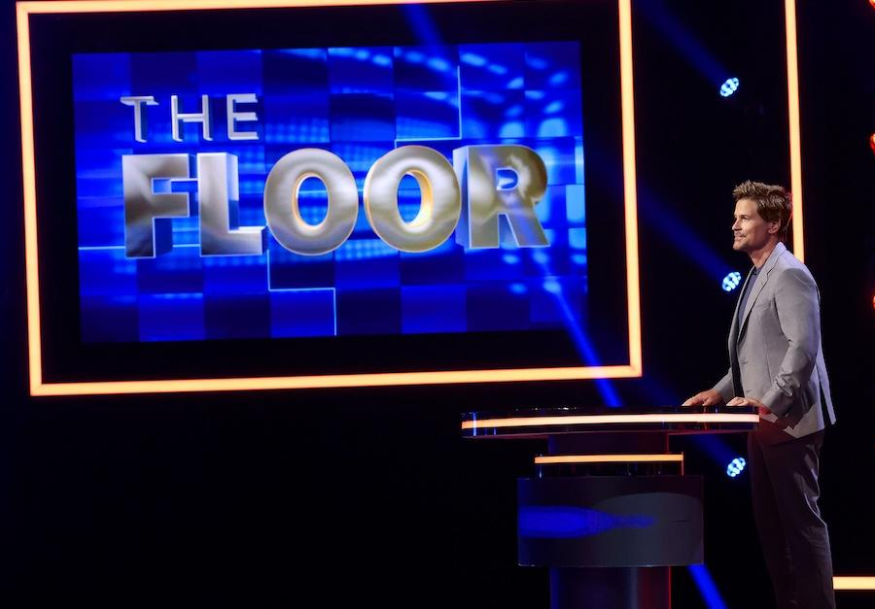

Slide 32

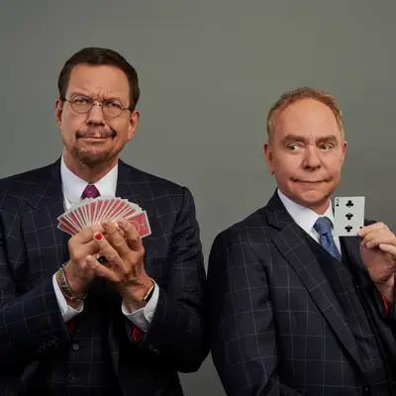
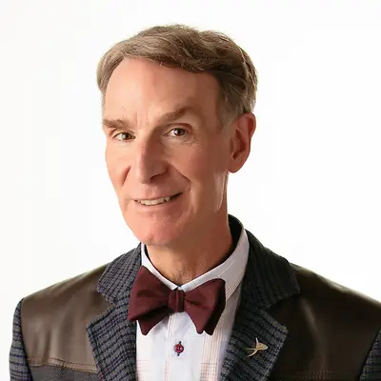

Committee for Skeptical Inquiry

Slide 33
Websites
Skeptical Inquirer. Website for the Committee for Skeptical Inquiry.
Snopes. Investigates shocking claims that have gone viral on the internet.
Science-Based Medicine. Scrutinizes dubious claims related to health.

Slide 34

skepticalinquirer.org

Slide 35
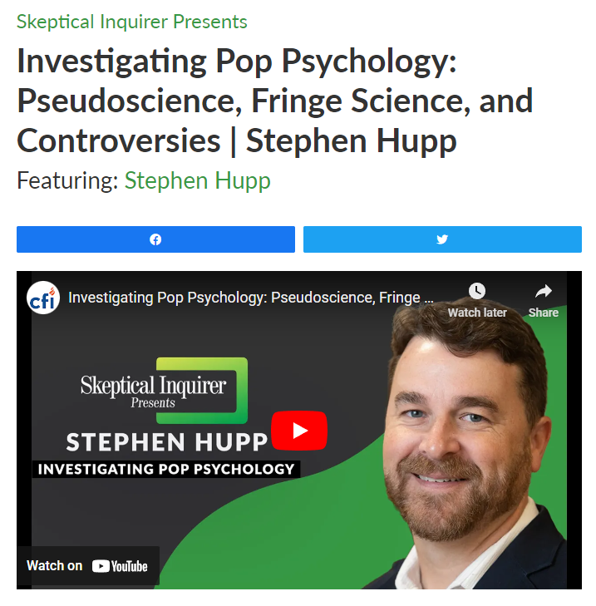

Slide 36
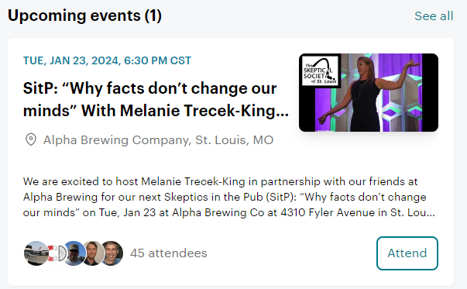

Slide 37
Questions?
Comments?
Games you are playing?
New ideas for the future?
Other activities?
Other ways to promote engagement?
Ways to teaching critical thinking?

