Slide 1
Setting Expectations for AI Usage with Your Students
Jessica DeSpain
Nicole Klein
Meg Smith

Slide 2
Defining AI
1
What is AI? What kinds of tools might be included in the definition?

Slide 3
What is AI?
“The science and engineering of making intelligent machines”
John McCarthy (1955)

Slide 4
What is AI?
The ability of machines to…
Identify patterns
Perform tasks
Make predictions

Slide 5
What is AI Not?
AI struggles to…
Invent content from scratch
Perceive, process, or feel emotions
Hold ideas in tension
Make complex, evidence-based arguments
Humanize data and sources

Slide 6
What Can AI Do?
Aid comprehension
Youtube Summary
Speechify
Otter.ai
Support research
ResearchRabbit
Semantic Scholar
Give feedback
PowerPoint Speaker Coach
Grammarly
Suggest design choices
Canva Magic
Adobe Sensei/Firefly
Slidesai.io
Generate content
ChatGPT
GitHub Copilot
Dall-E
Bard

Slide 7
Disciplinary Differences
Sample syllabus statements

Slide 8
Discussion
What have you been experiencing in the classroom with AI usage among students?

Slide 9
Aligning AI Usage with Course Objectives
2
Emphasizing process over product, authorial accountability, and assessment

Slide 10
When to Talk about AI
With the Syllabus
Be transparent with student about when, how, and why you permit or do not permit AI usage in your syllabus
With Assignments
Tell students what tools might be useful for their purpose; model its usage; show them what it gets wrong and what it gets right
With Assessments
You cannot detect AI, but you can often see its results; talk with students about their usage of AI and how it can help or harm their learning process

Slide 11
Define AI for Students
Students may not know what tools count as AI
Be clear about which tools you welcome them to use for which purposes
Talk through the “why” of your policy and how it relates to course objectives
Have students write their own AI statements (see Cate Denial’s post: ChatGPT and All that Follows)

Slide 12
AI usage is ITERATIVE
Asking Good Questions
Refining Inputs
Revising the Product

Slide 13
AI Can Come with Ethical Pitfalls
Content generated by AI is an amalgam of other sources, which the tool may or may not cite
When AI does provide citations they can be fake or “hallucinations”
Sometimes the data used to generate AI content is outdated
The data used to generate AI may have embedded biases

Slide 14
Students should Cite and Describe AI Usage
Most citation systems have recommendations for citing AI-generated content; they may include the prompt; student should prepare to document their process
Students should describe their usage of AI in an acknowledgement statement or methods section
Liza Long’s Acknowledging and Citing Generative AI in Academic Work is a helpful resource

Slide 15
Spectrums of AI Policy Statements
3
Prohibiting, allowed, or required, and under what circumstances?

Slide 16
AI Statement in SIUE Syllabus Template
“Unless expressly allowed by the instructor, the use of artificial intelligence (AI) tools and applications (including ChatGPT, DALL-E, and others) to produce content for course assignments and assessments is a violation of SIUE’s academic policy and is prohibited.”
From https://www.siue.edu/its/idlt/toolkit.shtml

Slide 17
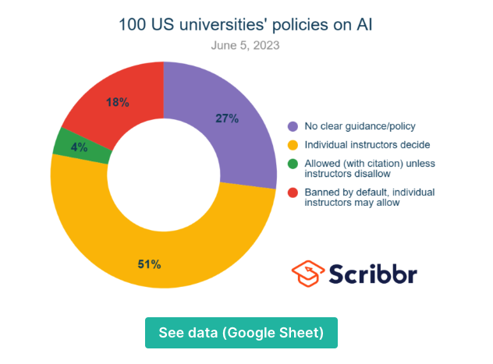
https://rb.gy/diukv

Slide 18
Discussion
What AI usage do you permit/encourage/limit in your classes?

Slide 19
Spectrum of AI Policy Statements
Prohibiting
Mediating
Encouraging
Prohibiting
Mediating
See representative samples from Temple University’s Center for the Advancement of Teaching.
Encouraging

Slide 20
Steps Prior to Developing an
AI Policy for Your Courses
Discuss teaching approaches and unit-wide policies or practices with colleagues, department and unit leaders.
Learn about the implications of AI tools for teaching and learning.
Try out ChatGPT, Bard, or other free tools.

Slide 21
Resources for Writing Your AI Policy
Curated AI resources on the Center for Faculty Development and Innovation website
List of AI policy statements curated by Lance Eaton, College Unbound.
AI Forecasting Challenge created by Nicholas Carlini

Slide 22
Let’s create
Try out the AI Syllabus Statement Tool from Pepperdine University

Slide 23
THANKS!
Any questions?
You can find us at
iriscenter@siue.edu or facultycenter@siue.edu

